Slide 2
Types of Questions you Will Be Asked
Rhetorical
Participatory

Slide 3
Disclosure of Relevant Financial Relationships
In accordance with the ACCME Standards for Commercial Support, The France Foundation (TFF) requires that individuals in a position to control the content of an educational activity disclose all relevant financial relationships with any commercial interest. TFF resolves all conflicts of interest to ensure independence, objectivity, balance, and scientific rigor in all its educational programs. Furthermore, TFF seeks to verify that all scientific research referred to, reported, or used in a CME/CE activity conforms to the generally accepted standards of experimental design, data collection, and analysis. TFF is committed to providing learners with high-quality CME/CE activities that promote improvements in health care and not those of a commercial interest.

Slide 4
Faculty Disclosures
Amy Olson, MD has served on the advisory board for Genentech. She has also served on the Speakers’ Bureau for Boehringer Ingelheim Pharmaceuticals, Inc.
Activity Staff Disclosures
The planners, reviewers, editors, staff, or other members at The France Foundation who control content have no relevant financial relationships to disclose.
Educational Support
Supported by educational grants from
Boehringer Ingelheim Pharmaceuticals Inc., and Genentech, Inc.

Slide 5
Accreditation/Designation Statements
The France Foundation is accredited by the Accreditation Council for Continuing Medical Education (ACCME) to provide continuing medical education for physicians.
The France Foundation designates this live activity for a maximum of 1.0 AMA PRA Category 1 Credit™. Physicians should claim only the credit commensurate with the extent of their participation in the activity.

Slide 6
Learning Objectives
01
Identify clues in the history and physical that suggest uncommon conditions
Select appropriate primary care testing that can help confirm frequently overlooked diagnoses
02
Refer patients for specialty evaluation/ management in a timely and appropriate manner
03

Slide 7
Case Study: Eric

Slide 8
Clinical Case: Eric
32 yo white patient with h/o asthma
Presented to local ED with increased SOB, treated for asthma and sent home
Syncopal episode at home and taken back to ED
Admitted to hospital
No family history of PH, no drug abuse, non-smoker
Meds: Fluticasone/salmeterol and albuterol inhalers
What is your differential for this patient?
What additional information would you seek?

Slide 9
Dyspnea Differential
COPD
Heart Disease
Pulmonary HTN
Obesity
ILD
Asthma
Dyspnea

Slide 10
How would these types of dyspnea alter your differential?
Cardiac, COPD, ILD, PH
Exertional →
Positional →
Episodic →
Nocturnal →
Orthopnea, platypnea
Asthma
CHF, asthma

Slide 11
How would these heart findings alter your differential?
Cardiac
S3, S4, murmurs →
RV heave, loud P2, JVD →
Lung

Slide 12
How would these physical findings alter your differential?
Heart failure, ILD
Crackles →
Wheezing or rhonchi →
Digital clubbing →
Pedal edema →
Pallor →
What would be the next step in diagnosis?
COPD, asthma
ILD
PH
Anemia

Slide 13
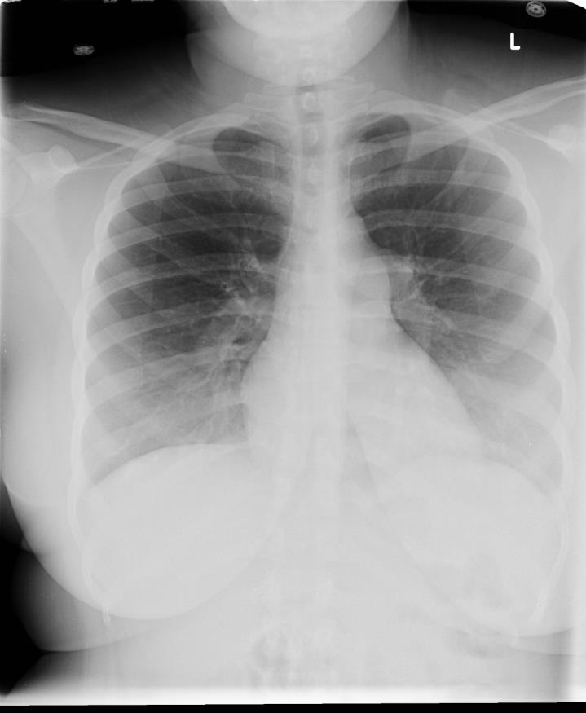
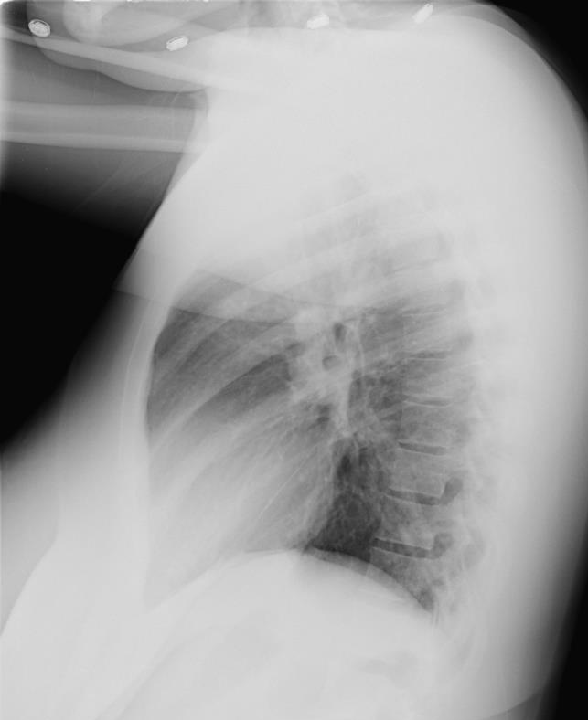
The CXR reveals………..
Enlarged pulmonary artery segment
Enlarged right ventricle filling retrosternal space

Slide 14
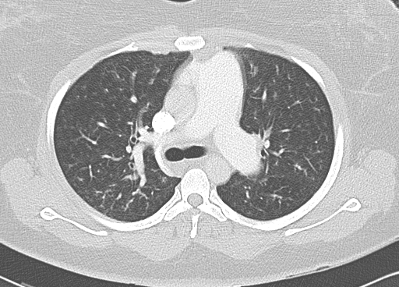
HRCT confirms an enlarged pulmonary artery:
What are the implications for your diagnosis?

Slide 15
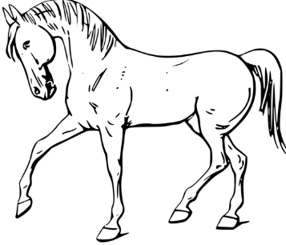
Let’s take stock of Eric’s diagnosis…
What findings rule out the common causes of dyspnea?
COPD
Asthma
Heart disease
What are the next steps to diagnose Eric?

Slide 16
What do Eric’s findings tell you?
CT angiogram negative
Lung parenchyma normal
PFTs
FVC 72%, FEV₁ 70% c/w mild restriction, DL_{CO} 45%
V/Q - low probability
6MWT: 165 meters with no significant desaturation
Serologies
CTD negative
HIV negative
Notes:
the CT almost certainly rules out ILD, but should be HRCT to really rule it out.

Slide 17
What can an echocardiogram add?
Cardiac chamber morphology
Left ventricular systolic/diastolic function
Exclusion of congenital heart disease
Intracardiac (or pulmonary) shunts
Valvular function
RV function
Estimation of PA pressure
McLaughlin VV, et al. J Am Coll Cardiol. 2009;53:1573-1619.

Slide 18
What is the most common cause of PH?
PAH → 2%
CETPH → 1%
Left heart disease → 79%
Right ventricular dysfunction → 2%
PAH
CETPH
Left heart disease
Right ventricular dysfunction

Slide 19
What do you see?

Slide 20
Eric’s Echocardiogram Results
RVSP ~120 mm Hg
Severely dilated RV with hypokinesis
What is your diagnosis?
PH
PAH
Congenital heart disease
Insufficient data to diagnose
What additional tests would you do?

Slide 21
How would cardiac catheterization assist?
…confirm diagnosis
Echo is not adequately accurate, even with very high estimates of PASP
…exclude congenital heart disease
…assess contribution of left heart (PAOP)
…establish severity and prognosis
…establish presence/absence of vasodilator response
Catheterization is required for every patient with
suspected pulmonary hypertension who will be treated

Slide 22
Eric’s RH Catheterization Results
RA 15 mm Hg
PA 120/16 mm Hg (mPAP=76 mm Hg).
No vasodilator response to inhaled NO
PCWP 14 mm Hg
Cardiac output 2.4 L/min
Cardiac Index 1.3 L/min/m²
What’s the diagnosis?
Diagnosis: PAH

Slide 23
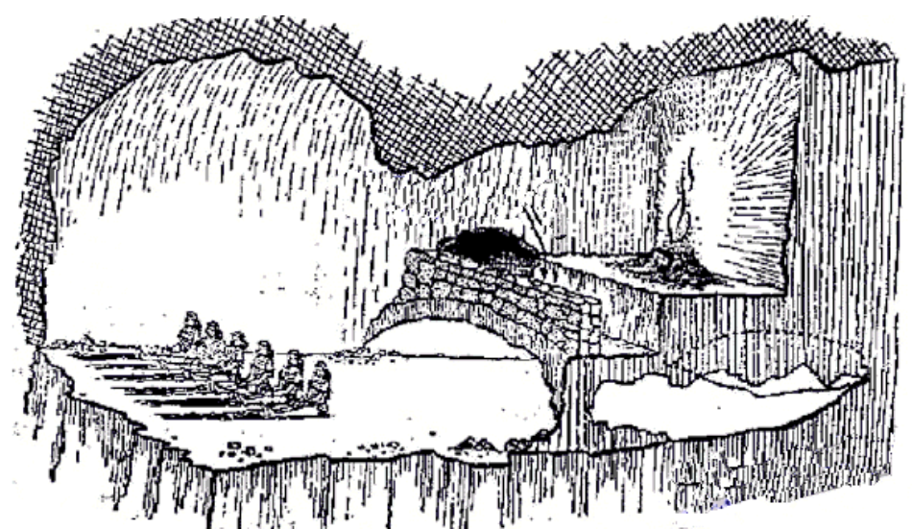
Shadows in Plato’s Cave….. PAH Clues
Resting PFTs
High FVC/DLco
Low Kco
Low pO₂/DLco
Desaturation on exercise
Serum BNP
Echocardiography
Enlarged PA on HRCT
RHC
Plato. The Republic (Πολιτεία). 380 BCE.

Slide 24
Many Treatment Options for PAH
2016
Selexipag
2014
Oral Treprostinil
2013
Riociguat & Macitentan
2009
Tadalafil & Inhaled Treprostinil
2006
Ambrisentan
2005
Sildenafil
2004
Inhaled Iloprost & IV Treprostinil
2002
SQ Treprostinil
2001
Bosentan
1995
IV Epoprostenol
Red = prostanoid and prostanoid analogues
Teal = endothelin receptor antagonists
Purple = nitric oxide pathway agents

Slide 25
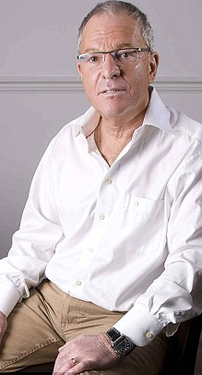
Gary was recently diagnosed with IPF

Slide 26
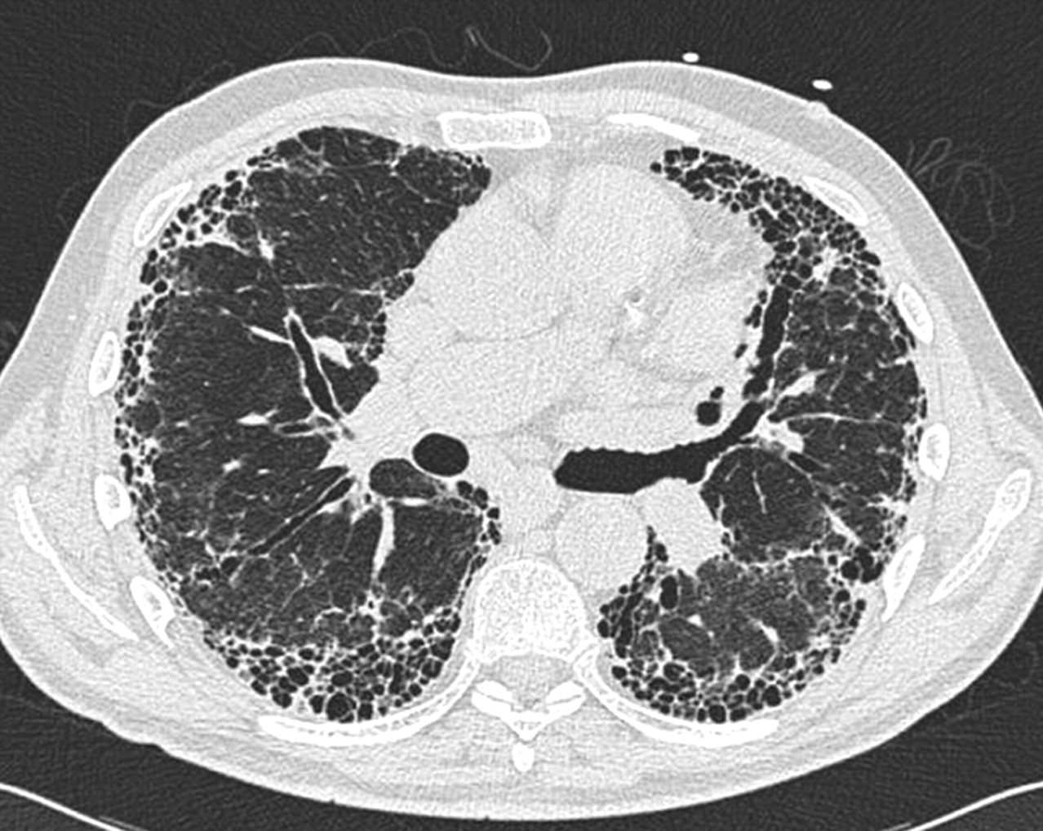
IPF is a Common ILD

Slide 27
IPF
Chronic, fibrosing interstitial pneumonia
40-50% of idiopathic ILDs
Unknown etiology
More common in smokers
Male:Female 1.5-2:1
Vast majority are >50 yo (mean 66 y)
Devastating
Median survival 2.5-3.5 years
20-40% 5-year survival
Prevalence: 14-43/100,000
Raghu G, et al. Am J Respir Crit Care Med. 2006;174(7):810-816.

Slide 28
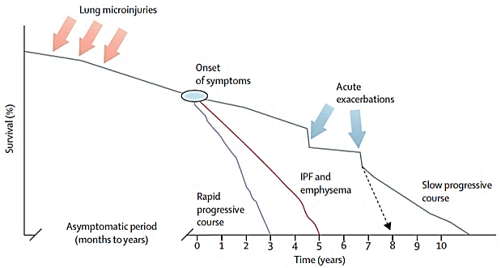
The Course of IPF is Variable
Survival (%)
King TE Jr, et al. Lancet. 2011;378(9807):1949-1961.

Slide 29
Precious Time is Wasted in Diagnosis
38% of IPF patients see
3 or more physicians
before accurate diagnosis¹
Patients can spend up to 2 years before
being accurately diagnosed with IPF²
COPD?
Asthma?
Obesity?
Emphysema?
¹Collard HR, et al. Respir Med. 2007;101(6):1350-1354.
²Lamas DJ, et al. Am J Respir Crit Care Med. 2011;184(7):842-847.

Slide 30
What are the clues that suggested Gary’s ILD?
Presentation
Age: 60 years
Progressive breathlessness for ~ 3 years
Cough, non-productive, noted for perhaps longer
Never-smoker
No mold or bird exposures
No family history of ILD, oxygen use, or CTD
Physical Exam
BP = 107/72
HR = 80
RR = 20
BMI = 26.5
SpO2 93 % on room air at 5280 feet
Notes:
Rheumatoid lung
Please furnish:
Presentation
Histories (medical, family, social)
Labs, physical
Diagnosis algorithm
Imaging features
Positive autoimmune serology

Slide 31
Don’t forget to examine Gary’s hands
What if they show one of the following….?
What are the consequences for your differential?

Slide 32
Digital Clubbing
Reynen K, et al. N Engl J Med. 2000;343(17):1235.

Slide 33
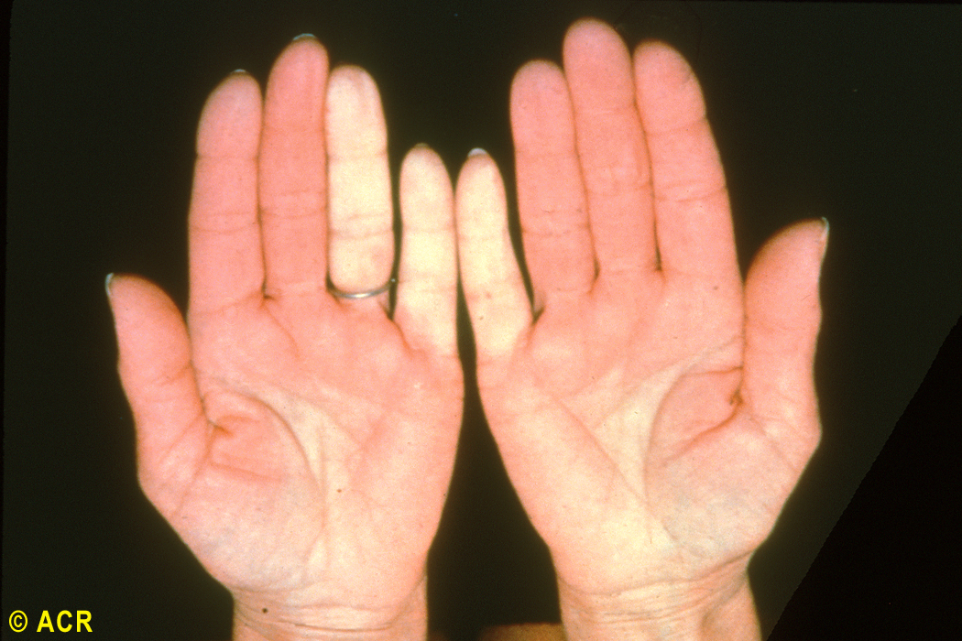
Raynaud’s Phenomenon
Notes:
Scleroderma: Raynaud's phenomenon, blanching of hands
The marked pallor of the fourth and fifth digits on the left hand and of the fifth digit on the right hand is characteristic of Raynaud’s phenomenon. Vasospastic changes are common in systemic sclerosis but may also occur in rheumatoid arthritis, systemic lupus erythematosus, and idiopathic Raynaud’s disease.
#9110010

Slide 34
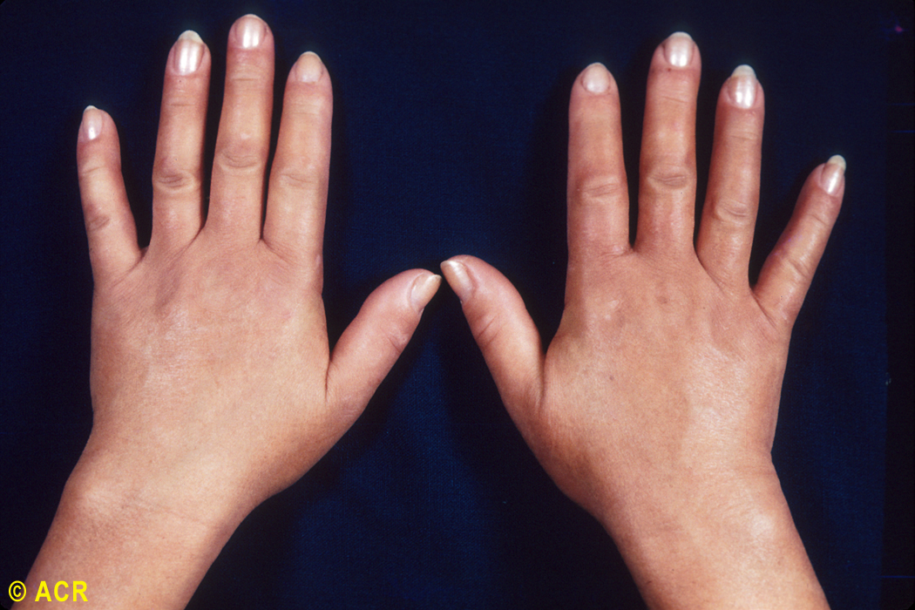
Edematous fingers (SSc, MCTD)
Notes:
Scleroderma: edematous changes, hands
Swelling of the distal limbs may develop early in the course of systemic sclerosis. Puffy hands are shown here.
#9110030

Slide 35
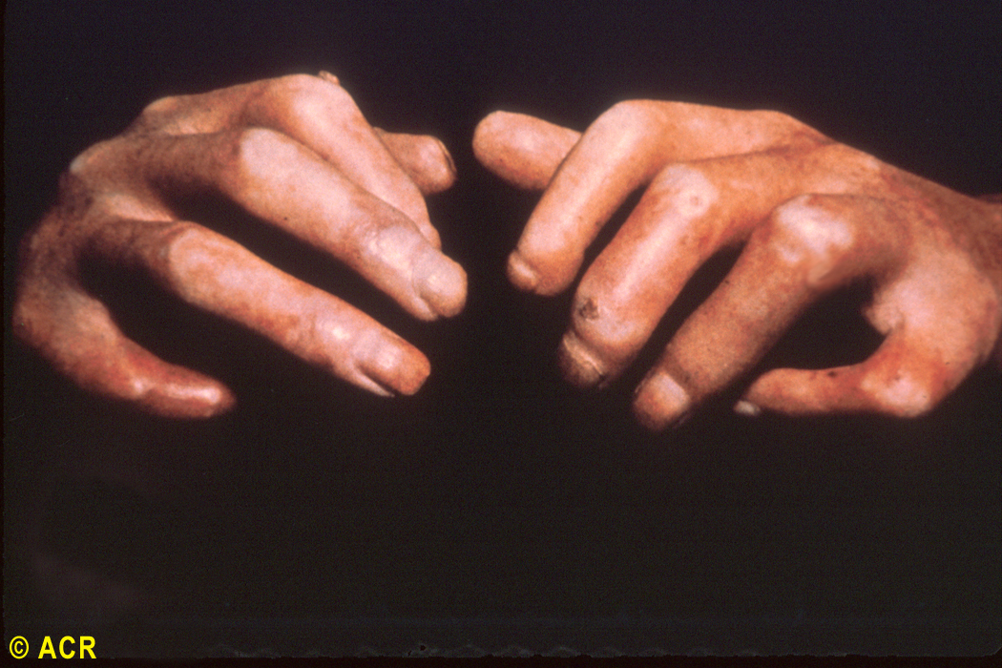
Sclerodactyly
Notes:
Scleroderma: acrosclerosis
Flexion contractures of the fingers are secondary to a tightened indurated skin. This type of change in the fingers is called acrosclerosis (sclerodactyly) and is characteristic of systemic sclerosis. However, skin changes proximal to the metacarpophalangeal joints are more specific for systemic sclerosis than changes only in the fingers. Areas of increased and decreased pigmentation are also visible.
#9110060

Slide 36
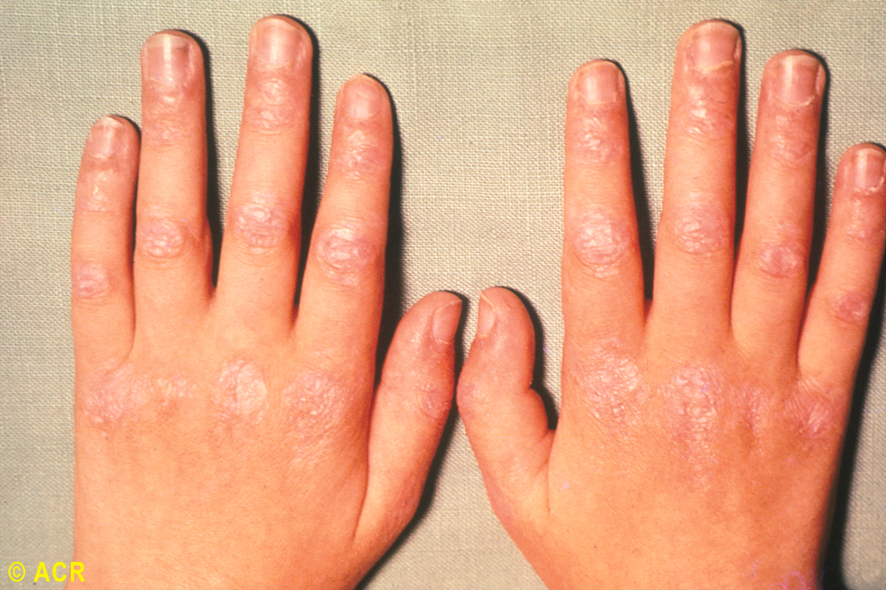
Gottron’s papules
Notes:
Dermatomyositis: rash, hands
Typical late cutaneous involvement is seen on the extensor aspect of the joints. The lesions are reddish-white, shiny, slightly scaly, and atrophic.
#9109050

Slide 37
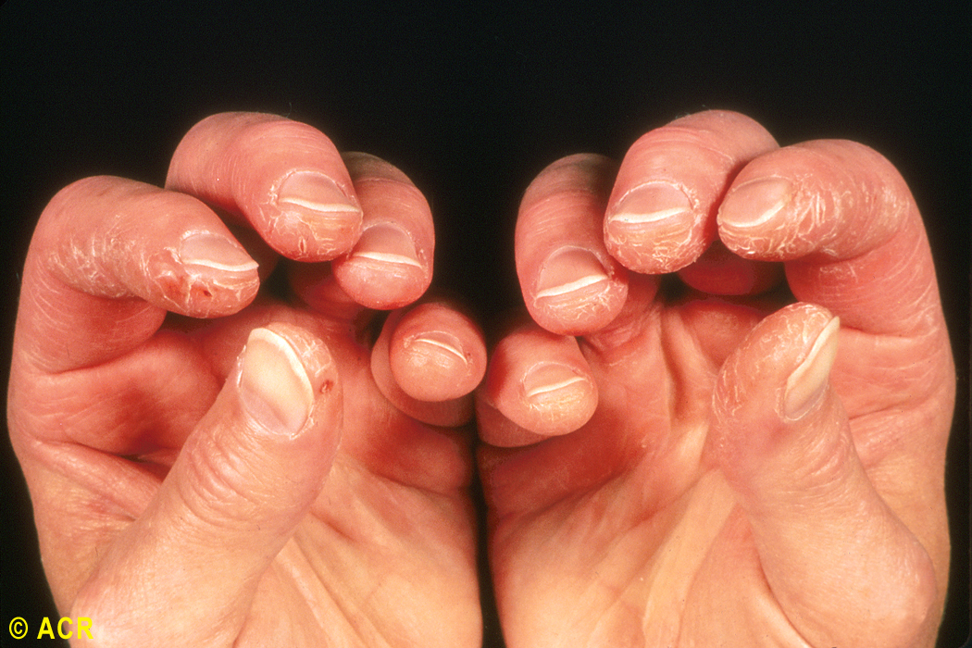
Mechanic’s hands
Notes:
Dermatomyositis: ”mechanic's hands"
Cracking of the finger pad skin, commonly involving the first, second, and third fingers, is demonstrated in this patient with dermatomyositis.
Miller FW. Myositis-specific autoantibodies: touchstones for understanding the inflammatory myopathies. JAMA 1993;270:1846-1849.
#9109060

Slide 38
“Look, Listen, and Walk”
LOOK at the skin and fingers
LISTEN carefully for crackles
Both lung bases
Laterally in mid-axillary line
Anteriorly
WALK the patient in the hallway (or on a staircase)
Try to elicit exertional dyspnea if possible
Measure SpO₂ before & after walking
A 3% drop in SpO₂ indicates exertional desaturation

Slide 39
Pertinent Findings
Inspiratory crackles at bases bilaterally
1
No joint or hand deformities, evidence for synovitis, or rashes
2
6MWT: 533 meters on 2L, nadir
SpO₂ 90 %
3
What’s the next step in diagnosing Gary?

Slide 40
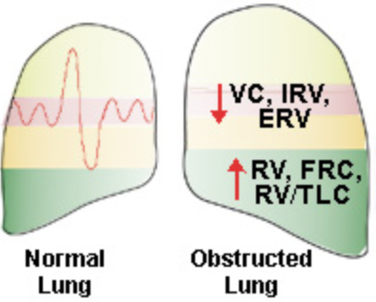
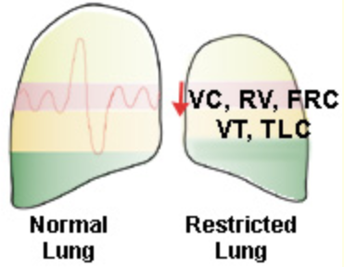
How would you interpret Gary‘s PFTs?
 | Obstructive | ? ←Gary→ ? | Restrictive
FVC | Reduced | 56% | Reduced
FEV₁ | Reduced | 69% | Reduced
FEV₁/FVC ratio | Reduced | 91% | Normal
TLC | Increased | 76% | Reduced
RV | Increased | 110% | Reduced
DL_{CO} | Reduced | 59% | Reduced
http://www.ugr.es/~jhuertas/EvaluacionFisiologica/Espirometria/restobst.htm. Accessed Nov 2016.

Slide 41
IPF is a Diagnosis of Exclusion
If a patient has Exertional Dyspnea and/or Chronic Cough:
Finding | To Rule Out
History
CXR, echo
Comprehensive physical exam
Spirometry
HRCT
Serology
Lung biopsy
Exposures, family Hx,
infection
Heart disease, PH
Autoimmune disease
COPD, asthma
NSIP,
cHP
, asbestosis, ??
Autoimmune disease
NSIP,
cHP
, ??

Slide 42
HRCT Criteria for UIP
 | UIP Pattern | Possible UIP Pattern
Subpleural, basal predominance | + | +
Reticular abnormality | + | +
Honeycombing (+/- traction bronchiectasis) | + | -
Absence of any “inconsistent” features | + | +
Raghu G, et al, and the ATS/ERS/JRS/ALAT Committee on IPF. Am J Respir Crit Care Med. 2011;183:788-824
Notes:
Panel Discussion
Does your radiologist give a reading of UIP?
Are your radiologist’s findings consistent with the ATS/ERS criteria?
The 2011 ATS/ERS diagnostic guidelines lay out the criteria for a radiologic finding of usual interstitial pneumonia (UIP). This table summarizes the criteria for UIP and possible UIP and gives the inconsistent features that would rule out UIP and IPF.

Slide 43
Gary’s Axial HRCT
What are your findings?
Notes:
FEB 2014

Slide 44
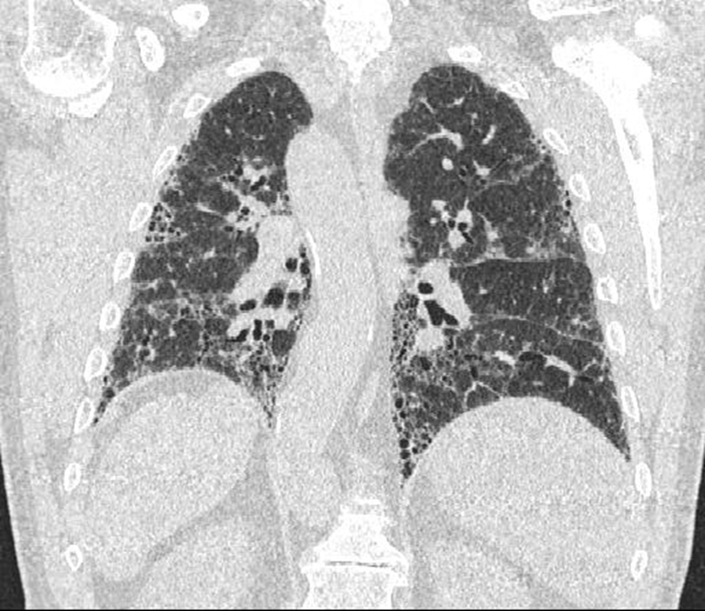
Coronal HRCT
What are your findings?

Slide 45
On the basis of these features, what is your rating of Gary’s UIP?
UIP
Possible UIP
Inconsistent with UIP

Slide 46
What other information was necessary for an IPF diagnosis?
Serology
Pathology
Sleep study
Rheumatology consult
Diagnosis is clear; proceed to treatment
Gary’s serology profile was negative, enabling a diagnosis.

Slide 47
A Multidisciplinary Approach
“ILDometer”
ILD
HRCT
INDEX
OF
SUSPICION
PFTS: restriction
CXR:?ILD
“Velcro”
crackles
at lung bases
SOB +/- cough
Notes:
This slide illustrates the growing suspicion of ILD with accumulating clinical evidence. The following slide shows how the index of suspicion for IPF increases with the addition of more information such as exclusion of exposures and serology.
These slides are animated and don’t require participant interaction. The presenter can briefly discuss each piece of evidence as it accumulates and can also mention specific factors that suggest alternative diagnoses.

Slide 48
A Multidisciplinary Approach
“ILDometer”
“IPFometer”
Possible
UIP pattern
Inconsistent UIP pattern
ILD
IPF
UIP pattern
HRCT
IPF
INDEX
OF
SUSPICION
IPF
PFTS: restriction
Increasing
Age
CXR:?ILD
No CTD*
No exposures
“Velcro”
crackles
at lung bases
ILD
SOB +/- cough
* signs, symptoms or serologies

Slide 49
Let’s review Gary’s evidence
3y dyspnea
Family Hx negative
History
Environmental
Radiology
Serology
Pathology
Physical exam
Not necessary for Gary
No mold or bird exposures (cHP)
Skin, joints negative
No clubbing
Basal crackles
SpO2 desat on walk
Restrictive PFTs
IPF
CXR: fibrosis
HRCT: UIP
Negative
Notes:
This diagnostic paradigm for IPF emphasizes the multidisciplinary nature of the process, as well as the opportunity for misdiagnosis if some of the stones are left unturned. Pathology, as seen in Maria’s case, is sometimes not required and is indicated in parentheses.

Slide 50
Two Therapies for IPF Were Approved in 2014
Nintedanib
(Ofev)
Pirfenidone
(Esbriet)
Would you treat Gary?
Which medication would you recommend?
Let’s look at the evidence….
Notes:
Before going into the following clinical didactic slides you can ask for a show of hands: How many of you have ever prescribed ______? How many prefer nintedanib? How many prefer pirfenidone? How many use corticosteroids? What are the reasons for selecting one or the other?
The count of hands is not as important as having the participants reflect on their own experience and attitudes to the drugs, as well as their reasons for choosing one or the other.
Suggest that participants might write down their choice of therapy for review after further information is provided. Is the choice different after more information? Tell them that you will ask them later if this information has changed their recommendation.

Slide 51
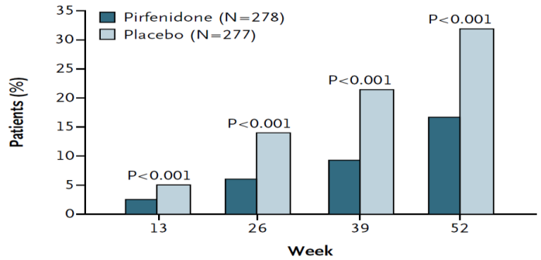
Primary ASCEND Endpoint Achieved
Primary Endpoint
Patients with ≥ 10% FVC Decline or Death (%)
48% Relative
Reduction
Week
King TE, et al. N Engl J Med. 2014;370(22):2083-2092.
Notes:
This and the following slides are didactic and lay the foundation for making an informed choice of therapy. The evidence they provide answers some of the questions that will help the participants engage in the best Shared Decision Making process with the patient.

Slide 52
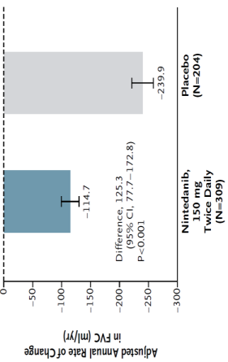
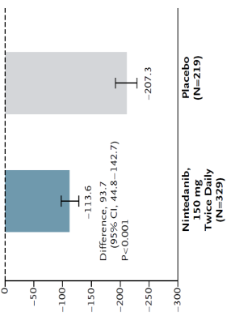
Primary INPULSIS Endpoint Achieved
INPULSIS-1
INPULSIS-2
52% Relative
Reduction
45% Relative
Reduction
Nintedanib Placebo
Richeldi L, et al. N Engl J Med. 2014;370(22):2071-2082.

Slide 53
Treating Gary
He is a good candidate for either pirfenidone or nintedanib
Shared decision-making allowed you to individualize the choice
Dosing
Side effect tolerance
Gary’s preference?

Slide 54
PCP/Pulmonology Partnership for IPF
PCP
Pulmonology
Risk factors
Smoking
Obesity
Comorbidities
Vaccinations
Diagnosis
Treatment
Pulmonary rehab
Clinical trials
Lung transplant evaluation
BOTH
Patient education
Supplemental oxygen
End-of-life issues
Mental health

Slide 55
Gary’s Summary
Gary’s signs and symptoms led to a suspicion of ILD
Timely referral was essential to diagnosis and treatment
HRCT finding was definite UIP
SLB was not necessary for diagnosis
There was no identifiable cause for Gary’s ILD
Diagnosis: IPF
Gary is a candidate for nintedanib or pirfenidone
Current therapies slow the rate of decline
Multiple emerging therapies are in development

Slide 56
Conclusions
Multiple causes of SOB
Common causes are commonly diagnosed
COPD, asthma
Heart failure, CAD
Rare causes are commonly missed
PH
ILD
Elements of diagnosis: each step can move the clinician in the direction of making an early and accurate diagnosis:
Patient history
Physical Exam
PFTs
Imaging

Slide 57
Thank you for your participation!
Please fill out your
evaluations!
Your feedback helps us measure educational outcomes and provide continued education.

