Slide 1
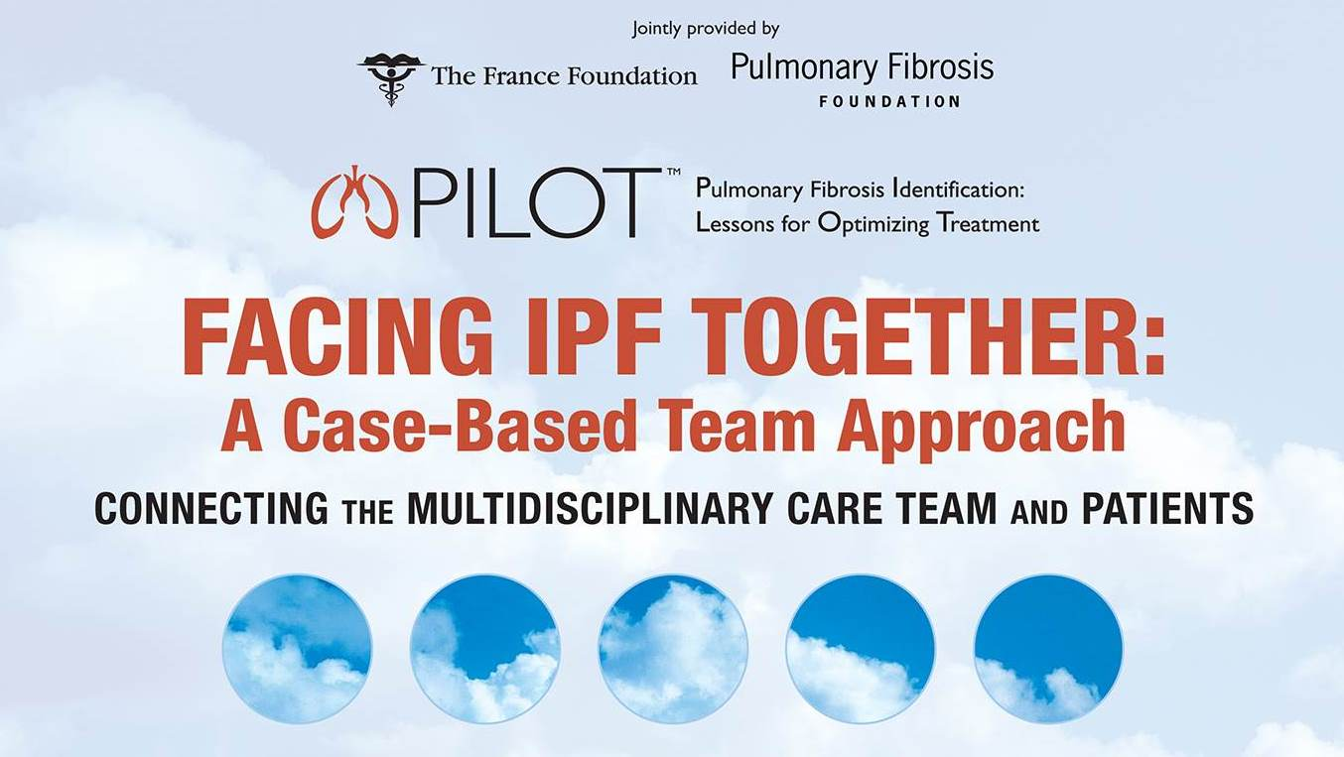

Slide 2
What’s on the Horizon: Potential Therapies in Clinical Trials

Slide 3
Disclosure of Relevant Financial Relationships
In accordance with the ACCME Standards for Commercial Support, The France Foundation (TFF) and The Pulmonary Fibrosis Foundation (PFF) require that individuals in a position to control the content of an educational activity disclose all relevant financial relationships with any commercial interest. TFF and PFF resolve all conflicts of interest to ensure independence, objectivity, balance, and scientific rigor in all their educational programs. Furthermore, TFF and PFF seek to verify that all scientific research referred to, reported, or used in a CME/CE activity conforms to the generally accepted standards of experimental design, data collection, and analysis. TFF and PFF are committed to providing learners with high-quality CME/CE activities that promote improvements in health care and not those of a commercial interest.
The following faculty has indicated relationships with industry relative to the content of this CME activity:
Amy Olson, MD, has served on the advisory board for Genentech. She has also served on the speakers’ bureau for Boehringer Ingelheim Pharmaceuticals, Inc.

Slide 4
Learning Objective
Examine emerging research related to IPF treatment

Slide 5
Clinical Trials
Find them at www.clinicaltrials.gov
Critical for finding new treatments
Many patients fit the inclusion criteria
Current treatment for IPF usually doesn’t disqualify patients
No cost to patient!

Slide 6
Look for this symbol for trials that are open for participation:

Slide 7
Overview
Phase 4 studies
Combining nintedanib and pirfenidone
Phase 3 studies
Cotrimoxazole
Phase 2 studies (by mechanism)
Epithelial injury and fibrosis
Connective tissue growth factor (CTGF) signaling
Mesenchymal stem cells

Slide 8
Combining Pirfenidone and Nintedanib: Published Findings
Ogura
Randomized, double-blind, phase 2, dose escalation trial (N = 50)
Safety, tolerability and PK
Nintedanib +/- ongoing pirfenidone therapy
Trend toward lower exposure of nintedanib when added to ongoing pirfenidone therapy
Co-administration with nintedanib had no effect on the PK of pirfenidone
Adverse events
Nintedanib alone: 9/17 patients (53%)
Nintedanib + pirfenidone: 10/21 patients (48%)
Hagmeyer
Case report (1 male patient)
2 years of treatment with pirfenidone monotherapy
Decline in FVC: 3.5 liter before treatment to 2.5 liter
Nintedanib added, ongoing for nearly 12 months
Lung function stabilized
Two treatments were well tolerated
Ogura T, et al. Eur Respir J. 2015;45(5):1382-1392. Hagmeyer L, et al. Respiration. 2016;91(4):327-332.

Slide 9
Combining Pirfenidone and Nintedanib: Ongoing Studies in Patients with IPF
(NCT02598193) Roche
N = 80 patients stable on pirfenidone
Nintedanib added
Safety/tolerability
24 weeks
Recruiting, study completion estimated July 2017
(NCT02579603) BI
N = 100 patients
Nintedanib +/- pirfenidone
Safety/tolerability/PK
12 weeks
Recruiting, study completion estimated January 2017
ClinicalTrials.gov. Accessed July 2016.

Slide 10
Recent Cotrimoxazole History
Antibiotic (sulfamethoxazole + trimethoprim)
N = 181 patients with fibrotic IIP (IPF or fibrotic NSIP)
12 months duration
Treatment regimens stable for 6 weeks
Treatment with 960 mg twice daily or placebo
Results
No change in FVC (primary endpoint), 6MWT, MRC dyspnea score
Per-protocol analysis showed significant improvements
EQ5D-based utility
% of patients requiring oxygen increase
All-cause mortality
Increased rate of nausea and rash
Shulgina L, et al. Thorax. 2013;68(2):155-162.
Notes:
Thorax. 2013 Feb;68(2):155-62. doi: 10.1136/thoraxjnl-2012-202403. Epub 2012 Nov 10.
Treating idiopathic pulmonary fibrosis with the addition of co-trimoxazole: a randomised controlled trial.
Shulgina L¹, Cahn AP, Chilvers ER, Parfrey H, Clark AB, Wilson EC, Twentyman OP, Davison AG, Curtin JJ, Crawford MB, Wilson AM.
Author information
Abstract
BACKGROUND:
Idiopathic pulmonary fibrosis (IPF) is a fatal condition with limited treatment options. However, in a previous small study, co-trimoxazole was found to be beneficial.
METHODS:
In a double-blind multicentre study, 181 patients with fibrotic idiopathic interstitial pneumonia (89% diagnosed as definite/probable IPF) were randomised to receive co-trimoxazole 960 mg twice daily or placebo for 12 months in addition to usual care. Measurements were made of forced vital capacity (FVC) (primary endpoint), diffusing capacity of carbon monoxide (Dlco) and EuroQol (EQ5D)-based utility, 6-minute walk test (6MWT) and Medical Research Council (MRC) dyspnoea score (secondary endpoints). All-cause mortality and adverse events were recorded (tertiary endpoints).
RESULTS:
Co-trimoxazole had no effect on FVC (mean difference 15.5 ml (95% CI -93.6 to 124.6)), Dlco (mean difference -0.12 mmol/min/kPa (95% CI 0.41 to 0.17)), 6MWT or MRC dyspnoea score (intention-to-treat analysis). The findings of the per-protocol analysis were the same except that co-trimoxazole treatment resulted in a significant improvement in EQ5D-based utility (mean difference 0.12 (95% CI 0.01 to 0.22)), a reduction in the percentage of patients requiring an increase in oxygen therapy (OR 0.05 (95% CI 0.00 to 0.61)) and a significant reduction in all-cause mortality (co-trimoxazole 3/53, placebo 14/65, HR 0.21 (95% CI 0.06 to 0.78), p=0.02)) compared with placebo. The use of co-trimoxazole reduced respiratory tract infections but increased the incidence of nausea and rash.
CONCLUSIONS:
The addition of co-trimoxazole therapy to standard treatment for fibrotic idiopathic interstitial pneumonia had no effect on lung function but resulted in improved quality of life and a reduction in mortality in those adhering to treatment. ISRCTN22201583.

Slide 11
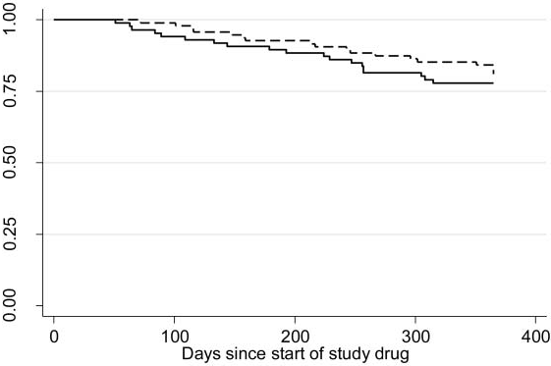
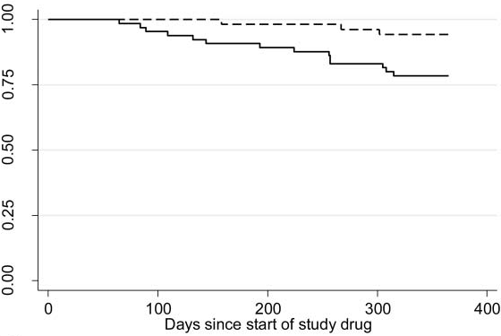
Cotrimoxazole Improves 1 Measure of Mortality
Intention-to-Treat
Per Protocol
3/53, 6%
19/86, 19%
18/95, 22%
14/65, 22%
Fraction of Patients Surviving
HR = 0.2 (95% CI 0.06 to 0.78)
New trials are currently ongoing
UK (ISRCTN17464641)
Spain (NCT01777737)
Shulgina L, et al. Thorax. 2013;68(2):155-162.
Notes:
Comment from Borie et al 2016:
In a double-blind multicenter study, 181 patients with fibrotic idiopathic interstitial
pneumonia (89% diagnosed as definite/probable IPF) were randomized to receive co-trimoxazole 960mg
twice daily or placebo for 12 months in addition to usual care. After 12months, co-trimoxazole had no effect on
FVC decline, the primary outcome.However, inpatients adhering to treatment, co-trimoxazole reduced
mortality (a tertiary endpoint), a finding possibly related to reduced respiratory infection. Indeed, many patients
included in that study were receiving corticosteroids (60%) or immunosuppressants (30% were receiving
azathioprine), and this could at least partly explain the benefit associated with the antibiotic treatment. New
trials are currently ongoing in UK (ISRCTN17464641) and Spain (NCT01777737) to further evaluate this
therapeutic option in IPF patients.

Slide 12
Phase 2 Candidates for IPF
Mode of action | Compound | Trials
Anti-CTGF | FG-3019 | Phase 2 ongoing (NCT01890265)
Anti-IL-13 | Lebrikizumab | Phase 2 ongoing (NCT01872689)
Anti-IL-4, IL-13 | SAR156597 | Phase 2 ongoing (NCT01529853)
Anti-αvβ6 integrin | STX-100 | Phase 2 ongoing (NCT01371305)
Pentraxin-2 (monocyte differentiation) | PRM-151 | Phase 2 recruiting (NCT02550873)
Anti-CD20, Reduction of autoantibodies | Rituximab | Phase 2 ongoing(NCT01969409)
mTOR inhibition | Sirolimus | Phase 2 ongoing (NCT01462006)
Lysophosphatidic acid receptor antagonist | BMS-986020 | Phase 2 ongoing (NCT01766817)
Anti-inflammatory/anti-oxidation | Carbon monoxide | Phase 2 ongoing (NCT01214187)
Galactose-galectin interaction | TD-139 (inhaled) | Phase 1/2 recruiting (NCT02257177)
Anti-inflammatory/anti-fibrotic | MN-001/tipulekast | Phase 2 recruiting (NCT02503657)
Autotaxin inhibition | GLPG1690 | Phase 2 recruiting (NCT02738801)
Immunomodulation | Mesenchymal Stem Cells | Phase 1/2 recruiting (NCT02013700 in US. Also trials in Spain, India, Russia)
Adapted from: Borie R, et al. Respirology. 2016;21(4):615-625.

Slide 13
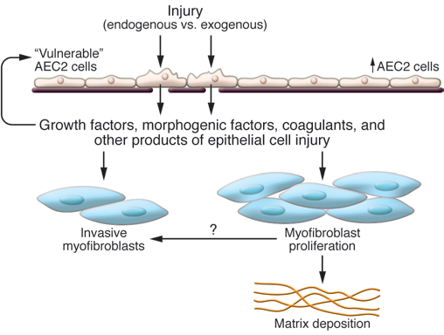
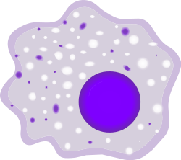
Epithelial Injury and Fibrosis
Latent TGF-β
TGF-β
αvβ6
LPA1
Macrophage, M2a
LPA = Lysophosphatidic acid
Noble PW, et al. J Clin Invest. 2012;122(8):2756-2762.

Slide 14
Epithelial Injury and Fibrosis Approaches
BMS-986020 (AM152)
Small molecule LPA1 antagonist
Ongoing trial NCT01766817: ΔFVC, tolerability
N = 80, 26 weeks, completed
BG00011 (STX-100)
Humanized mab against epithelial αvβ6 integrin
Blocks activation of latent TGF-β
Ongoing trial NCT01371305: Safety and tolerability of sc-administered multiple, escalating doses
N = 40, study completion estimated March 2017
PRM-151 (pentraxin-2)
Ligand for Fcγ receptors on monocytes and macrophages
Stimulates differentiation into restorative regulatory macrophages with local production of IL-10
Ongoing trial NCT02550873: efficacy and safety
N = 117, 24 weeks, study completion estimated March 2019

Slide 15
Epithelial Injury and Fibrosis
STX-100
Latent TGF-β
TGF-β
αvβ6
LPA1
Macrophage, M2a
AM152
Pentraxin-2
LPA = Lysophosphatidic acid
Noble PW, et al. J Clin Invest. 2012;122(8):2756-2762.

Slide 16
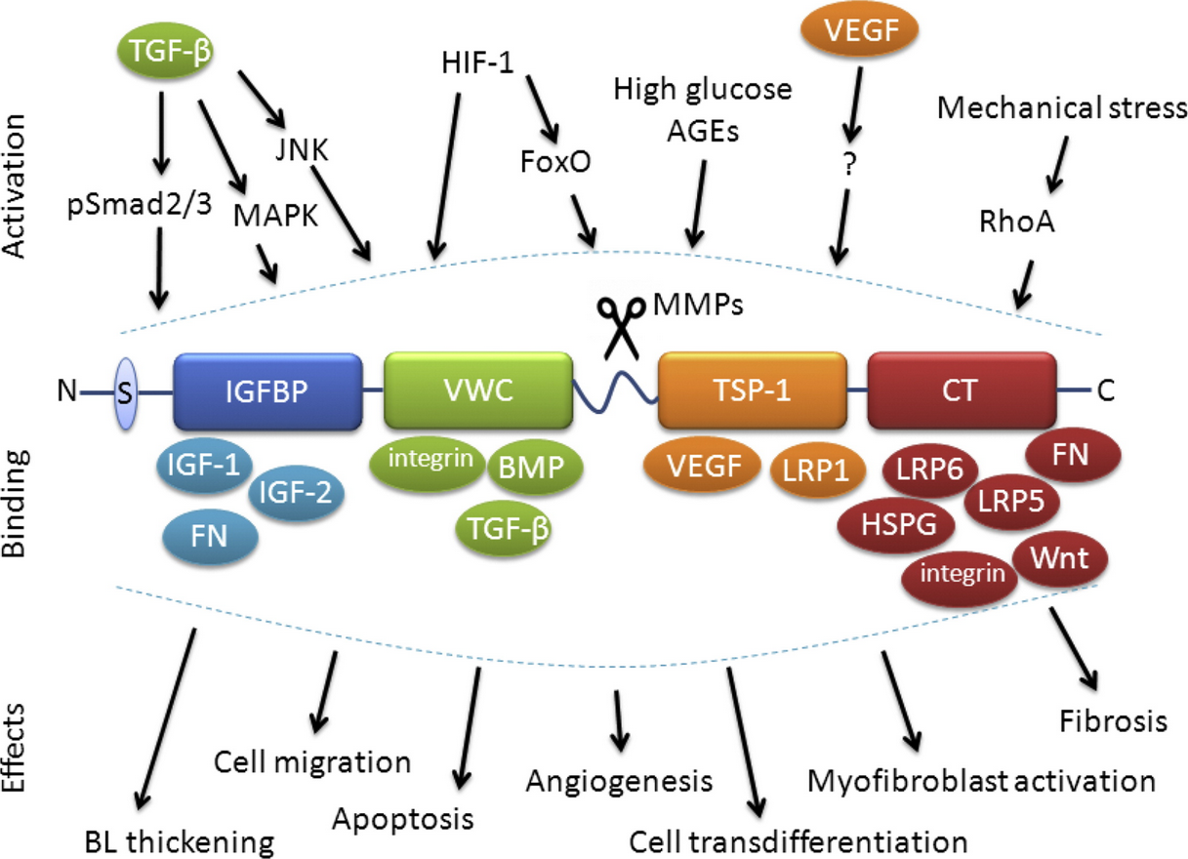
CTGF Signaling
Klaassen I, et al. Exp Eye Res. 2015;133:37-48.
Notes:
Exp Eye Res. 2015 Apr;133:37-48. doi: 10.1016/j.exer.2014.10.016.
The role of CTGF in diabetic retinopathy.
Klaassen I1, van Geest RJ2, Kuiper EJ2, van Noorden CJ2, Schlingemann RO3.
Author information
Abstract
Connective tissue growth factor (CTGF, CCN2) contributes to fibrotic responses in diabetic retinopathy, both before clinical manifestations occur in the pre-clinical stage of diabetic retinopathy (PCDR) and in proliferative diabetic retinopathy (PDR), the late clinical stage of the disease. CTGF is a secreted protein that modulates the actions of many growth factors and extracellular matrix (ECM) proteins, leading to tissue reorganization, such as ECM formation and remodeling, basal lamina (BL) thickening, pericyte apoptosis, angiogenesis, wound healing and fibrosis. In PCDR, CTGF contributes to thickening of the retinal capillary BL and is involved in loss of pericytes. In this stage, CTGF expression is induced by advanced glycation end products, and by growth factors such as vascular endothelial growth factor (VEGF) and transforming growth factor (TGF)-β. In PDR, the switch from neovascularization to a fibrotic phase - the angio-fibrotic switch - in PDR is driven by CTGF, in a critical balance with vascular endothelial growth factor (VEGF). We discuss here the roles of CTGF in the pathogenesis of DR in relation to ECM remodeling and wound healing mechanisms, and explore whether CTGF may be a potential novel therapeutic target in the clinical management of early as well as late stages of DR.
CTGF domain structure, activating factors, binding partners and cellular effects. CTGF consists of a secretory signal peptide (S), an insulin-like growth factor-binding protein domain (IGFBP), a von Willebrand type C domain (VWC), a thrombospondin-1 domain (TSP-1) and a cysteine knot (CT) domain. Domains are linked by hinge regions, susceptible to protease cleavage by matrix metalloproteinases (MMPs). CTGF is activated by multiple growth factors and environmental stimuli, has numerous binding partners and modulates a wide range of biological functions. AGEs, advanced glycation end products; BMP, bone morphogenetic protein; C, C-terminus; IGF, insulin-like growth factor; FN, fibronectin; FoxO, forkhead box O transcription factors; HIF-1, hypoxia-inducible factor-1; HSPG, heparan sulfate proteoglycan; JNK, c-Jun N-terminal kinase; LRP, lipoprotein receptor-related protein; MAPK, mitogen-activated protein kinase; N, N-terminus; RhoA, Ras homolog gene family, member A; TGF-β, transforming growth factor-β; VEGF, vascular endothelial growth factor.

Slide 17
CTGF Approaches: FG-3019
Human mab
Open-label 48 week trial reported
Safe and well-tolerated
Changes in fibrosis correlated with ΔFVC
Ongoing trial NCT01890265
ΔFVC, safety/tolerability
48 weeks
N = 136, study completion estimated April 2017
Raghu G, et al. Eur Respir J. 2016; In press. Accessed July 2016.

Slide 18
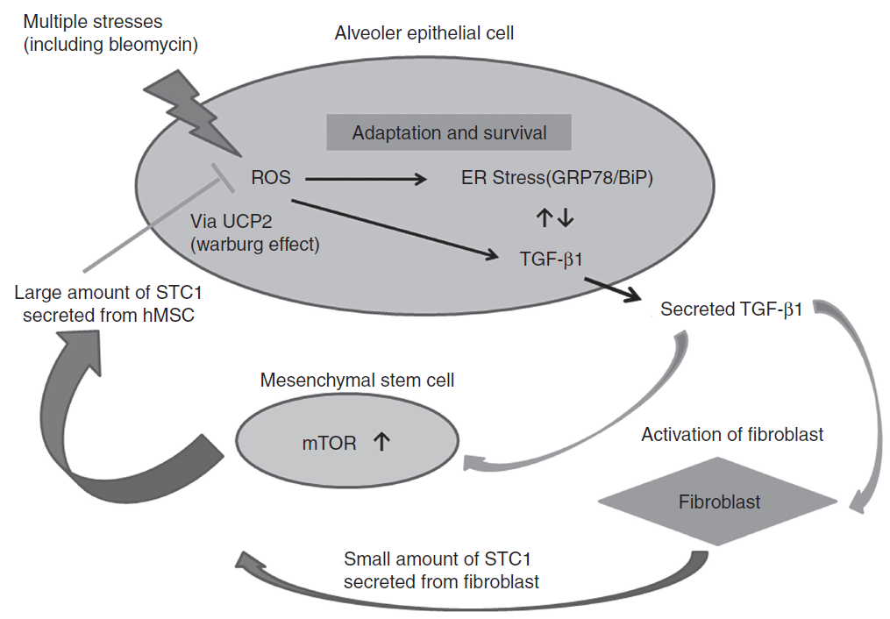
MSC Involvement in Fibrogenesis
STC1: Stanniocalcin-1
Ono M, et al. Mol Ther. 2015;23(3):549-560.
Notes:
Normalization of the inappropriate relation between epithelium and mesenchyme is achieved by
Stanniocalcin-1 (STC1) secretion from mesenchymal stem cells (MSCs) stimulated by TGF-β1 in the microenvironment of pulmonary fibrosis. ER stress
and oxidative stress generated by various types of stress led to excessive TGF-β1 synthesis in AECs. TGF-β1 promoted the secretion of large amounts
of STC1 by MSCs via PI3/AKT/mTOR pathway. STC1 derived from MSCs reduced oxidative stress, ER stress and TGF-β1 synthesis in AECs under the
function of UCP2, which shifts mitochondrial respiration into aerobic glycolysis. This is one of the negative feedback pathways for the protection
against fibrosis in cooperation with AECs and MSCs.
Mol Ther. 2015 Mar;23(3):549-60. doi: 10.1038/mt.2014.217. Epub 2014 Nov 6.
Mesenchymal stem cells correct inappropriate epithelial-mesenchyme relation in pulmonary fibrosis using stanniocalcin-1.
Ono M1, Ohkouchi S2, Kanehira M3, Tode N1, Kobayashi M1, Ebina M4, Nukiwa T5, Irokawa T6, Ogawa H6, Akaike T7, Okada Y8, Kurosawa H6, Kikuchi T1, Ichinose M1.
Current hypotheses suggest that aberrant wound healing has a critical role in the pathogenesis of idiopathic pulmonary fibrosis (IPF). In these hypotheses, continuous TGF-β1 secretion by alveolar epithelial cells (AECs) in abnormal wound healing has a critical role in promoting fibroblast differentiation into myofibroblasts. Mesenchymal stem cells (MSCs) home to the injury site and reduce fibrosis by secreting multifunctional antifibrotic humoral factors in IPF. In this study, we show that MSCs can correct the inadequate-communication between epithelial and mesenchymal cells through STC1 (Stanniocalcin-1) secretion in a bleomycin-induced IPF model. Inhalation of recombinant STC1 shows the same effects as the injection of MSCs. Using STC1 plasmid, it was possible to enhance the ability of MSCs to ameliorate the fibrosis. MSCs secrete large amounts of STC1 in response to TGF-β1 in comparison to AECs and fibroblasts. The antifibrotic effects of STC1 include reducing oxidative stress, endoplasmic reticulum (ER) stress, and TGF-β1 production in AECs. The STC1 effects can be controlled by blocking uncoupling protein 2 (UCP2) and the secretion is affected by the PI3/AKT/mTORC1 inhibitors. Our findings suggest that STC1 tends to correct the inappropriate epithelial-mesenchymal relationships and that STC1 plasmid transfected to MSCs or STC1 inhalation could become promising treatments for IPF.

Slide 19
MSC Approaches
Ongoing trial NCT02013700
Allogenic human mesenchymal stem cells
Phase 1, randomized, blinded, placebo-controlled
9 subjects pilot safety run-in
Additional 16 randomized subjects (placebo or MSC)
Safety and tolerability
Active study, not recruiting
Study completion estimated March 2017

Slide 20
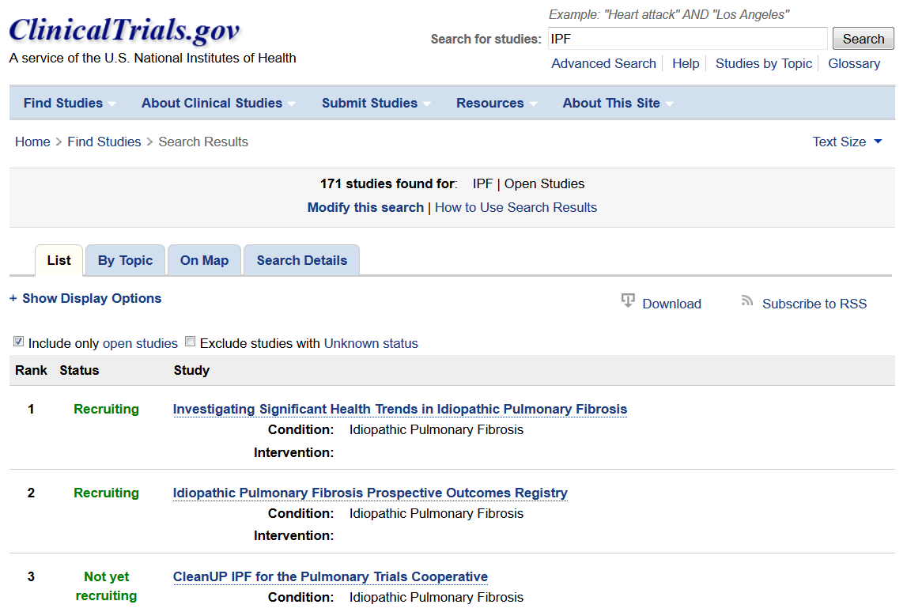
Need more information about clinical trials?

Slide 21
Conclusions
Multiple approaches to IPF therapy are being tested
Many compounds are in various stages of clinical testing
Multiple clinical trials are enrolling patients with IPF
Pirfenidone or nintedanib are FDA approved
Some clinical trials allow concurrent therapy

