Slide 2
IPF Diagnosis and Treatment with Case Review

Slide 3
PILOT: Background
PILOT (Pulmonary Fibrosis Identification: Lessons for Optimizing Treatment) is a national education initiative driven by The France Foundation, an ACCME-accredited provider
Education focuses on the early and accurate diagnosis of IPF, while also addressing critical issues related to optimizing disease intervention and management
Led by experts in the IPF field, PILOT has attained a level of recognition and credibility across practitioner and patient communities that places it as one of the primary sources for timely and innovative education on IPF
In the 10+ years since its launch, PILOT has had over 13 million hits to its educational website, www.PILOTforIPF.org.

Slide 4
PILOT Steering Committee
Steven Nathan, MD (Chair)
Medical Director, Lung Transplant Program
Director, Advanced Lung Disease Program
Inova Health System
A. Whitney W. Brown, MD
Pulmonologist
Inova Health System
Harold R. Collard, MD
Director of the Interstitial Lung Disease Program
UCSF Medical Center
Kevin Flaherty, MD
Professor of Medicine
University of Michigan Health System
Marilyn K. Glassberg, MD Professor of Medicine and Surgery Miller School of Medicine, University of Miami
Jonathan Goldin, MD, PhD
Professor of Radiology, Medicine &
Biomedical Physics Program Executive Chair of Radiology (Clinical Care),
Department of Radiology UCLA Medical Center, Santa Monica Santa Monica, California
David Lederer, MD, MS
Herbert Irving Assistant Professor of Medicine and Epidemiology
Associate Medical Director, Lung Transplant Program
Co-Director, Interstitial Lung Disease Program
Columbia University Medical Center/
New York Presbyterian Hospital
Kevin Leslie, MD
Professor of Laboratory Medicine & Pathology
Mayo Clinic
Paul W. Noble, MD
Chair, Department of Medicine
Director, Women’s Guild Lung Institute
Cedars-Sinai Medical Center
Amy Olson, MD, MSPH
Assistant Professor
National Jewish Health
Luca Richeldi, MD, PhD
Professor of Respiratory Medicine
Chair of Interstitial Lung Disease
University of Southampton
Jeffrey James Swigris, DO, MS
Associate Professor, Interstitial Lung Disease Program Director, Interstitial Lung Disease Visiting Fellow’s Program Co-Director, Autoimmune Lung Center Division of Pulmonary Medicine National Jewish Health

Slide 5
Pulmonary Fibrosis Foundation (PFF) A Collaborator in this Regional Activity
The PFF was founded in 2000 by brothers Albert Rose and Michael Rosenzweig, PhD, after the brothers experienced firsthand the devastating effects of PF, when their sister Claire passed away from the disease. Both brothers were also diagnosed with PF, and it was their vision and dedication that led to the creation of the Foundation.
The mission of the PFF is to serve as the trusted resource for the pulmonary fibrosis community by raising awareness, providing disease education, and funding research.

Slide 6
Learning Objectives
Apply current ATS/ERS criteria to the process for differentially diagnosing IPF
Integrate histopathologic with high-resolution computed tomography (HRCT) data in the diagnosis of IPF when necessary
Explain disease progression and the heterogeneity of the disease
Examine emerging research related to IPF treatment
Select appropriate therapies that reflect current evidence and/or widely accepted guidelines that are individualized to patients
Utilize dose modification to manage side effects in patients
Recognize treatment success, disease progression, and when/if to switch therapy
Collaborate with patients and/or caregivers in overcoming barriers to daily living

Slide 7
Continuing Medical Education
Accreditation Statement
This activity has been planned and implemented in accordance with the accreditation requirements and policies of the Accreditation Council for Continuing Medical Education (ACCME) through the joint providership of The France Foundation and the Pulmonary Fibrosis Foundation. The France Foundation is accredited by the ACCME to provide continuing medical education for physicians.
Credit Designation
Physicians
The France Foundation designates this live activity for a maximum of 3.5 AMA PRA Category 1 Credit(s) ™. Physicians should claim only the credit commensurate with the extent of their participation in the activity.
How to Claim Credit
Please complete the evaluation and return to The France Foundation staff or leave it on the Registration Desk outside the room.
Supported by an Educational Grant from Boehringer Ingelheim Pharmaceuticals, Inc.

Slide 8
Disclosure of Relevant Financial Relationships
It is the policy of The France Foundation to ensure balance, independence, objectivity, and scientific rigor in all its educational activities. All faculty, activity planners, content reviewers, and staff participating in this activity will disclose to the participants any significant financial interest or other relationship with manufacturer(s) of any commercial product(s)/device(s) and/or provider(s) of commercial services included in this educational activity. The intent of this disclosure is not to prevent a person with a relevant financial or other relationship from participating in the activity, but rather to provide participants with information on which they can base their own judgments. The France Foundation has identified and resolved any and all conflicts of interest prior to the release of this activity.
The following faculty have indicated relationships with industry relative to the content of this CME activity:
Kevin Flaherty, MD, MS, has received grants/research support from Boehringer Ingelheim Pharmaceuticals, Inc., Bristol-Myers Squibb, and InterMune/Genentech. He has also served as a consultant for Biogen, Boehringer Ingelheim Pharmaceuticals, Inc., FibroGen, InterMune/Genentech, Monroe Matrix, Roche, and Veracyte. He has received financial support from UpToDate®
Jonathan Goldin, MD, PhD, has served as a consultant for Boehringer Ingelheim Pharmaceuticals, Inc., Merck, and IMG.
David Lederer, MD, MS, has received grants/research support from Boehringer Ingelheim Pharmaceuticals, Inc., Fibrogen, Gilead, Global Blood Therapeutics, and the National Institute of Health. He has also served as a consultant for Boehringer Ingelheim Pharmaceuticals, Inc., Genentech/Roche, Gilead, Pharmakea, the Pulmonary Fibrosis Foundation, and Veracyte.
Amy Olson, MD, has served on the advisory board for Genentech. She has also served on the speakers’ bureau for Boehringer Ingelheim Pharmaceuticals, Inc.
The following faculty have indicated they have no relationship with industry relevant to the content of this CME activity:
Kevin O. Leslie, MD

Slide 9
Case 1: James

Slide 10
71-year-old Male with Progressive Cough
Respiratory Symptoms began over past year
Cough
Worse when lying down at night and in the morning
Productive of mucus - amount and color vary
Sometimes gets worse and associated with more dyspnea and seems to respond for period of time to antibiotics
Mild, intermittent chest burning/discomfort retrosternal
Past Medical/Social/Family History
Chronic sinusitis but otherwise healthy
No birds, molds, hot tubs but works as art teacher with some exposure to paints, oils, and dyes
60 pack year history of smoking, quit 1995
Physical Exam
Normal except mild basilar crackles without wheeze or rhonchi
Notes:
This patient has IPF by CT but also has other comorbidity.
I think most of his cough, sputum and response to antibiotics reflects chronic bronchitis and exacerbations.
He has chest pain but no evaluation for CAD
Possibility of GERD
So for this case trying to get audience to think beyond IPF
H - 100437048

Slide 11
71-year-old Male with Progressive Cough
What is your initial diagnosis?
Chronic upper airway cough syndrome
COPD
Interstitial lung disease
Congestive heart failure
Notes:
H - 100437048

Slide 12
71-year-old Male with Progressive Cough
Pulmonary Function Testing
FEV₁ | 2.54 (89%)
FVC | 2.91 (69%)
FEV₁/FVC | 0.87
DL_{CO} | 14.89 (58%)
ECHO
Normal left and right ventricular function
Unable to estimate RVSP
Notes:
HRCT Images

Slide 13
71-year-old Male with Progressive Cough
Cough is related to chronic bronchitis and should be treated as COPD.
Agree
Disagree
Notes:
H - 100437048

Slide 14
71-year-old Male with Progressive Cough
He should be evaluated for ischemic heart disease.
Agree
Disagree
Notes:
H - 100437048

Slide 15
71-year-old Male with Progressive Cough
What about possible GERD?
I’m not worried at all and would not evaluate or treat
I would empirically treat with medication
I would order diagnostic testing such as pH monitoring
Notes:
H - 100437048

Slide 16
When do you suspect ILD?
If a patient has Exertional SOB and/or Chronic Cough:
Listen carefully for crackles
Examine digits and joints for evidence of autoimmune disease
Order spirometry and DL_{CO}
Order a chest x-ray
Do an informal hallway walk: desaturation ≥ 3% is abnormal
If any of the above suggest ILD, order HRCT
Courtesy of D. Lederer
Notes:
Dr. David Lederer recommends these early steps in the diagnosis of ILD.

Slide 17
Which are the features of an HRCT?
Type of HRCT
Non contrast
View
Axial
Coronal
Slice thickness
Breathing
1 mm
Inspiratory
Expiratory
Prone
Position
Supine
Notes:
ATS/ERS HRCT recommendation for diffuse lung disease
Non-contrast
Scans obtained on full inspiration without respiratory motion
Contiguous or noncontiguous axial scans with thin sections, reconstructed at ≤ 2 cm intervals
Reconstructed slice collimation ≤ 2 mm
High-resolution reconstruction algorithm
Field of view to include lungs only
Expiratory scans are helpful to exclude lobular air trapping suggestive of hypersensitivity pneumonitis
Prone scans if dependent density obscures detail on supine images
Optional coronal and sagittal reconstructions if volumetric images are obtained
Raghu G, et al. Am J Respir Crit Care Med. 2011;183:788-824. Supplement

Slide 18
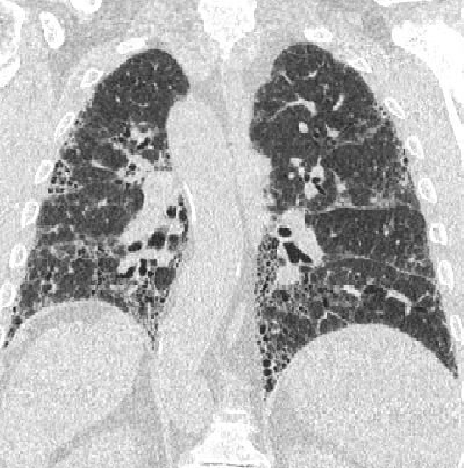
Coronal HRCT

Slide 19
Notes:
During the stops in the movie the presenter should point out a feature and ask the participants to identify it. If it’s controversial or unclear a show of hands can encourage the participants to engage.

Slide 24
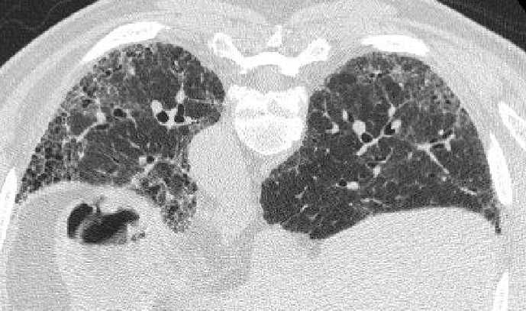
Honeycombing is not always black and white!

Slide 25
HRCT Criteria for UIP
 | UIP Pattern | Possible UIP Pattern
Subpleural, basal predominance | + | +
Reticular abnormality | + | +
Honeycombing (+/- traction bronchiectasis) | + | -
Absence of “inconsistent” features | + | +
Raghu G, et al, and the ATS/ERS/JRS/ALAT Committee on IPF. Am J Respir Crit Care Med. 2011;183:788-824

Slide 26
71-year-old Male with Progressive Cough
Respiratory Symptoms began over past year
Cough
Mild, intermittent chest burning/discomfort retrosternal
Past Medical/Social/Family History
Chronic sinusitis but otherwise healthy
No relevant exposures
60 pack/year history of smoking, quit 1995
Physical Exam
Normal except mild basilar crackles without wheeze or rhonchi
Pulmonary Function Testing
FEV₁ | 2.54 (89%)
FVC | 2.91 (69%)
FEV₁/FVC | 0.87
DL_{CO} | 14.89 (58%)
Notes:
This patient has IPF by CT but also has other comorbidity.
I think most of his cough, sputum and response to antibiotics reflects chronic bronchitis and exacerbations.
He has chest pain but no evaluation for CAD
Possibility of GERD
So for this case trying to get audience to think beyond IPF
H - 100437048

Slide 27
Diagnosis of IPF
No alternative cause of ILD (eg, environmental exposures, CTD, drug toxicity)
UIP pattern on HRCT
Surgical lung biopsy not necessary
Possible UIP pattern on HRCT with UIP on surgical lung biopsy (SLB)
SLB is not required for IPF diagnosis with HRCT finding of UIP
Raghu G, et al, and the ATS/ERS/JRS/ALAT Committee on IPF. Am J Respir Crit Care Med. 2011;183:788-824

Slide 28
What is your next step to establish James’ diagnosis?
Surgical lung biopsy
Transbronchial biopsy
Serologies (connective tissue disease, HP panel)
Referral to rheumatology
Diagnosis is clear, proceed to treatment

Slide 29
What is your next step to establish James’ diagnosis?
Surgical lung biopsy
Transbronchial biopsy
Serologies
Referral to rheumatology
Diagnosis is clear, proceed to treatment
His serologies were negative

Slide 30
What is your next step to establish James’ diagnosis?
Surgical lung biopsy
Transbronchial biopsy
Serologies (connective tissue disease, HP panel)
Referral to rheumatology
Diagnosis is clear, proceed to treatment

Slide 31
71-year-old Male with Progressive Cough
What is your final diagnosis?
Idiopathic Pulmonary Fibrosis
COPD – Chronic Bronchitis
Unstable Angina
GERD
Notes:
H - 100437048

Slide 32
Attempt to Identify the Cause if ILD
Step 1: Perform a detailed history and physical
Disease | Questions/findings
Drug/ Radiation-induced ILD | Chemotherapy, amiodarone, nitrofurantoin, other drugs; Check PneumoTox.com, Radiation therapy to the chest
Connective Tissue Disease-related ILD | Joints, skin, Raynaud’s reflex, dry eyes/mouth, muscle weakness or pain
Vasculitis | Sinus disease, hoarseness, hematuria, hemoptysis
Chronic Hypersensitivity Pneumonitis | Exposure to mold sources; Exposure to birds, down bedding, farming or agriculture
Pneumoconioses | Occupational history
Familial ILD | Family history of ILD, sarcoidosis, home oxygen use, autoimmune disease
Step 2: Order relevant blood tests
Step 3: Consider surgical lung biopsy
Disease | Blood tests
Eosinophilic pneumonia | CBC with differential
Sarcoidosis | Serum calcium
Scleroderma/MCTD | ANA, Scl70, centromere, U1RNP
Rheumatoid Arthritis | RF, CCP
Sjogren’s | ANA, Ro/SSA, La/SSB
Idiopathic inflammatory myositis | ANA, Jo-1, CK, myoglobin, aldolase, consider myositis panel
Vasculitis | Anti-PR3 and MPO (ANCA), creatinine
Chronic hypersensitivity Pneumonitis | HP panel (controversial)
CTD-ILD | ESR, CRP
Involve a multidisciplinary team at an ILD center to determine whether a surgical lung biopsy is required.
If a biopsy is performed, ask the surgeon to take multiple appropriately sized biopsies from 2-3 lobes (not just the lingual or middle lobe). Biopsy unaffected areas. Do not biopsy only the most severely affected area.
Have the biopsy reviewed by a pulmonary pathologist with expertise in ILD.
PFF Pocket Card, kindly provided by PFF.

Slide 33
Diagnostic Algorithm for IPF
Suspected IPF
Identifiable causes
for ILD?
Yes
No
HRCT
JAMES
Possible UIP
Inconsistent w/UIP
Surgical Lung Biopsy
Not UIP
UIP
UIP
Probable UIP
Non-classifiable fibrosis
MDD
IPF
Not IPF
Raghu G, et al, and the ATS/ERS/JRS/ALAT Committee on IPF. Am J Respir Crit Care Med. 2011;183:788-824

Slide 34
Diagnostic Paradigm
History
Environmental
Radiology
Serology
Pathology
Physical exam
IPF
Notes:
This diagnostic paradigm for IPF emphasizes the multidisciplinary nature of the process, as well as the opportunity for misdiagnosis if some of the stones are left unturned. Pathology, as seen in Maria’s case, is sometimes not required and is indicated in parentheses.

Slide 35
71-year-old Male with Progressive Cough
In addition to discussing participation in clinical trials/registries, how should his IPF be treated?
Close monitoring of PFTs and symptoms without pharmaceutical treatment
Recommend therapy with pirfenidone
Recommend therapy with nintedanib
Recommend therapy and discuss choice of nintedanib or pirfenidone with the patient
Notes:
H - 100437048

Slide 36
Treating James
Nintedanib
(Ofev)
Pirfenidone
(Esbriet)

Slide 37
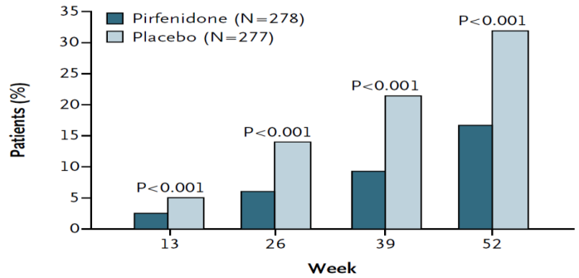
Primary ASCEND Endpoint Achieved
Primary Endpoint
Patients with ≥ 10% FVC Decline or Death (%)
48% Relative
Reduction
Week
King TE, et al. N Engl J Med. 2014;370(22):2083-2092.

Slide 38
Common ASCEND Adverse Events
Adverse Event | Pirfenidone (%) (N = 278) | Placebo (%) (N = 277) | Δ (%)
Nausea | 36 | 13.4 | 22.6
Rash | 28.1 | 8.7 | 19.4
Dyspepsia | 17.6 | 6.1 | 11.5
Anorexia | 15.8 | 6.5 | 9.3
GERD | 11.9 | 6.5 | 5.4
Weight Loss | 12.6 | 7.9 | 4.7
Insomnia | 11.2 | 6.5 | 4.7
Dizziness | 17.6 | 13 | 4.6
Vomiting | 12.9 | 8.7 | 4.2
… | … | … | …
Dyspnea | 14.7 | 17.7 | -3
Cough | 25.2 | 29.6 | -4.4
IPF | 9.4 | 18.1 | -8.7
King TE, et al. N Engl J Med. 2014;370(22):2083-2092.

Slide 39
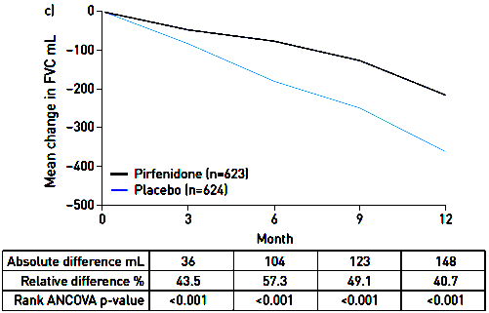
Update on Pirfenidone Efficacy: Change in FVC ASCEND + CAPACITY 1 + CAPACITY 2
Δ = 148 mL
P < 0.001
Noble PW, et al. Eur Respir J. 2016;47(1):243-253.

Slide 40
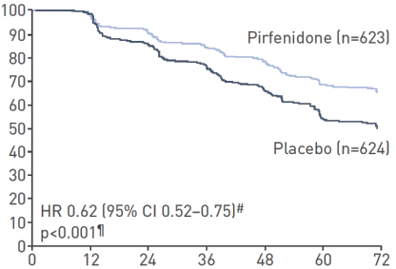
Update on Pirfenidone Efficacy: PFS ASCEND + CAPACITY 1 + CAPACITY 2
Patients, %
Week
Noble PW, et al. Eur Respir J. 2016;47(1):243-253.

Slide 41
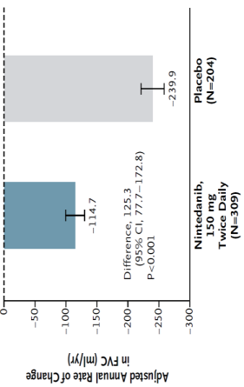
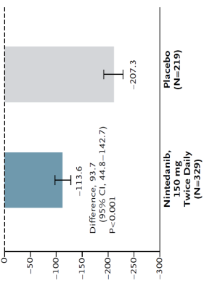
Primary INPULSIS Endpoint Achieved
Annual Rate of Change of FVC
INPULSIS-1
INPULSIS-2
52% Relative
Reduction
45% Relative
Reduction
Nintedanib Placebo
Richeldi L, et al. N Engl J Med. 2014;370(22):2071-2082.

Slide 42
Common INPULSIS Adverse Events
Event | INPULSIS-1 |  | INPULSIS-2
 | Nintedanib (n = 309) | Placebo (n = 204) | Nintedanib (n = 329) | Placebo (n = 219)
Any (%) | 96 | 89 | 94 | 90
Diarrhea (%) | 62 | 19 | 63 | 18
Nausea (%) | 23 | 6 | 26 | 7
Richeldi L, et al. N Engl J Med. 2014;370(22):2071-2082.

Slide 43
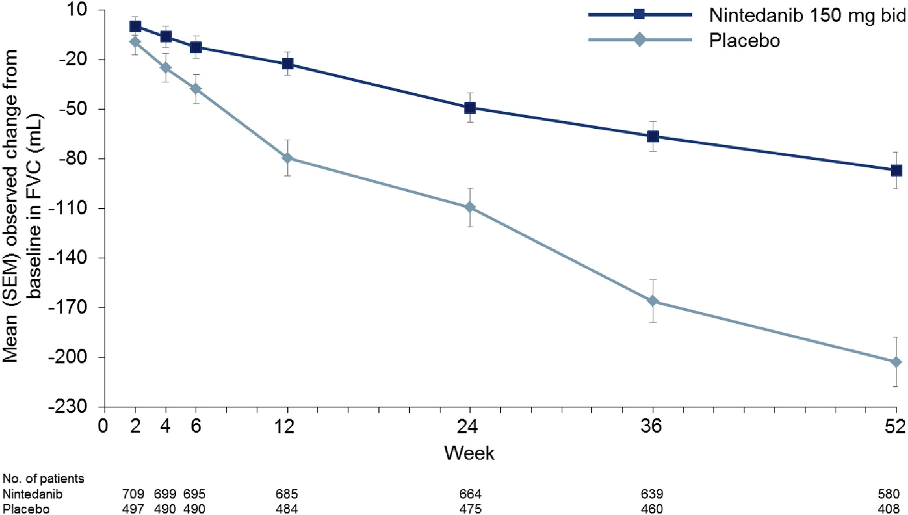
Update on Nintedanib Efficacy: Change in FVC TOMORROW + INPULSIS Trials
Δ = 111 mL/y
P < 0.0001
Richeldi L, et al. Respir Med. 2016;113:74-79.

Slide 44
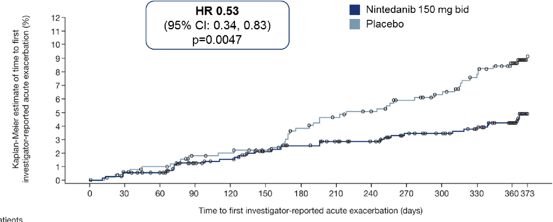
Update on Nintedanib Efficacy: PFS TOMORROW + INPULSIS Trials
Richeldi L, et al. Respir Med. 2016;113:74-79.

Slide 45
Shared Decision-Making With James
Physician
Drug Efficacy
Side Effects
Comorbidities
James
Preferences
Side Effect Tolerance

Slide 46
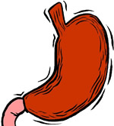
Which therapy would you recommend for James after seeing the evidence and exploring the patient’s preferences?
Physician and patient agreed on pirfenidone
Liver enzymes monitored monthly: normal
He experienced some indigestion with pirfenidone, especially when taken on empty stomach

Slide 47
What is the best way to address James’ GI symptoms?
Hold pirfenidone
Dose reduction protocol
Switch to nintedanib
Switch to prednisone
Switch to prednisone/NAC/azathioprine

Slide 48
Managing Pirfenidone Side Effects
Dose reduction protocol was used
Dose reduced
Instructed to take dose with food
Then titrated to therapeutic dose over 14 days
James reported no side effects after 3 months

Slide 49
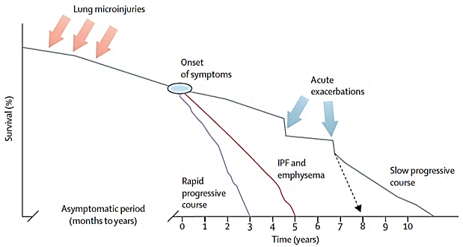
Episodes of More Acute Decline Punctuate Periods of Stability or Slower Decline
Episodes of acute decline, some of which may qualify as acute exacerbations
Survival (%)
King TE Jr, et al. Lancet. 2011;378(9807):1949-1961.

Slide 50
James Progresses
After 1 year PFTs decline:
FVC = 2.28 (54%, > 10% decline)
FEV₁ = 2.05 (72%)
HRCT shows progression
What is the best course for James?
Continue pirfenidone
Increase pirfenidone dose
Switch to nintedanib
Add NAC to pirfenidone

Slide 51
Pirfenidone Effect After FVC Decline 6 Months After FVC Decline ≥ 10%
 | Pirfenidone (N=34) | Placebo (N=68) | Δ | P-Value
≥ 10% decline in FVC or death | 2 (5.9%) | 19 (28%) | −79% | 0.009
No further decline in FVC | 20 (59%) | 26 (38%) | +54% | 0.059
Death | 1 (2.9%) | 14 (21%) | −86% | 0.018
Nathan SD, et al. Thorax. 2016;71(5):429-435.

Slide 52
IPF Management
Risk factor reduction
Smoking cessation
Healthy weight
Patient education
Advocacy group involvement
Focus on comorbidities
GERD, OSA, CAD, PH, VTE, etc.
Supplemental oxygen
Pulse oximeter
Consider nocturnal oximetry or polysomnography
Influenza and pneumococcal vaccination
Nintedanib or pirfenidone?
Pulmonary rehabilitation
Clinical trials
Lung transplant evaluation
Mental health needs
Support groups
Online resources
Address end-of-life issues
Palliative care
Hospice care
Living will

Slide 53
James Summary
Clinical and serologic features plus definite UIP on HRCT enabled definitive diagnosis without histology
Shared decision-making, recognizing comorbidities and patient preference led to choice of pirfenidone
Side effects managed with dose reduction and titration
IPF progressed despite therapy
Therapy was continued despite progression

Slide 54
Case 2: William

Slide 55
Presentation
63-year-old man
Cough for 2 years prior
Progressive breathlessness for 6 months prior
Initial evaluation in San Diego
Seen and diagnosed with allergies and post-nasal drip
Moved to Colorado, significant worsening of cough and breathlessness
Cough syncope
Can’t walk a flight of stairs
Came to you for diagnosis and therapy

Slide 56
History
PMHx
DJD of his knees
Recent diagnosis of OSA
GERD
No relevant exposures
No smoking history
Current medications
Hydrocodone/homatropine cough syrup

Slide 57
Physical Examination
BP = 123/72, HR = 63, RR = 16, SpO₂ = 91 % on room air at 5,280 feet elevation
Pertinent findings
Inspiratory crackles at bases bilaterally
No edema, clubbing, skin thickening, or rash
No joint deformities or evidence for synovitis

Slide 58
Data
TLC = 3.92 L (63%)
FVC = 2.85 L (65%)
FEV₁ = 2.54 L (78 %)
FEV₁/FVC = 89%
DL_{CO} = 21.14 (66 %)
DL/VA = 98 %

Slide 59
Coronal Images

Slide 60
Coronal Images

Slide 61
Coronal Images

Slide 62
Coronal Images

Slide 63
Coronal HRCT
IMPRESSION:
Relatively diffuse fibrosing interstitial pneumonia characterized by architectural distortion, fine reticular abnormality and lobular mosaicism. Cumulative findings suggest chronic fibrotic hypersensitivity pneumonitis as an underlying etiology. Other differentials would include drug reaction, collagen vascular disease and familial fibrosis
Central pulmonary artery prominence. Correlate for pulmonary hypertension
Coronary artery and aortic calcifications
Findings suggesting GERD
Notes:
I’ll have David help me load the entire scan

Slide 64
Axial HRCT

Slide 65
Axial HRCT

Slide 66
Axial HRCT

Slide 67
Axial HRCT

Slide 68
Axial HRCT

Slide 69
Axial HRCT

Slide 70
Axial HRCT

Slide 71
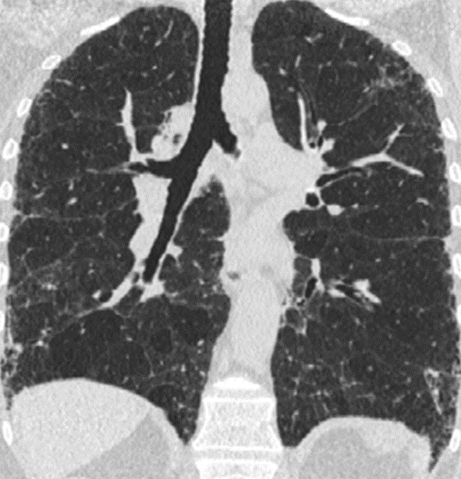
Air Trapping
Expiratory
Inspiratory

Slide 72
On the basis of these features, what is your rating of William’s UIP?
 | UIP Pattern | Possible UIP Pattern
Subpleural, basal predominance | + | +
Reticular abnormality | + | +
Honeycombing (+/- traction bronchiectasis) | + | -
Absence of “inconsistent” features | + | +
UIP
Possible UIP
Inconsistent with UIP

Slide 73
What is your next step to establish William’s diagnosis?
Surgical lung biopsy
Transbronchial biopsy
Serology
Referral to rheumatology
Diagnosis is clear, proceed to treatment
Negative

Slide 74
What is your next step to establish William’s diagnosis?
Surgical lung biopsy
Transbronchial biopsy
Serology
Referral to rheumatology
Diagnosis is clear, proceed to treatment

Slide 75
Diagnostic Algorithm for IPF
Suspected IPF
Identifiable causes
for ILD?
Yes
No
HRCT
Possible UIP
Inconsistent w/UIP
Surgical Lung Biopsy
Not UIP
UIP
UIP
Probable UIP
Non-classifiable fibrosis
MDD
IPF
Not IPF
Raghu G, et al, and the ATS/ERS/JRS/ALAT Committee on IPF. Am J Respir Crit Care Med. 2011;183:788-824

Slide 76
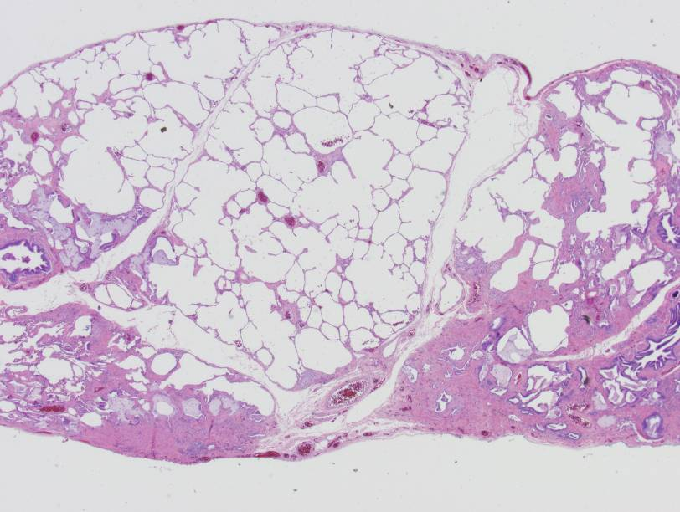
Histopathology
Normal Lung
Micro Honeycombing
THIS IS UIP
Temporal heterogeneity
Microscopic honeycombing
Dense subpleural pink scar
Fibroblast foci (at the edge of dense scar)
Fibroblast focus
Dense scar
Dense scar

Slide 77
Histopathology Summary
Lung, right upper, middle and lower lobe wedge biopsies
Patchy chronic fibrosing interstitial pneumonia associated with early honeycomb change
COMMENT:
Fibroblastic activity is seen occasionally in histologic sections from all lobes, the overall morphology is most consistent with usual interstitial pneumonia (UIP)
Notes:
Steve Groshong is getting me the pathology slides that indicated UIP.

Slide 78
Diagnosis of IPF by HRCT and Lung Biopsy
Histopathologic Pattern
 | UIP | Probable UIP | Possible UIP | Not UIP | Not performed
UIP | IPF | IPF | IPF | Not IPF | IPF
Possible UIP | IPF | IPF | +/- IPF | Not IPF | Not IPF
Inconsistent with UIP | +/- IPF | Not IPF | Not IPF | Not IPF | Not IPF
Radiologic Pattern
Raghu G, et al, and the ATS/ERS/JRS/ALAT Committee on IPF. Am J Respir Crit Care Med. 2011;183:788-824

Slide 79
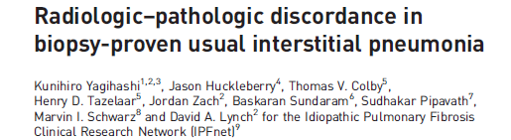
“Inconsistent” HRCT Scans are not Uncommon in Patients with IPF
241 cases of IPF (from the IPFnet)
Most common inconsistent finding was mosaicism (72%)
Yagihashi K, et al. Eur Respir J. 2016;47:1189-1197.
Notes:
Radiologic–pathologic discordance in
biopsy-proven usual interstitial pneumonia
Kunihiro Yagihashi1,2,3, Jason Huckleberry4, Thomas V. Colby5,
Henry D. Tazelaar5, Jordan Zach2, Baskaran Sundaram6, Sudhakar Pipavath7,
Marvin I. Schwarz8 and David A. Lynch2 for the Idiopathic Pulmonary Fibrosis
Clinical Research Network (IPFnet)9
ABSTRACT The aim of this study was to compare the clinical, radiological and histological findings in a
large population of subjects enrolled during a multicentre study of idiopathic pulmonary fibrosis, with a
focus on discordance between imaging and histologic diagnoses of usual interstitial pneumonia (UIP).
Two independent radiologists retrospectively reviewed 241 subjects who underwent high-resolution
computed tomography (HRCT) and surgical lung biopsies. HRCT findings were classified as UIP, possible
UIP and inconsistent with UIP. Histological findings were classified as definite, probable, possible and not
UIP.
Of the 241 cases, 102 (42.3%) had HRCT findings of UIP, 64 (26.6%) had possible UIP and 75 (31.1%)
were inconsistent with UIP. Among those with UIP on HRCT, 99 (97.1%) had histologically definite or
probable UIP (concordant group), and 71 (94.7%) of those with “inconsistent” HRCT features had
histologically definite or probable UIP (discordant group). Discordant subjects were slightly younger and
less likely to be smokers than concordant subjects, but no survival differences were identified.
In this population of patients enrolled with a diagnosis of idiopathic pulmonary fibrosis, 94.7% of those
with HRCT findings “inconsistent with UIP” demonstrated histological UIP. This suggests that the term
“inconsistent with UIP” is misleading.

Slide 80
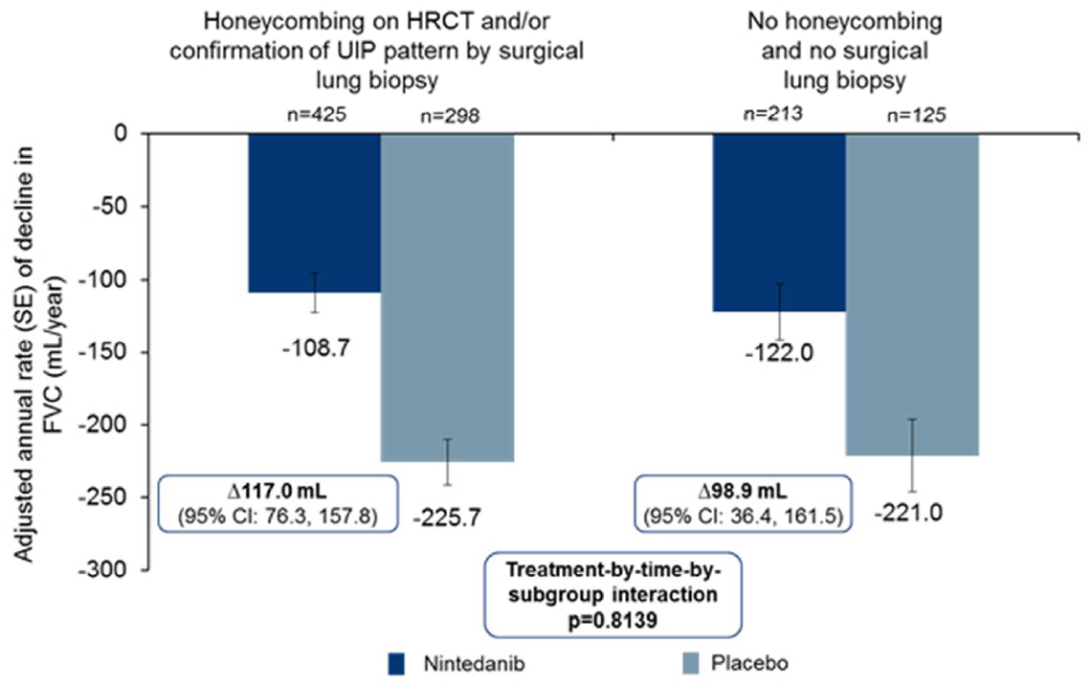
INPULSIS Analysis: Potential New Criteria for Diagnosis?
Raghu G, et al. Am J Respir Crit Care Med. 2016 Jun 22. [Epub ahead of print].
Notes:
Effect of Nintedanib in Subgroups of Idiopathic Pulmonary Fibrosis by Diagnostic Criteria.
Raghu G1, Wells AU2,3, Nicholson AG2,4, Richeldi L5, Flaherty KR6, Le Maulf F7, Stowasser S8, Schlenker-Herceg R9, Hansell DM
Am J Respir Crit Care Med. 2016 Jun 22. [Epub ahead of print]
What does this study add to the field?
• These are the first data to show that the progression of disease is the same in placebo-treated patients with IPF with features of possible UIP with traction bronchiectasis on HRCT as in patients with honeycombing on HRCT and/or confirmation of UIP by surgical lung biopsy.
• Nintedanib has a consistent treatment effect in patients diagnosed with IPF who have features of possible UIP with traction bronchiectasis on HRCT as in patients
who have honeycombing on HRCT and/or confirmation of UIP by surgical lung biopsy.
Abstract
Rationale: In the absence of a surgical lung biopsy, patients diagnosed with idiopathic
pulmonary fibrosis (IPF) in clinical practice could participate in the INPULSIS® trials of
nintedanib if they had honeycombing and/or traction bronchiectasis plus reticulation,
without atypical features of usual interstitial pneumonia (UIP), on high-resolution
computed tomography (HRCT). Thus the patients in these trials represented patients
with definite UIP and a large subgroup of patients with possible UIP.
Objective: We investigated the potential impact of diagnostic subgroups on the
progression of IPF and effect of nintedanib.
Methods: Post-hoc subgroup analysis of patients with honeycombing on HRCT and/or
confirmation of UIP by biopsy versus patients without either, using pooled data from the
INPULSIS® trials.
Measurements and main results: 723 (68.1%) patients had honeycombing and/or
biopsy and 338 (31.9%) had no honeycombing or biopsy. In these subgroups,
respectively, the adjusted annual rate of decline in forced vital capacity (FVC) in
patients treated with placebo was −225.7 mL/year and −221.0 mL/year, and the
nintedanib versus placebo difference in adjusted annual rate of decline in FVC was
117.0 mL/year (95% CI: 76.3, 157.8) and 98.9 mL/year (95% CI: 36.4, 161.5). There
was no significant treatment-by-subgroup interaction (p=0.8139). Adverse events were
similar between subgroups.
Conclusion: Patients with IPF diagnosed in clinical practice who have possible UIP
with traction bronchiectasis on HRCT and have not undergone surgical lung biopsy
have disease that progresses in a similar way, and responds similarly to nintedanib, as
patients with honeycombing on HRCT and/or confirmation of UIP by biopsy.

Slide 81
Shared Decision-Making With William
William
Preferences
Side Effect Tolerance
Lifestyle
Physician
Drug Efficacy
Side Effects
Comorbidities

Slide 82
Treating William
William expressed a preference for nintedanib
Regular sun exposure
Lower pill burden
Constipation
He was started on 150 mg 2x daily
After 3 weeks he complained of diarrhea

Slide 83
What is the best way to manage William’s diarrhea?
Hold nintedanib
Dose reduction protocol
Switch to pirfenidone
Switch to prednisone
Switch to prednisone/NAC/azathioprine

Slide 84
Treating William
Management
Dose reduced to 100 mg 2x daily with loperamide
Diarrhea subsided after 1 week
Dose escalated to 150 mg 2x daily after 2 weeks
Strategy was successful
No further side effects reported
No liver enzyme abnormalities

Slide 85
How often do you monitor patients with IPF after the initial medication period?
Every 3 months
Every 6 months
Every 12 months
Upon clinical worsening

Slide 86
Monitoring for Disease Progression
Every 3 months:
PFTs (at least FVC and DLCO)
6MWT (distance/nadir saturation)
O₂ requirement during activity
Comorbidities
Consider dyspnea questionnaire (UCSD)
Consider periodic overnight pulse oximetry to assess for nocturnal desaturation
HRCT
Upon suspicion of clinical worsening

Slide 87
At Each Visit…
Ask yourself and your patient:
Are we still comfortable with what we’re doing?
Assess quality of life, barriers
Side effects of medications
Should we change anything?
Are there data to support doing anything different?
Determine whether your patient is progressing
If unsure, bring them back in 6 weeks and get another data point

Slide 88
William Progresses Slowly
FVC continued to decline
12 months: 61 %
24 months: 56 %
HRCT shows progression
William reports that his SOB is “a little bit worse”
Important to manage patient expectations

Slide 89
William’s Summary
HRCT was inconsistent with UIP
SLB performed for diagnosis
Histology revealed UIP
Outdoor lifestyle, and patient preferences led to choice of nintedanib
GI side effects managed with dose reduction and loperamide
IPF progressed during therapy

Slide 90
Q & A
The 2 available therapies have similar efficacy. How can we decide between them?
How do we decide when to switch medications?
How can we distinguish between treatment failure and disease progression in an individual patient?
In what fraction of cases is the dose reduction protocol effective for each drug?

Slide 91
Conclusions
Diagnosis
Histology is sometimes necessary to establish diagnosis
Multidisciplinary team discussions lead to better diagnoses
Exclusion of other ILD causes is required: Thorough history, exam, serology, and proper HRCT protocol
Treatment decisions depend on patient factors and preferences: Shared Decision-Making
Side effects
Comorbidities
Lifestyle
Pirfenidone and nintedanib slow disease progression
Side effects are usually manageable
Disease progression is variable

Slide 92
Resources
Educational resources, including this slide deck
www.pilotforipf.org
Pulmonary Fibrosis Foundation, including patient registry
http://www.pulmonaryfibrosis.org/
Clinical trials
www.clinicaltrials.gov

Slide 93
Case 3: Theresa

Slide 94
Theresa Presentation
56-year-old woman
Presentation
Progressive shortness of breath on exertion for 6 months
Dry hacking cough for 3 months
Referred from primary care

Slide 95
Theresa: Workup
Medical History
Obesity
Depression
Obstructive sleep apnea
You suspect ILD and order an HRCT
Physical Exam
Resting SpO₂ 94% breathing room air
Bibasilar crackles
No clubbing
PFT Results
FVC = 1.64 L (48%)
FEV₁ = 1.40 L (51%)
FEV₁/FVC = 86%
DL_{CO} = 5.9 (22%)

Slide 96
Axial HRCT
Notes:
https://www.dropbox.com/sh/t7zvc9ylg7l9hr9/AAAWVmKsFymY-H4BRXnSOeCya?dl=0

Slide 97
Axial HRCT
Notes:
https://www.dropbox.com/sh/t7zvc9ylg7l9hr9/AAAWVmKsFymY-H4BRXnSOeCya?dl=0

Slide 98
Axial HRCT
Notes:
https://www.dropbox.com/sh/t7zvc9ylg7l9hr9/AAAWVmKsFymY-H4BRXnSOeCya?dl=0

Slide 99
Axial HRCT
Notes:
https://www.dropbox.com/sh/t7zvc9ylg7l9hr9/AAAWVmKsFymY-H4BRXnSOeCya?dl=0

Slide 100
Axial HRCT
Notes:
https://www.dropbox.com/sh/t7zvc9ylg7l9hr9/AAAWVmKsFymY-H4BRXnSOeCya?dl=0

Slide 101
Axial HRCT
Notes:
https://www.dropbox.com/sh/t7zvc9ylg7l9hr9/AAAWVmKsFymY-H4BRXnSOeCya?dl=0

Slide 102
Axial HRCT
Notes:
https://www.dropbox.com/sh/t7zvc9ylg7l9hr9/AAAWVmKsFymY-H4BRXnSOeCya?dl=0

Slide 103
Axial HRCT
Notes:
https://www.dropbox.com/sh/t7zvc9ylg7l9hr9/AAAWVmKsFymY-H4BRXnSOeCya?dl=0

Slide 104
Axial HRCT
Notes:
https://www.dropbox.com/sh/t7zvc9ylg7l9hr9/AAAWVmKsFymY-H4BRXnSOeCya?dl=0

Slide 105
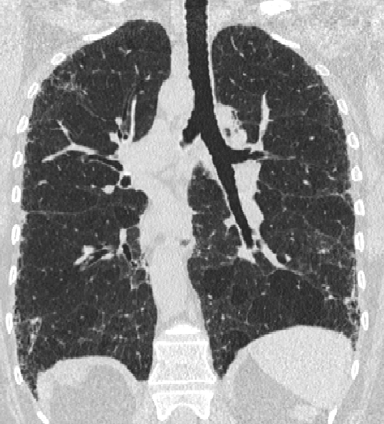

Slide 106
HRCT Criteria for UIP
 | UIP Pattern | Possible UIP Pattern
Subpleural, basal predominance | + | +
Reticular abnormality | + | +
Honeycombing (+/- traction bronchiectasis) | + | -
Absence of “inconsistent” features | + | +
Raghu G, et al, and the ATS/ERS/JRS/ALAT Committee on IPF. Am J Respir Crit Care Med. 2011;183:788-824

Slide 107
On the basis of all the information you have gathered, you diagnose IPF. What is the best treatment option?
Prednisone
NAC/prednisone/azathioprine
Nintedanib
Pirfenidone
Either nintedanib or pirfenidone, depending on patient preference

Slide 108
Treatment Decision
You use shared decision-making and prescribe nintedanib
Theresa returns after 3 months with increased SOB
On follow-up exam, you now hear inspiratory squeaks

Slide 109
What is your next step to refine Theresa’s diagnosis? (choose all that apply)
Expiratory HRCT
Detailed social, exposure, and medical history
Surgical lung biopsy
Serology for CTD
Diagnosis is clear, proceed to treatment

Slide 110
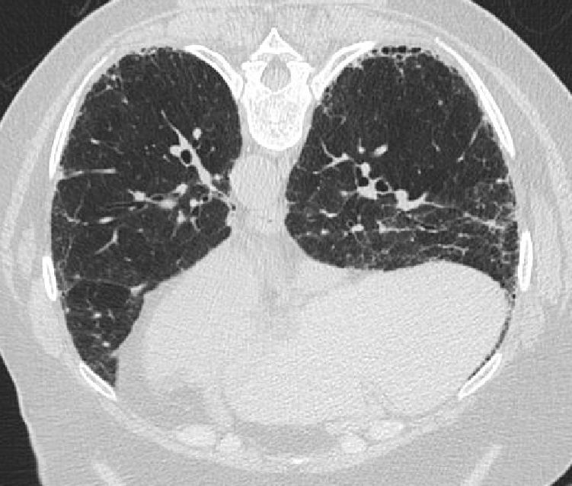
Expiratory
HRCT

Slide 111
Additional Findings
Expiratory HRCT reveals gas trapping
No birds in the home, but Theresa has worked as a volunteer in the local zoo aviary for 15 years
HP panel is positive for serum precipitants to pigeons
You change your diagnosis from IPF to chronic hypersensitivity pneumonitis

Slide 112
Theresa Summary
An inadequate clinical workup plus definite UIP on HRCT led to a wrong diagnosis of IPF
Several features were missed
Environmental (bird) exposure
Gas trapping on expiratory HRCT
Serologies
After a complete workup a correct diagnosis of chronic HP was made

