Slide 1
NAVIGATING the NEW ERA in IPF:
Pathophysiology and Recent Clinical Trials
FACULTY
Title
Affiliation

Slide 2
PILOT Learning Objectives
Summarize the current understanding of the IPF disease process and strategies that can help measure disease progression and treatment response
Identify approaches to IPF management that are covered in current guidelines, taking into account the strength of relevant recommendations
Evaluate clinical trial data on available and emerging treatments for IPF

Slide 3
Outline
Pathogenic model
Biomarkers
Review of clinical trials in IPF
2011 ATS/ERS treatment guidelines
Clinical trial update
Recent drug approvals!
Clinical trial issues
Conclusions

Slide 4
ILD Disease Progression
Exogenous and
Endogenous stimuli
Dust
Fumes
Cigarette smoke
Autoimmune conditions
Drugs
Infections-viruses
Radiation
Other diseases
Microscopic lung injury:
Separated spatially and temporally
Intact
Wound healing
Aberrant
Genetic
predisposition
Lung homeostasis
Interstitial lung disease
Steele MP, Schwartz DA. Annu Rev Med. 2013;64:265-276.
Notes:
Annu Rev Med. 2013;64:265-76. doi: 10.1146/annurev-med-042711-142004. Epub 2012 Sep 27.
Molecular mechanisms in progressive idiopathic pulmonary fibrosis.
Steele MP1, Schwartz DA.
Author information
Abstract
There is clear evidence that environmental exposures and genetic predisposition contribute to the pathogenesis of idiopathic pulmonary fibrosis (IPF). Cigarette smoking increases the risk of developing IPF several-fold, as do other exposures such as metal-fume and wood-dust exposure. Occupations that increase the risk of IPF are agricultural work, hairdressing, and stone polishing, supporting the role of environmental exposure in disease pathogenesis. Genetic predisposition to IPF is evident from its familial aggregation and the fact that pulmonary fibrosis develops in several rare genetic disorders. Mutations in surfactant proteins lead to pulmonary fibrosis and are associated with endoplasmic reticulum stress in alveolar type II epithelial cells. Mutations in telomerase have been found in several families with IPF, and shortened telomeres are found in sporadic cases of IPF. A common variant in mucin 5B predisposes to both familial and sporadic IPF and is present in the majority of cases, indicating sporadic IPF occurs in those with genetic predisposition.

Slide 5
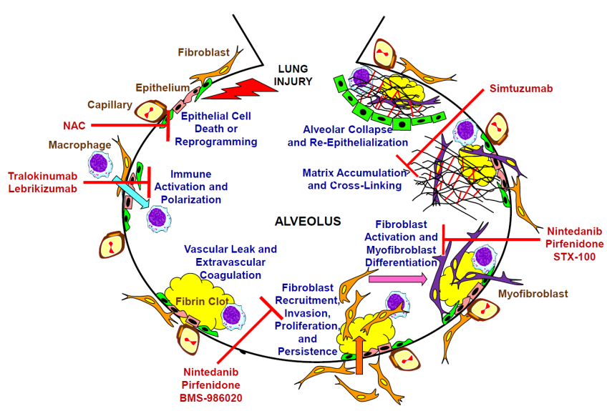
Linking IPF Pathogenesis to Potential Therapies
Ahluwalia N, et al. Am J Respir Crit Care Med. 2014 Aug 4. [Epub ahead of print].
Notes:
Am J Respir Crit Care Med. 2014 Aug 4. [Epub ahead of print]
New Therapeutic Targets in Idiopathic Pulmonary Fibrosis: Aiming to Rein in Runaway Wound Healing Responses.
Ahluwalia N¹, Shea BS, Tager AM.
Author information
Abstract
Idiopathic pulmonary fibrosis (IPF) is a devastating disease, with a median survival as short as 3 years from the time of diagnosis, and no pharmacological therapies yet approved by the US Food and Drug Administration (FDA). To address the great unmet need for effective IPF therapy, a number of new drugs have recently been, or are now being, evaluated in clinical trials. The rationales for most of these therapeutic candidates are based on the current paradigm of IPF pathogenesis, in which recurrent injury to the alveolar epithelium is thought to drive aberrant wound healing responses, resulting in fibrosis rather than repair. Here we discuss drugs in recently completed or currently ongoing Phase II and III IPF clinical trials in the context of their putative mechanisms of action, and the aberrant repair processes they are thought to target: innate immune activation and polarization, fibroblast accumulation and myofibroblast differentiation, or extracellular matrix deposition and stiffening. Placed in this context, the positive results of recently completed trials of pirfenidone and nintedanib, and results that will come from ongoing trials of other agents, should provide valuable insights into the still enigmatic pathogenesis of this disease, in addition to providing benefits to patients with IPF.
Figure Legend:
This schematic indicates the sequential pro-fibrotic processes implicated in the currently
prevailing paradigm of IPF pathogenesis, in which recurrent or persistent injury to the alveolar
epithelium is thought to drive aberrant wound healing responses, resulting in fibrosis rather than
repair (figure inspired by Selman M, King TE, Pardo A. Idiopathic pulmonary fibrosis: Prevailing and evolving
hypotheses about its pathogenesis and implications for therapy. Ann Intern Med 2001;134:136-
151.6). Drug candidates evaluated in recently completed or
ongoing Phase II and III clinical trials in IPF are placed in the context of the pro-fibrotic
process(es) they are thought to target. Although fibrosis in IPF appears to predominantly expand
the interstitial compartment, the aberrant repair processes driving IPF progression, and the
fibrosis they produce, may occur in both the interstitium and the airspaces. For purposes of
figure clarity, we have depicted the development of fibrosis in the airspaces in this figure.

Slide 6
Biomarkers for IPF
Candidates
  Serum CCL18
  LOXL2
  Telomerase
  Surfactant proteins A & D
  KL-6
  Matrix Metallo-Proteases (MMP1/MMP7)
  Circulating fibrocytes
  Clinical parameters
Pending validation
Not widely available
Prasse A, et al. Respirology. 2009;14:788-795.
Rosas IO, et al. PLoS Med. 2008;5:e93.
Notes:
Biomarkers for IPF
Surfactant proteins-A (SP-A) and -D (SP-D) are produced and secreted by type II cells. Serum SP-A and SP-D levels were significantly elevated in patients with IPF and systemic sclerosis compared to sarcoidosis, beryllium disease and normal controls, and the level of SP-D correlated with radiographic abnormalities in patients with IPF.¹ Serum SP-A and SP-D levels were highly predictive of survival in patients with IPF.
Circulating levels of glycoprotein KL-6 are elevated in a majority of patients with a number of ILDs, including IPF. Yokoyama et al² retrospectively compared the serum KL-6 level at IPF diagnosis with prognosis. Variables such as age, FVC%, PaO₂ at rest, initial LDH level, CRP and KL-6 were assessed. Multivariate analysis revealed that KL-6 was a predictor of prognosis. The median survival of patients with KL-6 < 1000 U/mL was more than 36 months, whereas that of patients with high KL-6 was only 18 months. The baseline level of the myeloid cell product CCL18 predicted changes in TLC and FVC at the 6-month follow-up.³
A search for plasma markers for IPF⁴ revealed a group of proteins that distinguish IPF. MMP7 and MMP1 concentrations were not increased in patients with COPD or sarcoidosis and were significantly (P < 0.01, P < 0.001, resp) higher in IPF compared to HP. MMP7 concentrations were significantly (P < 0.0001) higher in IPF patients compared to controls in an independent validation cohort. Furthermore, MMP7 concentrations were significantly (P < 0.02) elevated in patients with subclinical ILD and IPF (P < 0.02, P < 0.0001, resp); both predicted FVC% and DL_{CO}% were negatively correlated with MMP7 (P = 0.002).
Peripheral blood fibrocyte levels were higher in patients with IPF than in control subjects, and were highest in patients experiencing an exacerbation.⁵
These biomarkers are at the discovery phase and may become extremely useful after development and clinical validation.
Nakamura M, Ogura T, Miyazawa N, et al. Outcome of patients with acute exacerbation of idiopathic interstitial fibrosis (IPF) treated with sivelestat and the prognostic value of serum KL-6 and surfactant protein D. Nihon Kokyuki Gakkai Zasshi. 2007;45:455-459.
Yokoyama A, Kohno N, Hamada H, et al. Circulating KL-6 predicts the outcome of rapidly progressive idiopathic pulmonary fibrosis. Am J Respir Crit Care Med. 1998;158:1680-1684.
3. Prasse A, Probst C, Bargagli E, et al. Serum CC-chemokine ligand 18 concentration predicts outcome in idiopathic pulmonary fibrosis. Am J Respir Crit Care Med. 2009;179:717-723.
4. Rosas IO, Richards TJ, Konishi K, et al. MMP1 and MMP7 as potential peripheral blood biomarkers in idiopathic pulmonary fibrosis. PLoS Med. 2008;5:e93.
5. Moeller A, Gilpin SE, Ask K, et al. Circulating fibrocytes are an indicator of poor prognosis in idiopathic pulmonary fibrosis. Am J Respir Crit Care Med. 2009;179:588-594.

Slide 7
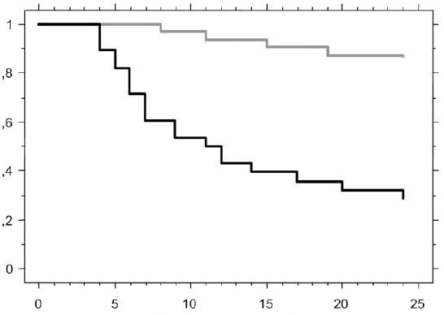
Elevated Baseline CCL18 Predicts Mortality
CCL18 < 150 ng/ml
P < 0.001
Cumulative Survival
CCL18 > 150 ng/ml
Time to Death (months)
Serum CC-Chemokine Ligand 18
Cut off of 150 ng/ml → HR = 7.63 (P < 0.0001)
Prasse A, et al. Am J Respir Crit Care Med. 2009;179:717-723.
Notes:
Elevated Baseline CCL18 Predicts Mortality
CCL18 is a human chemokine produced by alveolar macrophages which stimulates collagen production by lung fibroblasts. This prospective study tests the value of serum CCL18 concentrations in predicting the course of IPF. 72 patients were followed for 24 months; pulmonary function tests were performed at least every 6 months.
Baseline serum CCL18 concentrations correlated with the change in TLC and FVC at the 6-month follow-up (r = 0.59 and 0.54, respectively; each P < 0.0001).
ROC analysis indicates that a cutoff of 150 ng/ml yields the highest diagnostic accuracy. Kaplan-Meier survival analysis shows that patients with elevated CCL18 have higher mortality (graph) and shorter progression-free survival (data not shown, both P < 0.001). The hazard proportional ratio adjusted for age, sex, and baseline pulmonary function data was 8.0.
These data suggest that serum CCL18 may be a useful biomarker for predicting the disease course of IPF.
Prasse A, Probst C, Bargagli E, et al. Serum CC-chemokine ligand 18 concentration predicts outcome in idiopathic pulmonary fibrosis. Am J Respir Crit Care Med. 2009;179:717-723.

Slide 8
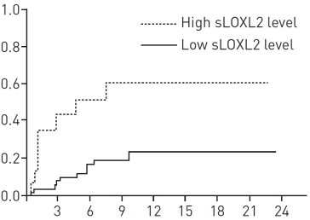
LOXL2 Biomarker: Target for Therapy?
Composite Disease Progression Endpoint
(ARTEMIS Cohort)*
Lysyl oxidase-like 2 (LOXL2) promotes cross-linking of collagen in pathological stroma
Association between sLOXL2 levels and IPF disease progression in 2 cohorts
Baseline sLOXL2 levels were not significantly correlated with FVC or DL_{CO}
Simtuzumab (humanized monoclonal, LOXL2 inhibitor) is in a phase 2 clinical trial
Cumulative Incidence Probability
Time Months
*Composite End-Point (time to first event)
Any cause mortality or
Respiratory hospitalization or
Decrease in lung function (FVC and DL_{CO} criteria)
Chien JW, et al. Eur Respir J. 2014;43(5):1430-1438.
Notes:
Eur Respir J. 2014 May;43(5):1430-8. doi: 10.1183/09031936.00141013. Epub 2013 Oct 31.
Serum lysyl oxidase-like 2 levels and idiopathic pulmonary fibrosis disease progression.
Chien JW1, Richards TJ, Gibson KF, Zhang Y, Lindell KO, Shao L, Lyman SK, Adamkewicz JI, Smith V, Kaminski N, O'Riordan T.
Author information
Abstract
We evaluated whether lysyl oxidase-like 2 (LOXL2), which promotes cross-linking of collagen in pathological stroma, was detectable in serum from idiopathic pulmonary fibrosis (IPF) patients, and assessed its relationship with IPF disease progression. Patients from the ARTEMIS-IPF (n=69) and the Genomic and Proteomic Analysis of Disease Progression in IPF (GAP) (n=104) studies were analysed. Baseline serum LOXL2 (sLOXL2) levels were compared with baseline clinical and physiological surrogates of disease severity, and the association with IPF disease progression was assessed using a classification and regression tree (CART) method. sLOXL2 correlated weakly with forced vital capacity and carbon monoxide diffusion capacity (r -0.24-0.05) in both cohorts. CART-determined thresholds were similar: ARTEMIS-IPF 800 pg·mL(-1) and GAP 700 pg·mL(-1). In ARTEMIS-IPF, higher sLOXL2 (>800 pg·mL(-1)) was associated with increased risk for disease progression (hazard ratio (HR) 5.41, 95% CI 1.65-17.73). Among GAP subjects with baseline spirometric data (n=70), higher sLOXL2 levels (>700 pg·mL(-1)) were associated with more disease progression events (HR 1.78, 95% CI 1.01-3.11). Among all GAP subjects, higher sLOXL2 levels were associated with increased risk for mortality (HR 2.28, 95% CI 1.18-4.38). These results suggest that higher sLOXL2 levels are associated with increased risk for IPF disease progression. However, due to multiple limitations, these results require validation.

Slide 9
Predictors of Disease Severity and Progression in IPF
TESTS/ CLINICAL FACTORS | PREDICTIVE VALUE
FVC | Initial value and change over time correlate with mortality
DL_{CO} | < 35% predicted → lower survival
6MWT | O₂ sat ≤ 88% → increased mortality risk for IPF & NSIP Walk distance correlates with mortality Heart rate recovery correlates with mortality
Pulmonary hypertension | Associated with higher mortality
Dyspnea score | Correlates with survival
Hospitalization | Predicts worse survival
Ley B, et al. Am J Respir Crit Care Med. 2011;183(4):431-440.
Notes:
Predictors of Disease Severity and Progression in IPF
This slide summarizes the predictive value of various clinical factors in the progression of IPF. Patients with compromised lung function or respiratory events have worse outcomes.

Slide 10
Predictors of Disease Severity and Progression in IPF
TESTS/ CLINICAL FACTORS | Study Inclusion Criteria | Study Endpoint
FVC | ✓ | ✓
DL_{CO} | ✓ | ✓
6MWT | ✓ | ✓
Pulmonary hypertension | ✓
Dyspnea score |  | ✓
Hospitalization |  | ✓
Nathan SD, Meyer KC. Curr Opin Pulm Med. 2014;20(5):463-471.
Notes:
Predictors of Disease Severity and Progression in IPF
This slide summarizes the predictive value of various clinical factors in the progression of IPF. Patients with compromised lung function or respiratory events have worse outcomes.

Slide 11
Diffusing Capacity Predicts Survival in IPF
DL_{co} ≥ 50%
DL_{co} 35-49%
Dl_{co} < 35%
Percent Survival
P=0.0001
Months
Nathan SD, et al. Chest. 2011;140:221-229.

Slide 12
FVC Predicts Survival in IPF
FVC ≥ 70%
FVC 55-69%
FVC < 55%
Percent Survival
P=0.0053
Months
Nathan SD, et al. Chest. 2011;140:221-229.

Slide 13
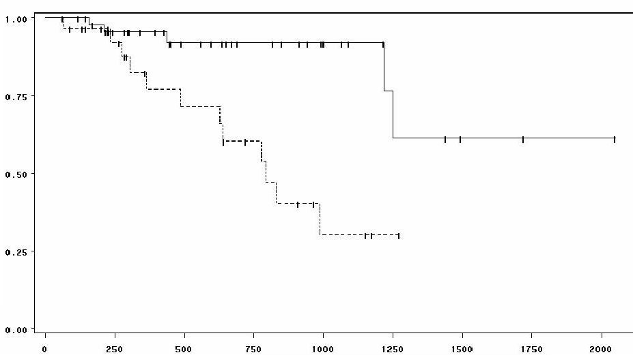
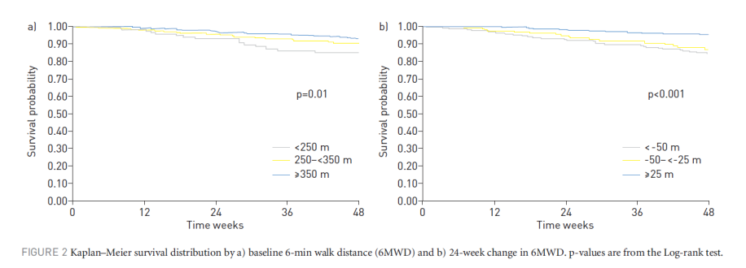
6MWT Parameters Predict Survival in IPF
P = 0.0007
Which 6MWT parameter
best predicts survival in IPF?
Δ > 13bpm
Survival Probability
HR 1 minute after 6MWT
≤ 13bpm
Days of Follow-Up
Baseline 6MWT distance
Δ 6MWT distance at 24 weeks
Survival Probability
P = 0.01
P < 0.001
Time Weeks
Time Weeks
du Bois RM, et al. Eur Respir J. 2014;43(5):1421-1429.
Swigris JJ, et al. Chest. 2009;136:841-848
Notes:
Eur Respir J. 2014 May;43(5):1421-9. doi: 10.1183/09031936.00131813. Epub 2013 Dec 5.
6-Minute walk distance is an independent predictor of mortality in patients with idiopathic pulmonary fibrosis.
du Bois RM1, Albera C, Bradford WZ, Costabel U, Leff JA, Noble PW, Sahn SA, Valeyre D, Weycker D, King TE Jr.
Author information
Abstract
6-min walk distance (6MWD) has recently been shown to be associated with the risk of mortality in patients with idiopathic pulmonary fibrosis (IPF); however, the independent contribution of 6MWD to the prediction of mortality risk has not been evaluated in a large, well-defined population of patients with IPF. A Cox proportional hazards model was used to characterise the relationship between risk factors of interest and all-cause mortality in IPF patients who completed a week 24 study visit in a clinical trial evaluating interferon γ-1b (n=748). Risk factors of interest included the independent predictors of mortality in the previously published clinical prediction model together with 6MWD and 24-week change in 6MWD. Baseline 6MWD <250 m was associated with a two-fold increase in the risk of mortality (hazard ratio 2.12, 95% CI 1.15-3.92) and a 24-week decline in 6MWD >50 m was associated with a nearly three-fold increase in mortality risk (hazard ratio 2.73; 95% CI 1.60-4.66). Inclusion of 6MWD data improved model discrimination compared with the original model (C-statistic 0.80 (95% CI 0.76-0.85) versus 0.75 (0.71-0.79)). Both 6MWD and change in 6MWD are independent predictors of mortality in patients with IPF. The addition of 6MWD to the clinical prediction model improves model discrimination compared with the original model.
Chest. 2009 Sep;136(3):841-8. doi: 10.1378/chest.09-0211. Epub 2009 Apr 24.
Heart rate recovery after 6-min walk test predicts survival in patients with idiopathic pulmonary fibrosis.
Swigris JJ1, Swick J, Wamboldt FS, Sprunger D, du Bois R, Fischer A, Cosgrove GP, Frankel SK, Fernandez-Perez ER, Kervitsky D, Brown KK.
Author information
Abstract
BACKGROUND:
In patients with idiopathic pulmonary fibrosis (IPF), our objectives were to identify predictors of abnormal heart rate recovery (HRR) at 1 min after completion of a 6-min walk test (6MWT) [HRR1] and 2 min after completion of a 6MWT (HRR2), and to determine whether abnormal HRR predicts mortality.
METHODS:
From 2003 to 2008, we identified IPF patients who had been evaluated at our center (n = 76) with a pulmonary physiologic examination and the 6MWT. We used logistic regression to identify predictors of abnormal HRR, the product-limit method to compare survival in the sample stratified on HRR, and Cox proportional hazards analysis to estimate the prognostic capability of abnormal HRR.
RESULTS:
Cutoff values were 13 beats for abnormal HRR1 and 22 beats for HRR2. In a multivariable model, predictors of abnormal HRR1 were diffusing capacity of the lung for carbon monoxide (odds ratio [OR], 0.4 per 10% predicted; 95% confidence interval [CI], 0.2 to 0.7; p = 0.003), change in heart rate from baseline to maximum (OR, 0.9; 95% CI, 0.8 to 0.97; p = 0.01), and having a right ventricular systolic pressure > 35 mm Hg as determined by transthoracic echocardiogram (OR, 12.7; 95% CI, 2.0 to 79.7; p = 0.01). Subjects with an abnormal HRR had significantly worse survival than subjects with a normal HRR (for HRR1, p = 0.0007 [log-rank test]; for HRR2, p = 0.03 [log-rank test]); these results held for the subgroup of 30 subjects without resting pulmonary hypertension (HRR1, p = 0.04 [log-rank test]). Among several candidate variables, abnormal HRR1 appeared to be the most potent predictor of mortality (hazard ratio, 5.2; 95% CI, 1.8 to 15.2; p = 0.004).
CONCLUSION:
Abnormal HRR after 6MWT predicts mortality in IPF patients. Research is needed to confirm these findings prospectively and to examine the mechanisms of HRR in IPF patients.

Slide 14
Pharmacologic Agents for IPF
ATS Statement
2011
Pre-ATS
Statement 2011
2011-2013
2014

Slide 15
Completed Trials for IPF:
Prior to 2011 Consensus Statement
ATS 2011
2014
2011-2013
Pre-2011
Trial | N | Primary Endpoint | Result
Interferon-beta (1999) | 167 | Progression-free survival time | Negative
Interferon-gamma (GIPF-001) | 330 | Progression-free survival | Negative
Interferon-gamma (Inspire) | 826 | Survival time | Negative
Pirfenidone (CAPACITY 1) | 344 | Change in FVC | Negative
Pirfenidone (CAPACITY 2) | 435 | Change in FVC | Positive
Pirfenidone (Ogura) | 275 | Change in FVC | Positive
Etanercept | 100 | Change in DL_{co}, FVC | Negative
Imatinib Mesylate | 120 | Progression-free survival | Negative
Bosentan (BUILD 1 and 2) | 132 | Change in 6MW | Negative
Bosentan (BUILD 3) | 390 | Progression-free survival time | Negative
Anticoagulation | 56 | Survival | Positive
N-acetylcysteine (NAC) (IFIGENIA) | 184 | Change in FVC, DL_{co} | Positive
Sildenafil (STEP) | 29 | Change in 6MWD, Borg dyspnea index | Negative
Subsequent trials showed that warfarin and NAC/azathioprine/prednisone should not be used for IPF
Noth I, et al. Am J Respir Crit Care Med. 2012;186(1):88-95.
Notes:
15
Completed Trials for IPF
An increasing number of trials have been completed for IPF. Though valuable new data have been extracted about the disease, the trials have been largely negative and the yield of therapeutic options has been disappointing.
The trials have been diverse in the primary endpoint, highlighting uncertainty about whether to rely on a clinical outcome such as mortality or physical function or a surrogate marker of pulmonary health such as FVC.

Slide 16
2011 Guidelines on
Management of IPF
ATS 2011
2014
Pre-2011
2011-2013
Treatment | Strong For | Weak For | Weak Against | Strong Against
Corticosteroid |  |  |  | X
Colchicine |  |  |  | X
Cyclosporine A |  |  |  | X
Interferon γ 1b |  |  |  | X
Bosentan |  |  |  | X
Etanercept |  |  |  | X
NAC/Azathioprine/Prednisone |  |  | X
NAC |  |  | X
Anticoagulation |  |  | X
Pirfenidone |  |  | X
Mechanical ventilation |  |  | X
Pulmonary rehab |  | X
Long-term oxygen | X
Lung transplantation | X
Notes:
Weak For: should be used in the majority of patients with IPF, but not using may be a reasonable choice in a minority
Weak Against: should not be used in the majority of patients with IPF, but may be a reasonable choice in a minority
Raghu G, et al. Am J Respir Crit Care Med. 2011;183:788-824
An Official ATS/ERS/JRS/ALAT Statement: Idiopathic Pulmonary Fibrosis: Evidence-based Guidelines for
Diagnosis and Management
Ganesh Raghu, Harold R. Collard, Jim J. Egan, Fernando J. Martinez, Juergen Behr, Kevin K. Brown,
Thomas V. Colby, Jean-Francxois Cordier, Kevin R. Flaherty, Joseph A. Lasky, David A. Lynch, Jay H. Ryu,
Jeffrey J. Swigris, Athol U. Wells, Julio Ancochea, Demosthenes Bouros, Carlos Carvalho, Ulrich Costabel,
Masahito Ebina, David M. Hansell, Takeshi Johkoh, Dong Soon Kim, Talmadge E. King, Jr., Yasuhiro Kondoh, Jeffrey Myers, Nestor L. Mu¨ller, Andrew G. Nicholson, Luca Richeldi, Moise´s Selman, Rosalind F. Dudden, Barbara S. Griss, Shandra L. Protzko, and Holger J. Schu¨nemann, on behalf of the ATS/ERS/JRS/ALAT Committee on Idiopathic Pulmonary Fibrosis
THIS OFFICIAL STATEMENT OF THE AMERICAN THORACIC SOCIETY (ATS), THE EUROPEAN RESPIRATORY SOCIETY (ERS), THE JAPANESE
RESPIRATORY SOCIETY (JRS), AND THE LATIN AMERICAN THORACIC ASSOCIATION (ALAT) WAS APPROVED BY THE ATS BOARD OF
DIRECTORS, NOVEMBER 2010, THE ERS EXECUTIVE COMMITTEE, SEPTEMBER 2010, THE JRS BOARD OF DIRECTORS, DECEMBER 2010, AND
THE ALAT EXECUTIVE COMMITTEE, NOVEMBER 2010
THIS STATEMENT HAS BEEN FORMALLY ENDORSED BY THE SOCIETY OF THORACIC RADIOLOGY AND BY THE PULMONARY PATHOLOGY SOCIETY

Slide 17
ATS 2011
2014
Pre-2011
2011-2013
Trials for IPF Stopped Early
Trial | N | Primary Endpoint | Result
Pirfenidone (Azuma) | 107 | Exercise gas exchange | Stopped +
Ambrisentan (Artemis-IPF) | 478 | Progression-free survival | Stopped -
Ambrisentan (Artemis-PH) | 50 | 6MWD | Stopped -
Warfarin (ACE study) | 145/256 | Death/hospitalization/∆10%FVC | Stopped -
Prednisone, Azathioprine, NAC (PANTHER) | 155* | ∆FVC | One arm stopped -
*number in placebo and triple therapy arms when latter arm halted

Slide 18
ATS 2011
2014
Pre-2011
2011-2013
Other Completed Trials
for IPF (2011-2013)
Trial | N | Primary Endpoint | Result
Macitentan |  | FVC | Negative
BIBF 1120 (nintedanib) | 432 | FVC | Trend (P = 0.06)
Everolimus | 89 | Progression | Negative
Co-trimoxazole | 181 | FVC | Negative, but QOL↑ Mortality 3/53 vs 14/65 (P = 0.02)

Slide 19
3 Clinical Trials Presented at ATS 2014
ATS 2011
2014
Pre-2011
2011-2013
PANTHER N-acetylcysteine (NAC)
ASCEND pirfenidone
INPULSIS nintedanib (BIBF1120)

Slide 20
PANTHER
N-acetylcysteine (NAC)

Slide 21
Possible NAC Mechanisms of Action
Increase glutathione→ antioxidation
Downregulate lysyl oxidase (LOX) activity, (essential for collagen deposition)
Li S, et al. Respiration. 2012;84(6):509-517.
Rushworth GF, et al. Pharmacol Ther. 2014;141(2):150-159.
Notes:
Respiration. 2012;84(6):509-17. doi: 10.1159/000340041. Epub 2012 Sep 20.
N-acetylcysteine downregulation of lysyl oxidase activity alleviating bleomycin-induced pulmonary fibrosis in rats.
Li S1, Yang X, Li W, Li J, Su X, Chen L, Yan G.
Idiopathic pulmonary fibrosis (IPF) is a progressive and fatal lung disease without beneficial therapy, except for lung transplantation. A high oral dose of N-acetylcysteine (NAC) added to prednisone and azathioprine has been found to improve lung function in IPF patients, though the mechanism of action remains poorly understood.
OBJECTIVE:
Based on our previous findings showing elevation of glutathione (GSH) content associated with downregulation of lysyl oxidase (LOX) activity, which is essential for collagen deposition, the aim of the present study was to test the hypothesis that NAC alleviates IPF by regulating LOX function.
METHODS:
We firstly analyzed the time course of collagen deposition in lung tissue, hydroxyproline content, LOX activity, GSH levels, and transforming growth factor-β(1) (TGF-β(1)) and α-smooth muscle actin (α-SMA) expression in bleomycin (BLM)-induced pulmonary fibrosis in a rat model. Then, we focused our studies on NAC modulation of LOX activity.
RESULTS:
LOX activity was increased on day 9 and peaked 14 days after BLM administration, while TGF-β(1) protein peaked on day 9. Interestingly, NAC treatment for 14 days from day 0 reversed LOX activity to normal levels and increased GSH levels in the lung of BLM-dosed rats. Consistently, NAC partially attenuated pulmonary fibrosis and inhibited TGF-β(1) and α-SMA expression in this model.
CONCLUSIONS:
Our study supports a novel mechanism of NAC alleviating IPF by inhibition of LOX activity via elevation of lung GSH in BLM-induced pulmonary fibrosis. The TGF-β(1)/α-SMA pathway may also play an important role in modulation of LOX activity

Slide 22
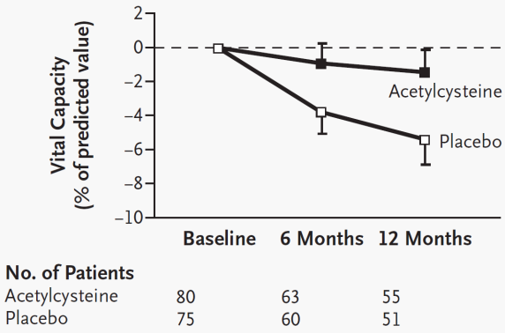
Early Evidence for a NAC Cocktail
ATS 2011
2014
Pre-2011
2011-2013
+ azathioprine + steroids
Acetylcysteine + azathioprine + steroids
Placebo + azathioprine + steroids
+ azathioprine + steroids
Demedts M, et al. New Engl J Med. 2005;353:2229-2242.

Slide 23
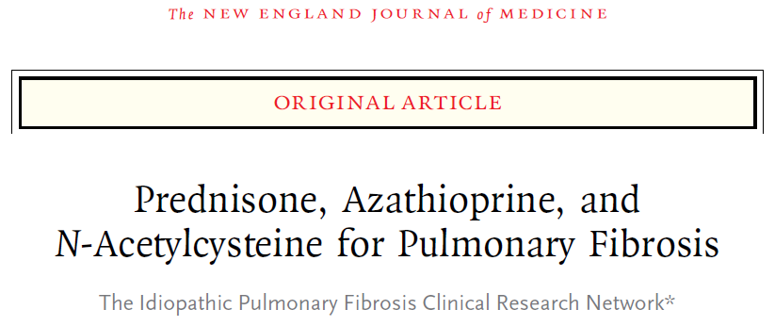
ATS 2011
PANTHER 2012
2014
Pre-2011
2011-2013
Raghu G, et al. N Engl J Med. 2012;366:1968-1977.
Notes:
Background
Acetylcysteine has been suggested as a beneficial treatment for idiopathic pulmonary
fibrosis, although data from placebo-controlled studies are lacking.
Methods
In our initial double-blind, placebo-controlled trial, we randomly assigned patients
who had idiopathic pulmonary fibrosis with mild-to-moderate impairment in pulmonary
function to receive a three-drug regimen of prednisone, azathioprine, and
acetylcysteine; acetylcysteine alone; or placebo. The study was interrupted owing to
safety concerns associated with the three-drug regimen. The trial continued as
a two-group study (acetylcysteine vs. placebo) without other changes; 133 and
131 patients were enrolled in the acetylcysteine and placebo groups, respectively.
The primary outcome was the change in forced vital capacity (FVC) over a 60-week
period.
Results
At 60 weeks, there was no significant difference in the change in FVC between the
acetylcysteine group and the placebo group (−0.18 liters and −0.19 liters, respectively;
P = 0.77). In addition, there were no significant differences between the acetylcysteine
group and the placebo group in the rates of death (4.9% vs. 2.5%, P = 0.30 by the
log-rank test) or acute exacerbation (2.3% in each group, P>0.99).
Conclusions
As compared with placebo, acetylcysteine offered no significant benefit with respect
to the preservation of FVC in patients with idiopathic pulmonary fibrosis with mildto-
moderate impairment in lung function. (Funded by the National Heart, Lung,
and Blood Institute and others; ClinicalTrials.gov number, NCT00650091.)

Slide 24
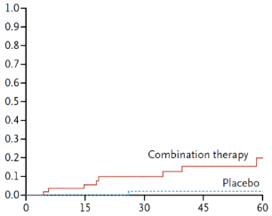
PANTHER 2012 Interim Results
ATS 2011
2014
Pre-2011
2011-2013
Primary | Triple Therapy | Placebo | P-value
FVC (liters) | -0.24 | -0.23 | 0.85
Time to Death
Kaplan–Meier Analysis
Triple therapy has no benefit for FVC
Increased risk of death
HR 9.26
(95% CI 1.16-74.1)
P = 0.01
Probability
Weeks Since Randomization
Raghu G, et al. N Engl J Med. 2012;366:1968-1977.

Slide 25
PANTHER 2012 Adverse Events
ATS 2011
2014
Pre-2011
2011-2013
Triple therapy has higher incidence of adverse events than placebo
P-values < 0.05
Percentage
P-value for each comparison < 0.05
Raghu G, et al. N Engl J Med. 2012;366:1968-1977.
IPFNet writing committee. N Engl J Med 2012;366;1968-77.

Slide 26
PANTHER 2012 Conclusions
“Increased risks of death and hospitalization were observed in patients with IPF who were treated with a combination of prednisone, azathioprine, and NAC, as compared with placebo.”
  Compelling evidence against the use of the triple combination for patients with mild-to-moderate IPF
Next steps
  Combination arm terminated
  Two arms of study continued (NAC vs placebo)
Raghu G, et al. N Engl J Med. 2012;366:1968-1977.

Slide 27
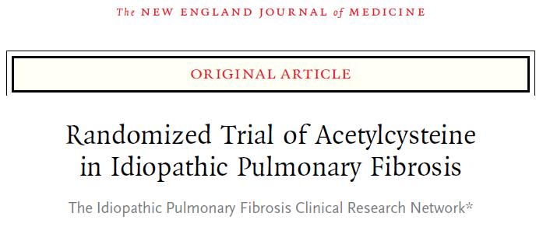
ATS 2011
PANTHER 2014
2014
Pre-2011
2011-2013
Martinez FJ, et al. N Engl J Med. 2014;370(22):2093-2101.
Notes:
Background
Acetylcysteine has been suggested as a beneficial treatment for idiopathic pulmonary
fibrosis, although data from placebo-controlled studies are lacking.
Methods
In our initial double-blind, placebo-controlled trial, we randomly assigned patients
who had idiopathic pulmonary fibrosis with mild-to-moderate impairment in pulmonary
function to receive a three-drug regimen of prednisone, azathioprine, and
acetylcysteine; acetylcysteine alone; or placebo. The study was interrupted owing to
safety concerns associated with the three-drug regimen. The trial continued as
a two-group study (acetylcysteine vs. placebo) without other changes; 133 and
131 patients were enrolled in the acetylcysteine and placebo groups, respectively.
The primary outcome was the change in forced vital capacity (FVC) over a 60-week
period.
Results
At 60 weeks, there was no significant difference in the change in FVC between the
acetylcysteine group and the placebo group (−0.18 liters and −0.19 liters, respectively;
P = 0.77). In addition, there were no significant differences between the acetylcysteine
group and the placebo group in the rates of death (4.9% vs. 2.5%, P = 0.30 by the
log-rank test) or acute exacerbation (2.3% in each group, P>0.99).
Conclusions
As compared with placebo, acetylcysteine offered no significant benefit with respect
to the preservation of FVC in patients with idiopathic pulmonary fibrosis with mildto-
moderate impairment in lung function. (Funded by the National Heart, Lung,
and Blood Institute and others; ClinicalTrials.gov number, NCT00650091.)

Slide 28
PANTHER Study Design
Subjects: 264 patients with IPF (2 arm continuation of PANTHER-IPF)
Treatment: acetylcysteine (600 mg) or placebo 3 times daily
Duration: 60 weeks
Primary end point: change in FVC
Secondary end points
  Time to the first acute exacerbation
  Change from baseline in the total score on the St. George’s Respiratory Questionnaire
Martinez FJ, et al. N Engl J Med. 2014;370(22):2093-2101.

Slide 29
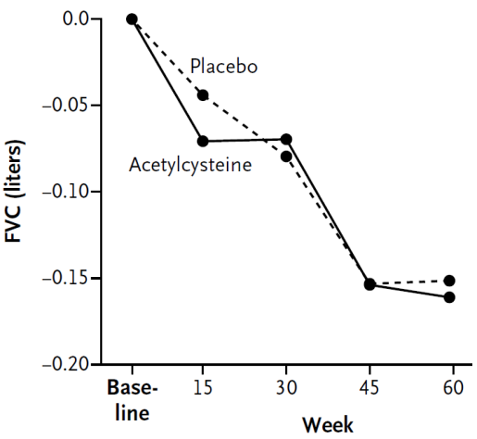
NAC Does Not Reduce FVC Decline
Martinez FJ, et al. N Engl J Med. 2014;370(22):2093-2101.

Slide 30
PANTHER Summary
Endpoint | NAC | Placebo | P-value
ΔFVC (liters) | −0.18 | −0.19 | 0.77
Rate of Death | 4.9% | 2.5% | 0.30
Acute Exacerbation | 2.3% | 2.3% | >0.99
Conclusion: NAC offered no significant benefit with respect to the preservation of FVC in patients with IPF with mild-to-moderate impairment in lung function
Martinez FJ, et al. N Engl J Med. 2014;370(22):2093-2101.

Slide 31
ASCEND
Pirfenidone

Slide 32
Possible Mechanisms of Pirfenidone Action
Antifibrotic
Molecular target unclear
Active in several animal models of fibrosis (lung,
liver, kidney)
Pirfenidone
  TNF-α
  IL-6
  TGF-β
  IL-6
  MMPs
  Collagenases
ROIs
  Collagen
Hilberg O, et al. Clin Respir J. 2012;6:131-143.

Slide 33
Early Pirfenidone Results
ATS 2011
2014
2011-2013
Pre-2011
Pirfenidone
(2 Doses)
Progression-Free Survival
Placebo
Time Days
 | Δ FVC at 52 weeks
1800 mg | -0.09
1200 mg | -0.08
placebo | -0.16
P = 0.04 vs placebo
Taniguchi H, et al. Eur Respir J. 2010;35:821-829.
Notes:
Pirfenidone in idiopathic pulmonary fibrosis
H. Taniguchi*, M. Ebina#, Y. Kondoh*, T. Ogura", A. Azuma+, M. Suga1, Y. Taguchie,
H. Takahashi**, K. Nakata##, A. Sato"", M. Takeuchi++, G. Raghu11, S. Kudoh+ and
T. Nukiwa#, and the Pirfenidone Clinical Study Group in Japan
ABSTRACT: Idiopathic pulmonary fibrosis (IPF) is a progressive lung disease without proven
effective therapy.
A multicentre, double-blind, placebo-controlled, randomised phase III clinical trial was
conducted in Japanese patients with well-defined IPF to determine the efficacy and safety of
pirfenidone, a novel antifibrotic oral agent, over 52 weeks. Of 275 patients randomised (high-dose,
1,800 mg?day-1; low-dose, 1,200 mg?day-1; or placebo groups in the ratio 2:1:2), 267 patients were
evaluated for the efficacy of pirfenidone. Prior to unblinding, the primary end-point was revised;
the change in vital capacity (VC) was assessed at week 52. Secondary end-points included the
progression-free survival (PFS) time.
Significant differences were observed in VC decline (primary end-point) between the placebo
group (-0.16 L) and the high-dose group (-0.09 L) (p50.0416); differences between the two groups
(p50.0280) were also observed in the PFS (the secondary end-point). Although photosensitivity, a
well-established side-effect of pirfenidone, was the major adverse event in this study, it was mild
in severity in most of the patients.
Pirfenidone was relatively well tolerated in patients with IPF. Treatment with pirfenidone may
decrease the rate of decline in VC and may increase the PFS time over 52 weeks. Additional
studies are needed to confirm these findings.
Shionogi corporate R&D report released 3/22/07. Available at: http://www.shionogi.co.jp/ir_en/explanatory/pdf/e_p070322.pdf. Accessed May 2007.

Slide 34
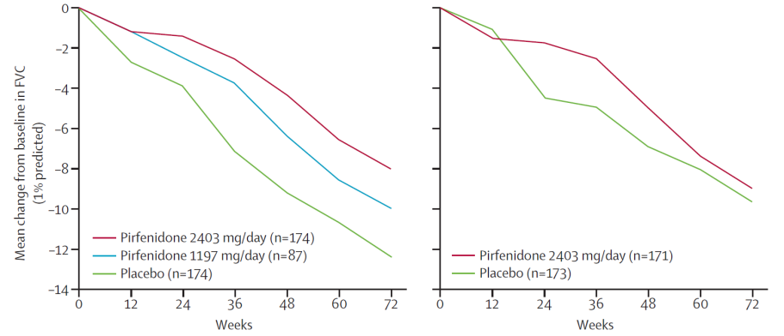
CAPACITY 2011
ATS 2011
2014
Pre-2011
2011-2013
CAPACITY-2
CAPACITY-1
One pirfenidone trial was positive, one was negative
CAPACITY-1 placebo group FVC declined more slowly than expected
Noble P, et al. Lancet. 2011;377:1760-1769.

Slide 35
CAPACITY Endpoints
Endpoint | CAPACITY-2 | CAPACITY-1
FVC | ✓ | X
Overall survival | X | X
Progression-free survival | ✓ | X
Six-minute walk distance | X | ✓
DL_{CO} | X | X
Dyspnea | X | X
Exertional desaturation | X | X
Noble P, et al. Lancet. 2011;377:1760-1769.

Slide 36
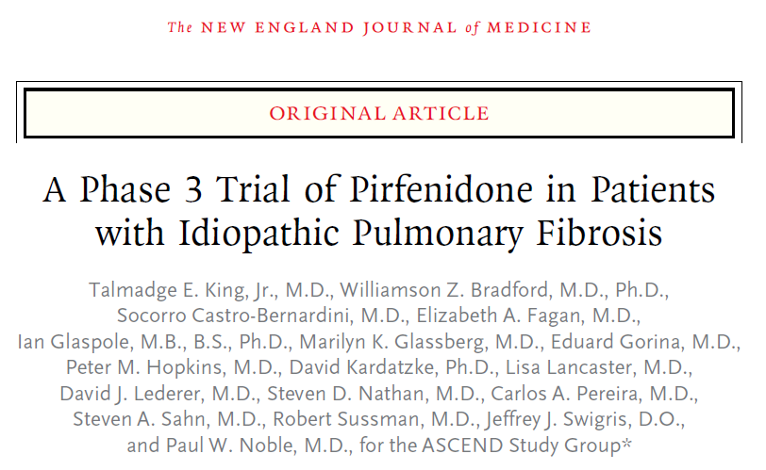
ATS 2011
ASCEND 2014
2014
Pre-2011
2011-2013
Notes:
Background
In two of three phase 3 trials, pirfenidone, an oral antifibrotic therapy, reduced
disease progression, as measured by the decline in forced vital capacity (FVC) or
vital capacity, in patients with idiopathic pulmonary fibrosis; in the third trial, this
end point was not achieved. We sought to confirm the beneficial effect of pirfenidone
on disease progression in such patients.
Methods
In this phase 3 study, we randomly assigned 555 patients with idiopathic pulmonary
fibrosis to receive either oral pirfenidone (2403 mg per day) or placebo for 52 weeks.
The primary end point was the change in FVC or death at week 52. Secondary end
points were the 6-minute walk distance, progression-free survival, dyspnea, and death
from any cause or from idiopathic pulmonary fibrosis.
Results
In the pirfenidone group, as compared with the placebo group, there was a relative
reduction of 47.9% in the proportion of patients who had an absolute decline of
10 percentage points or more in the percentage of the predicted FVC or who died;
there was also a relative increase of 132.5% in the proportion of patients with no
decline in FVC (P<0.001). Pirfenidone reduced the decline in the 6-minute walk
distance (P = 0.04) and improved progression-free survival (P<0.001). There was no
significant between-group difference in dyspnea scores (P = 0.16) or in rates of death
from any cause (P = 0.10) or from idiopathic pulmonary fibrosis (P = 0.23). However,
in a prespecified pooled analysis incorporating results from two previous phase 3
trials, the between-group difference favoring pirfenidone was significant for death
from any cause (P = 0.01) and from idiopathic pulmonary fibrosis (P = 0.006). Gastrointestinal
and skin-related adverse events were more common in the pirfenidone
group than in the placebo group but rarely led to treatment discontinuation.
Conclusions
Pirfenidone, as compared with placebo, reduced disease progression, as reflected
by lung function, exercise tolerance, and progression-free survival, in patients with
idiopathic pulmonary fibrosis. Treatment was associated with an acceptable sideeffect
profile and fewer deaths. (Funded by InterMune; ASCEND ClinicalTrials.gov
number, NCT01366209.)

Slide 37
ASCEND Study Design
52 Weeks
Inclusion Criteria
Age 40-80
Confirmed IPF
50 - 90% FVC pred
30 - 90% DL_{CO} pred
FEV₁/FVC ≥ 0.80
6-MWD ≥ 150 m
Endpoints
1⁰: Δ FVC or death
2⁰: 6-MWD
PFS
Dyspnea
Death
Oral Pirfenidone
2403 mg Daily
Placebo
555 Patients
  PFS - Progression-free survival
King TE, et al. N Engl J Med. 2014;370(22):2083-2092.

Slide 38
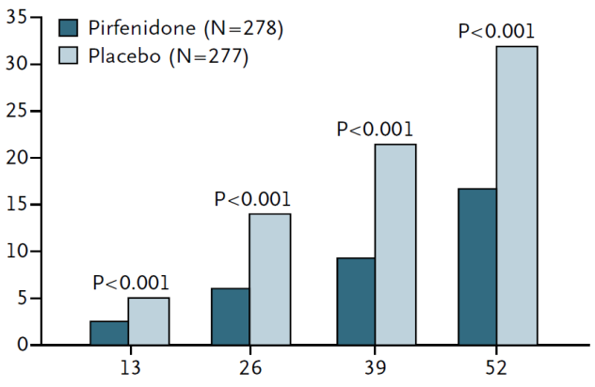
Primary ASCEND Endpoint Achieved
Primary Endpoint
Patients with ≥ 10% FVC Decline or Death (%)
48% Relative
Reduction
Week
King TE, et al. N Engl J Med. 2014;370(22):2083-2092.

Slide 39
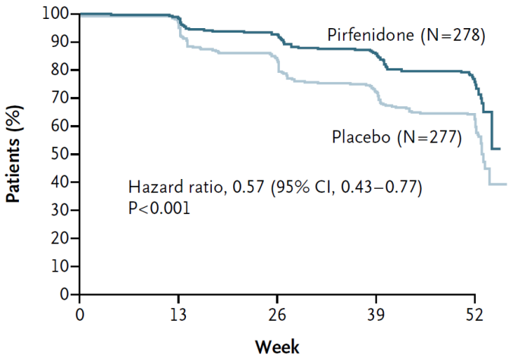
Pirfenidone Increased
Progression-Free Survival*
*Progression is first occurrence of death, 10% ↓ FVC, or 50 m ↓ 6MWD
King TE, et al. N Engl J Med. 2014;370(22):2083-2092.

Slide 40
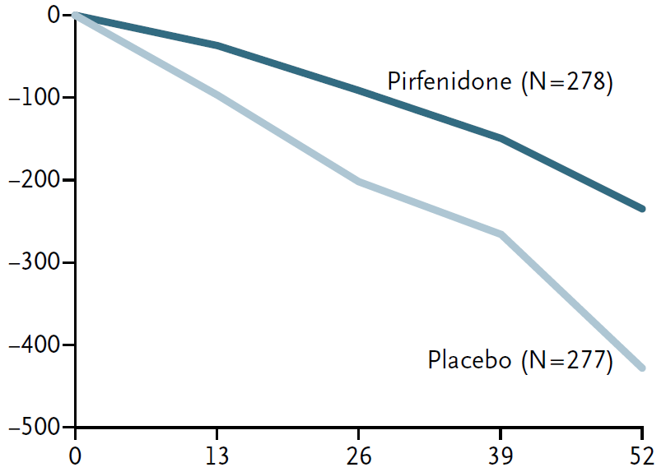
Pirfenidone Reduces Loss of FVC
Mean Change (ml)
235 ml
Rank ANCOVA P-value < 0.00001 at each indicated time point
428 ml
Week
<0.000001
King TE, et al. N Engl J Med. 2014;370(22):2083-2092.

Slide 41
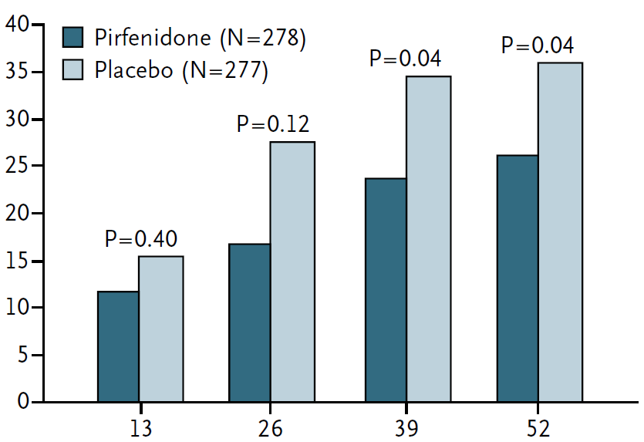
More Pirfenidone Patients Maintain Walk Distance or Survive
Proportion of Patients with
≥50 m Decline or Death (%)
Week
King TE, et al. N Engl J Med. 2014;370(22):2083-2092.

Slide 42
ASCEND Adverse Events
Adverse Event | Pirfenidone (%) (N = 278) | Placebo (%) (N = 277) | Δ (%)
Nausea | 36 | 13.4 | 22.6
Rash | 28.1 | 8.7 | 19.4
Dyspepsia | 17.6 | 6.1 | 11.5
Anorexia | 15.8 | 6.5 | 9.3
GERD | 11.9 | 6.5 | 5.4
Weight Loss | 12.6 | 7.9 | 4.7
Insomnia | 11.2 | 6.5 | 4.7
Dizziness | 17.6 | 13 | 4.6
Vomiting | 12.9 | 8.7 | 4.2
… | … | … | …
Dyspnea | 14.7 | 17.7 | -3
Cough | 25.2 | 29.6 | -4.4
IPF | 9.4 | 18.1 | -8.7
King TE, et al. N Engl J Med. 2014;370(22):2083-2092.

Slide 43
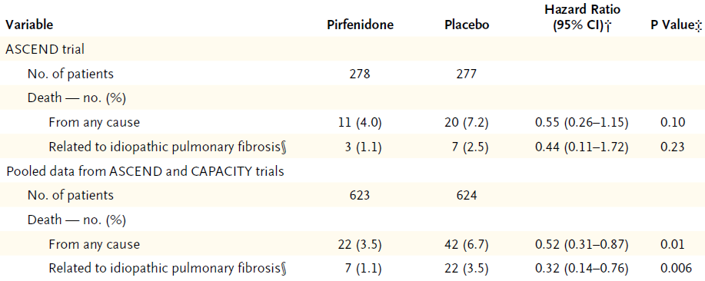
Pirfenidone Associated with Less Mortality
ASCEND and CAPACITY data
From randomization to 28 days after last dose
Cox proportional hazard model
Log-rank test
King TE, et al. N Engl J Med. 2014;370(22):2083-2092.

Slide 44
ASCEND Summary
Treatment with pirfenidone for 52 weeks significantly reduced disease progression, as measured by
  Changes in % predicted FVC (P < 0.001)
  Changes in 6-minute walk distance (P = 0.04)
  Progression-free survival (P < 0.001)
Treatment with pirfenidone reduced all-cause mortality and treatment emergent IPF-related mortality in pooled analyses at week 52
Pirfenidone was generally safe and well tolerated
King TE, et al. N Engl J Med. 2014;370(22):2083-2092.

Slide 45
ASCEND Conclusions
Pirfenidone, as compared with placebo, reduced disease progression in patients with IPF
Treatment was generally safe, had an acceptable side effect profile, and was associated with fewer deaths

Slide 46
FDA Approval of Pirfenidone (Esbriet)
Approved October 15, 2014
Indicated for the treatment of IPF
Dosage and administration
  801 mg (three 267 mg capsules) three times daily with food
  Doses should be taken at the same time each day
  Initiate with titration
    Days 1 through 7: 1 capsule 3x per day
    Days 8 through 14: 2 capsules 3x per day
    Days 15 onward: 3 capsules 3x per day
  Consider temporary dosage reduction, treatment interruption, or discontinuation for management of adverse reactions.
Prior to treatment, conduct liver function tests.
http://www.accessdata.fda.gov/scripts/cder/drugsatfda/index.cfm?fuseaction=Search.DrugDetails/. Accessed October 2014.

Slide 47
Pirfenidone Warnings and Precautions
Temporary dosage reductions or discontinuations may be required
Elevated liver enzymes: ALT, AST, and bilirubin elevations have occurred with pirfenidone. Monitor ALT, AST, and bilirubin before and during treatment.
Photosensitivity and rash: Photosensitivity and rash have been noted with pirfenidone. Avoid exposure to sunlight and sunlamps. Wear sunscreen and protective clothing daily.
Gastrointestinal disorders: Nausea, vomiting, diarrhea, dyspepsia, gastro-esophageal reflux disease, and abdominal pain have occurred with pirfenidone.
http://www.accessdata.fda.gov/scripts/cder/drugsatfda/index.cfm?fuseaction=Search.DrugDetails/. Accessed October 2014.

Slide 48
Pirfenidone: Other Considerations
Post-marketing experience (reactions of unknown frequency)
  Agranulocytosis
  Angioedema
  Bilirubin increased in combination with increases of ALT and AST
Drug interactions
  Metabolized primarily via CYP1A2
  Activators and inhibitors of CYP1A2 should be used with caution with pirfenidone
Use with caution with mild/moderate hepatic impairment, not recommended for patients with severe impairment
Use with caution with mild/moderate/severe renal impairment, not recommended for patients with ESRD requiring dialysis
Smoking causes decreased exposure to pirfenidone. Instruct patients to stop smoking prior to treatment with pirfenidone and to avoid smoking when using pirfenidone.
http://www.accessdata.fda.gov/scripts/cder/drugsatfda/index.cfm?fuseaction=Search.DrugDetails/. Accessed October 2014.

Slide 49
INPULSIS
Nintedanib

Slide 50
Possible Mechanisms of Nintedanib Action
Triple kinase inhibitor
Phosphatase activator
Antiangiogenic, antitumor activity
Nintedanib
  VEGF
  PDGF
  FGF
SHP-1
Pleiotropic Effects
Hilberg F, et al. Cancer Res. 2008;68(12):4774-4782.
Tai WT, et al. J Hepatol. 2014;61(1):89-97.
Notes:
BIBF 1120: triple angiokinase inhibitor with sustained receptor blockade and good antitumor efficacy.
Hilberg F1, Roth GJ, Krssak M, Kautschitsch S, Sommergruber W, Tontsch-Grunt U, Garin-Chesa P, Bader G, Zoephel A, Quant J, Heckel A, Rettig WJ. Cancer Res. 2008 Jun 15;68(12):4774-82.
Inhibition of tumor angiogenesis through blockade of the vascular endothelial growth factor (VEGF) signaling pathway is a novel treatment modality in oncology. Preclinical findings suggest that long-term clinical outcomes may improve with blockade of additional proangiogenic receptor tyrosine kinases: platelet-derived growth factor receptors (PDGFR) and fibroblast growth factor receptors (FGFR). BIBF 1120 is an indolinone derivative potently blocking VEGF receptor (VEGFR), PDGFR and FGFR kinase activity in enzymatic assays (IC(50), 20-100 nmol/L). BIBF 1120 inhibits mitogen-activated protein kinase and Akt signaling pathways in three cell types contributing to angiogenesis, endothelial cells, pericytes, and smooth muscle cells, resulting in inhibition of cell proliferation (EC(50), 10-80 nmol/L) and apoptosis. In all tumor models tested thus far, including human tumor xenografts growing in nude mice and a syngeneic rat tumor model, BIBF 1120 is highly active at well-tolerated doses (25-100 mg/kg daily p.o.), as measured by magnetic resonance imaging of tumor perfusion after 3 days, reducing vessel density and vessel integrity after 5 days, and inducing profound growth inhibition. A distinct pharmacodynamic feature of BIBF 1120 in cell culture is sustained pathway inhibition (up to 32 hours after 1-hour treatment), suggesting slow receptor off-kinetics. Although BIBF 1120 is rapidly metabolized in vivo by methylester cleavage, resulting in a short mean residence time, once daily oral dosing is fully efficacious in xenograft models. These distinctive pharmacokinetic and pharmacodynamic properties may help explain clinical observations with BIBF 1120, currently entering phase III clinical development.
Nintedanib (BIBF-1120) inhibits hepatocellular carcinoma growth independent of angiokinase activity.
Tai WT1, Shiau CW2, Li YS1, Chang CW1, Huang JW3, Hsueh TT2, Yu HC1, Chen KF4.
J Hepatol. 2014 Jul;61(1):89-97. doi: 10.1016/j.jhep.2014.03.017. Epub 2014 Mar 18.
Nintedanib, a triple angiokinase inhibitor, is currently being evaluated against advanced HCC in phase I/II clinical trials. Here, we report the underlying molecular mechanism by which nintedanib (BIBF-1120) induces an anti-HCC effect.
METHODS:
To further elucidate whether the effect of nintedanib on SHP-1 is dependent on its angiokinase inhibition activity, we developed a novel kinase-independent derivative of nintedanib, ΔN. HCC cell lines were treated with nintedanib or its derivative (ΔN) and apoptosis, signal transduction, and phosphatase activity were analyzed. Purified SHP-1 proteins or HCC cells expressing deletion N-SH2 domain or D61A point mutants were used to investigate the potential effect of nintedanib on SHP-1. In vivo efficacy was determined in nude mice with HCC subcutaneous xenografts (n⩾8 mice).
RESULTS:
Nintedanib induced anti-proliferation in HCC cell lines by targeting STAT3. Ectopic STAT3 abolished nintedanib-mediated apoptosis in HCC cells. Nintedanib further activated SHP-1 in purified SHP-1 proteins suggesting that nintedanib directly affects SHP-1 for STAT3 inhibition. HCC cells or recombinant SHP-1 proteins expressing deletion of N-SH2 domain or D61A mutants restored the activity of nintedanib suggesting that the auto-inhibition structure of SHP-1 was relieved by nintedanib. Although ΔN only retained the backbone of nintedanib without kinase activity, ΔN still induced substantial anti-HCC activity in vitro and in vivo by targeting STAT3.
CONCLUSIONS:
Nintedanib induced significant anti-HCC activity independent of angiokinase inhibition activity in a preclinical HCC model by relieving autoinhibition of SHP-1. Our findings provide new mechanistic insight into the inhibition of HCC growth by nintedanib.

Slide 51
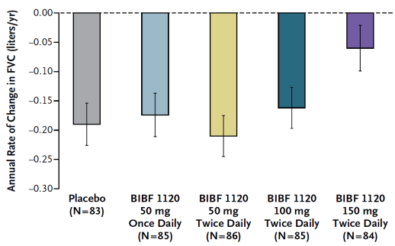
Nintedanib Showed Promise for FVC Endpoint
ATS 2011
2014
Pre-2011
2011-2013
Richeldi L, et al. N Engl J Med.2011:365;1079-1089.

Slide 52
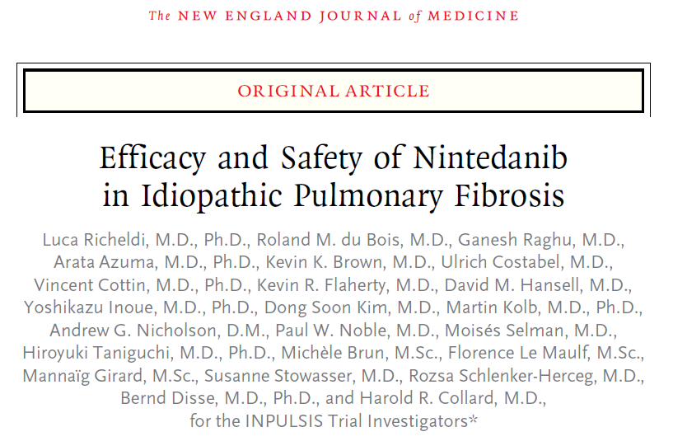
ATS 2011
INPULSIS 2014
2014
Pre-2011
2011-2013
Notes:
Background
Nintedanib (formerly known as BIBF 1120) is an intracellular inhibitor that targets
multiple tyrosine kinases. A phase 2 trial suggested that treatment with 150 mg of
nintedanib twice daily reduced lung-function decline and acute exacerbations in
patients with idiopathic pulmonary fibrosis.
Methods
We conducted two replicate 52-week, randomized, double-blind, phase 3 trials
(INPULSIS-1 and INPULSIS-2) to evaluate the efficacy and safety of 150 mg of
nintedanib twice daily as compared with placebo in patients with idiopathic pulmonary
fibrosis. The primary end point was the annual rate of decline in forced
vital capacity (FVC). Key secondary end points were the time to the first acute
exacerbation and the change from baseline in the total score on the St. George’s
Respiratory Questionnaire, both assessed over a 52-week period.
Results
A total of 1066 patients were randomly assigned in a 3:2 ratio to receive nintedanib
or placebo. The adjusted annual rate of change in FVC was −114.7 ml with nintedanib
versus −239.9 ml with placebo (difference, 125.3 ml; 95% confidence interval [CI],
77.7 to 172.8; P<0.001) in INPULSIS-1 and −113.6 ml with nintedanib versus −207.3 ml
with placebo (difference, 93.7 ml per year; 95% CI, 44.8 to 142.7; P<0.001) in
INPULSIS-2. In INPULSIS-1, there was no significant difference between the nintedanib
and placebo groups in the time to the first acute exacerbation (hazard ratio with
nintedanib, 1.15; 95% CI, 0.54 to 2.42; P = 0.67); in INPULSIS-2, there was a significant
benefit with nintedanib versus placebo (hazard ratio, 0.38; 95% CI, 0.19 to 0.77;
P = 0.005). The most frequent adverse event in the nintedanib groups was diarrhea,
with rates of 61.5% and 18.6% in the nintedanib and placebo groups, respectively,
in INPULSIS-1 and 63.2% and 18.3% in the two groups, respectively, in INPULSIS-2.
Conclusions
In patients with idiopathic pulmonary fibrosis, nintedanib reduced the decline in
FVC, which is consistent with a slowing of disease progression; nintedanib was frequently
associated with diarrhea, which led to discontinuation of the study medication
in less than 5% of patients. (Funded by Boehringer Ingelheim; INPULSIS-1 and
INPULSIS-2 ClinicalTrials.gov numbers, NCT01335464 and NCT01335477.)

Slide 53
INPULSIS-1 and INPULSIS-2 Study Design
52 Weeks
Inclusion Criteria
Age > 40
IPF ≤ 5y
≥ 50% FVC pred
30 - 79% DL_{CO} pred
HRCT within 1y
Endpoints
1⁰: ΔFVC
  2⁰: Time to first AE
  Δ SGRQ
Nintedanib
300 mg Daily
3
2
Placebo
1066 Patients
AE – Acute Exacerbation
SGRQ – St. George’s Respiratory Questionnaire
Richeldi L, et al. N Engl J Med. 2014;370(22):2071-2082.

Slide 54
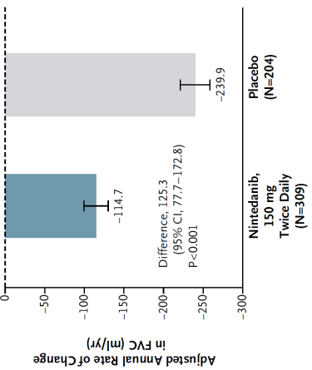
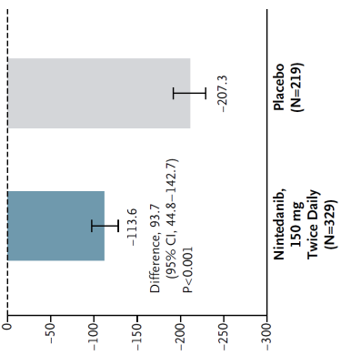
Primary INPULSIS Endpoint Achieved
Annual Rate of Change of FVC
INPULSIS-1
INPULSIS-2
52% Relative
Reduction
45% Relative
Reduction
Nintedanib Placebo
Richeldi L, et al. N Engl J Med. 2014;370(22):2071-2082.
Notes:
[e

Slide 55
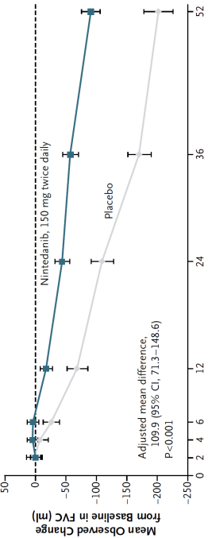
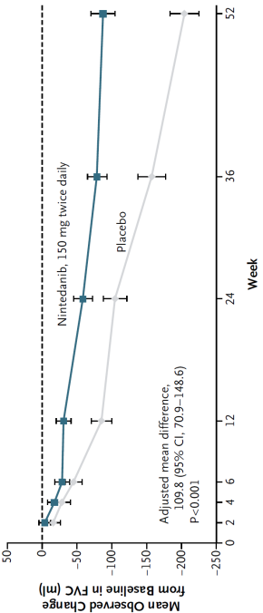
Nintedanib Reduces Loss of FVC
INPULSIS-1
Mean Observed Change from Baseline in FVC (mL)
INPULSIS-2
Week
Richeldi L, et al. N Engl J Med. 2014;370(22):2071-2082.
Notes:
[e

Slide 56
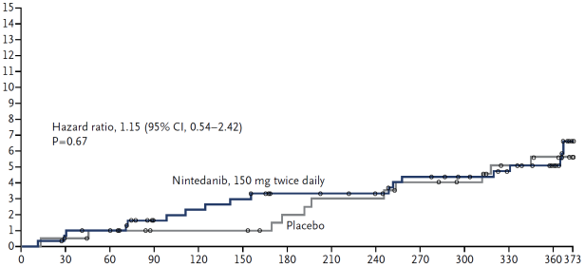
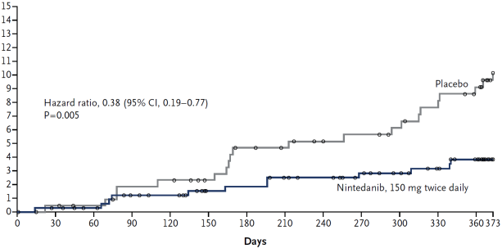
Mixed Findings for Time to First Acute Exacerbation
INPULSIS-1
Cumulative Incidence of First Acute Exacerbation (%)
INPULSIS-2
Richeldi L, et al. N Engl J Med. 2014;370(22):2071-2082.
Days
Notes:
Time to First Investigator Reported Acute Exacerbation

Slide 57
Common Nintedanib Adverse Events
Event | INPULSIS-1 |  | INPULSIS-2
 | Nintedanib (n = 309) | Placebo (n = 204) | Nintedanib (n = 329) | Placebo (n = 219)
Any (%) | 96 | 89 | 94 | 90
Diarrhea (%) | 62 | 19 | 63 | 18
Nausea(%) | 23 | 6 | 26 | 7
Richeldi L, et al. N Engl J Med. 2014;370(22):2071-2082.
Notes:
[e

Slide 58
INPULSIS Mortality Rates
Deaths | Nintedanib 150 mg bid (n = 638) | Placebo (n = 423) | HR | P-value
All-cause (%) | 5.5 | 7.8 | 0.70 | 0.14
Respiratory (%) | 3.8 | 5.0 | 0.74 | 0.34
On-treatment (%)* | 3.8 | 6.1 | 0.68 | 0.16
* Deaths between randomization and 28 days after last dose
Richeldi L, et al. N Engl J Med. 2014;370(22):2071-2082.

Slide 59
INPULSIS Summary
Nintedanib had significant benefit in adjusted annual rate of change in FVC
  INPULSIS-1 Δ = 125.3 ml P < 0.001
  INPULSIS-2 Δ = 93.7 ml P < 0.001
Nintedanib had significant benefit in time to the first acute exacerbation in INPULSIS-2
  INPULSIS-1 HR = 1.15 P = 0.67
  INPULSIS-2 HR = 0.38 P = 0.005
Significant difference in favor of nintedanib for the change from baseline in the total SGRQ score in INPULSIS-2 but not INPULSIS-1
Richeldi L, et al. N Engl J Med. 2014;370(22):2071-2082.
Notes:
[e

Slide 60
INPULSIS Conclusions
Nintedanib reduced the decline in FVC, which is consistent with a slowing of disease progression
Nintedanib was frequently associated with diarrhea, which led to discontinuation of the study medication in less than 5% of patients
Richeldi L, et al. N Engl J Med. 2014;370(22):2071-2082.
Notes:
[e

Slide 61
FDA Approval of Nintedanib (Ofev)
Approved October 15, 2014
Indicated for the treatment of IPF
Dosage and administration
  150 mg twice daily approximately 12 hours apart taken with food
  Consider temporary dose reduction to 100 mg, temporary interruption, or discontinuation for management of adverse reactions.
  Prior to treatment, conduct liver function tests.
http://www.accessdata.fda.gov/scripts/cder/drugsatfda/index.cfm?fuseaction=Search.DrugDetails/. Accessed October 2014.

Slide 62
Nintedanib Warnings and Precautions
Elevated liver enzymes: ALT, AST, and bilirubin elevations have occurred with nintedanib. Monitor ALT, AST, and bilirubin before and during treatment. Temporary dosage reductions or discontinuations may be required.
GI disorders: Diarrhea, nausea, and vomiting have occurred with nintedanib. Treat patients at first signs with adequate hydration and antidiarrheal medicine (e.g., loperamide) or anti-emetics. Discontinue nintedanib if severe diarrhea, nausea, or vomiting persists despite symptomatic treatment.
Embryofetal toxicity: Women of childbearing potential should be advised of the potential hazard to the fetus and to avoid becoming pregnant.
Arterial thromboembolic events have been reported. Use caution when treating patients at higher cardiovascular risk including known CAD.
Bleeding events have been reported. Use nintedanib in patients with known bleeding risk only if anticipated benefit outweighs the potential risk.
GI perforation has been reported. Use nintedanib with caution when treating patients with recent abdominal surgery. Discontinue nintedanib in patients who develop GI perforation. Only use nintedanib in patients with known risk of GI perforation if the anticipated benefit outweighs the potential risk.
http://www.accessdata.fda.gov/scripts/cder/drugsatfda/index.cfm?fuseaction=Search.DrugDetails/. Accessed October 2014.

Slide 63
Nintedanib: Other Considerations
Drug interactions
  Nintedanib is a substrate of P-glycoprotein (P-gp) and CYP3A4
  Concomitant use of P-gp and CYP3A4 inducers with nintedanib should be avoided
  Patients treated with P-gp and CYP3A4 inhibitors and nintedanib should be monitored closely for adverse reactions
Nintedanib is a VEGFR inhibitor, and may increase the risk of bleeding. Monitor patients on full anticoagulation therapy closely for bleeding and adjust anticoagulation treatment as necessary.
Nintedanib not recommended for patients with moderate or severe hepatic impairment
< 1% excreted via the kidney; no data on patients with severe renal impairment and ESRD
http://www.accessdata.fda.gov/scripts/cder/drugsatfda/index.cfm?fuseaction=Search.DrugDetails/. Accessed October 2014.

Slide 64
Current Phase 2 Trials for IPF
Next Generation Therapy?
Trial | Target | N | Primary Endpoint
Co-trimoxazole (Ph 3) | Pneumocystis jiroveci | 56 | Change in FVC or respir. Hospital’n
FG-3019 | Anti-CTGF | 90 | Change in FVC from baseline
Rituximab | CD-20 | 58 | Titers of anti-HEp-2 autoantibodies
Simtuzumab | Anti-LOXL2 | 500 | PFS
GC-1008 | TGF-β | 25 | Safety, tolerability, PK
QAX576 | Anti-IL-13 | 40 | Safety, tolerability, FVC
Tralokinumab | Anti-IL-13 | 302 | Change in FVC from baseline
STX-100 | αvβ6 | 32 | Adverse events
BMS-986020 | LPA Receptor | 300 | Rate of change in FVC

Slide 65
Clinical Trial Conclusions
2014 is a watershed year in IPF
  NAC did not show efficacy (PANTHER)
  Pirfenidone (ASCEND) and nintedanib (INPULSIS) showed efficacy in mild/moderate IPF
  Pirfenidone and nintedanib approved 10/15/14 for the treatment of IPF
  Still need data on advanced disease, combination therapy, long-term safety, adherence
Implications of having approved drug(s)
  Need early and accurate diagnosis
  Role of IPF and ILD Centers of Excellence is evolving

Slide 66
IPF: Role of Clinical Trials
Prior to 2000, only 1 multicenter RCT in IPF
2000–2013: ~ > 25 multicenter RCTs in IPF
Trials in IPF are difficult to recruit and populate
  Need effort, collaboration, and partnership of multiple health care providers
  ILD centers are important for patients, providers, and clinical studies
IPF patients of tomorrow need our help today!

Slide 67
Issues in Clinical Trials of IPF
Which patients should be studied?
Clinical Phenotypes
IPF rapid
accelerators
IPF slow
progressors
IPF
IPF acute
exacerbators
IPF/COPD
IPF/PH

Slide 68
Is There a Role for Genomics in Defining the Patient Cohort(s) to Study?
Will characterization of the patients genomic profile define responders versus non-responders?
Examples:
  Familial (autosomal dominant, up to 20%-25% of cases)
  Telomerase mutations in ~10%
  Surfactant C mutations
  Muc 5B variants

Slide 69
Genomics Applied to IPF
CTHRC1
MMP7
FHL2
PCSK1
CTSE
GAL
C6
NELL1
GREM1
LCN2
PLA2G2A
SLC2A5
Gene Expression Profiling
Genome-Wide Association
IPF Susceptibility
TOLLIP
SPPL2C
Mortality
TOLLIP rs5743890
Bauer Y, et al. Am J Respir Cell Mol Biol. 2014 Jul 16. [Epub ahead of print].
Noth I, et al. Lancet Respir Med. 2013;1:309-317.
Notes:
Am J Respir Cell Mol Biol. 2014 Jul 16. [Epub ahead of print]
A Novel Genomic Signature with Translational Significance for Human Idiopathic Pulmonary Fibrosis.
Bauer Y1, Tedrow J, de Bernard S, Birker-Robaczewska M, Gibson KF, Juan Guardela B, Hess P, Klenk A, Lindell KO, Poirey S, Renault B, Rey M, Weber E, Nayler O, Kaminski N.
Author information
1Actelion Pharmaceuticals, Drug Discovery Biology, Allschwil, Switzerland ; yasmina.bauer@actelion.com.
Abstract
The bleomycin-induced rodent lung fibrosis model is commonly used to study mechanisms of lung fibrosis and to test potential therapeutic interventions despite the well-recognized dissimilarities to human idiopathic pulmonary fibrosis (IPF). Therefore, in this study we sought to identify genomic commonalities between the gene expression profiles obtained from 100 IPF lungs and 108 control lungs that were obtained from the Lung Tissue Research Consortium and rat lungs harvested at days 3, 7, 14, 21, 28, 42 and 56 after bleomycin instillation. Surprisingly, the highest gene expression similarity between bleomycin-treated rat and IPF lungs was observed at day 7. At this point of maximal rat-human commonality we identified a novel set of twelve disease-relevant translational gene markers (C6; CTHRC1; CTSE; FHL2; GAL; GREM1; LCN2; MMP7; NELL1; PCSK1; PLA2G2A; SLC2A5) that was able to separate almost all IPF patients from controls in our cohort and in two additional IPF/control cohorts (GSE10667 and GSE24206). Furthermore, in combination with carbon monoxide (DLCO) measurements, four members of the translational gene marker set contributed to stratify IPF patients according to disease severity. Significantly, pirfenidone attenuated the expression change of one (CTHRC1) translational gene marker in the bleomycin-induced lung fibrosis model, TGF1-treated primary human lung fibroblasts and TGF1-treated human epithelial A549 cells. Our results suggest that a strategy focused on rodent model - human disease commonalities may identify genes that could be used to predict the pharmacological impact of therapeutic interventions and thus facilitates the development of novel treatments in this devastating lung disease.
Lancet Respir Med. 2013 Jun;1(4):309-17. doi: 10.1016/S2213-2600(13)70045-6. Epub 2013 Apr 17.
Genetic variants associated with idiopathic pulmonary fibrosis susceptibility and mortality: a genome-wide association study.
Noth I1, Zhang Y2, Ma SF3, Flores C4, Barber M3, Huang Y3, Broderick SM3, Wade MS5, Hysi P6, Scuirba J2, Richards TJ2, Juan-Guardela BM2, Vij R3, Han MK7, Martinez FJ7, Kossen K8, Seiwert SD8, Christie JD9, Nicolae D10, Kaminski N2, Garcia JG5.
Author information
Abstract
BACKGROUND:
Idiopathic pulmonary fibrosis (IPF) is a devastating disease that probably involves several genetic loci. Several rare genetic variants and one common single nucleotide polymorphism (SNP) of MUC5B have been associated with the disease. Our aim was to identify additional common variants associated with susceptibility and ultimately mortality in IPF.
METHODS:
First, we did a three-stage genome-wide association study (GWAS): stage one was a discovery GWAS; and stages two and three were independent case-control studies. DNA samples from European-American patients with IPF meeting standard criteria were obtained from several US centres for each stage. Data for European-American control individuals for stage one were gathered from the database of genotypes and phenotypes; additional control individuals were recruited at the University of Pittsburgh to increase the number. For controls in stages two and three, we gathered data for additional sex-matched European-American control individuals who had been recruited in another study. DNA samples from patients and from control individuals were genotyped to identify SNPs associated with IPF. SNPs identified in stage one were carried forward to stage two, and those that achieved genome-wide significance (p<5 × 10(-8)) in a meta-analysis were carried forward to stage three. Three case series with follow-up data were selected from stages one and two of the GWAS using samples with follow-up data. Mortality analyses were done in these case series to assess the SNPs associated with IPF that had achieved genome-wide significance in the meta-analysis of stages one and two. Finally, we obtained gene-expression profiling data for lungs of patients with IPF from the Lung Genomics Research Consortium and analysed correlation with SNP genotypes.
FINDINGS:
In stage one of the GWAS (542 patients with IPF, 542 control individuals matched one-by-one to cases by genetic ancestry estimates), we identified 20 loci. Six SNPs reached genome-wide significance in stage two (544 patients, 687 control individuals): three TOLLIP SNPs (rs111521887, rs5743894, rs5743890) and one MUC5B SNP (rs35705950) at 11p15.5; one MDGA2 SNP (rs7144383) at 14q21.3; and one SPPL2C SNP (rs17690703) at 17q21.31. Stage three (324 patients, 702 control individuals) confirmed the associations for all these SNPs, except for rs7144383. Linkage disequilibrium between the MUC5B SNP (rs35705950) and TOLLIP SNPs (rs111521887 [r(2)=0·07], rs5743894 [r(2)=0·16], and rs5743890 [r(2)=0·01]) was low. 683 patients from the GWAS were included in the mortality analysis. Individuals who developed IPF despite having the protective TOLLIP minor allele of rs5743890 carried an increased mortality risk (meta-analysis with fixed-effect model: hazard ratio 1·72 [95% CI 1·24-2·38]; p=0·0012). TOLLIP expression was decreased by 20% in individuals carrying the minor allele of rs5743890 (p=0·097), 40% in those with the minor allele of rs111521887 (p=3·0 × 10(-4)), and 50% in those with the minor allele of rs5743894 (p=2·93 × 10(-5)) compared with homozygous carriers of common alleles for these SNPs.
INTERPRETATION:
Novel variants in TOLLIP and SPPL2C are associated with IPF susceptibility. One novel variant of TOLLIP, rs5743890, is also associated with mortality. These associations and the reduced expression of TOLLIP in patients with IPF who carry TOLLIP SNPs emphasise the importance of this gene in the disease.

Slide 70
Issues in Clinical Trials of IPF
Fixed duration or event-driven?
How will drug approvals affect trial design?
What is the best endpoint?
  Lung function
    FVC, DLco
  Functional status (6MWT)
  QOL measures
  Hospitalization
  Mortality
  Composite endpoint
    Increasingly used in clinical trials

Slide 71
Composite Endpoints:
Potential Advantages
Increases statistical power & improved trial efficiency
Estimates net clinical benefit by capturing different disease domains
  Accounts for several equally important endpoints
Improves understanding of effect of intervention
Adapted from Ferreira-González I et al. J Clin Epidemiol. 2007;60:651-657.

Slide 72
Composite Endpoints:
Potential Advantages
Interpretation problematic when
  Components are dissimilar in clinical importance
  Event rates vary appreciably across components
  Components vary in sensitivity to treatment
May be influenced by clinician subjectivity
  Some components can be difficult to adjudicate
Potential masking of a harmful effect
Ferreira-González I et al. J Clin Epidemiol. 2007;60:651-657.
Nathan SD, du Bois RM. Eur Respir J. 2011;38:1002-1004.

Slide 73
Candidate Components of Composite Endpoints
ΔFVC
Δ6MWT
Hospitalization
Mean change or categorical?
Slope of change?
Frequency of measurement
Mean change or categorical?
Δ Distance or desaturation?
Δ Pulse rate recovery?
Δ Borg?
Respiratory or all-cause?
Different thresholds
Remote hospitalizations?
Patient compliance
Need vs. actual?
ΔNYHA FC
ΔPRO
“Blunt” instrument
Subjective
Assessor dependent
Remote monitoring?
Death
Which instrument?
Patient-centered
Requires further validation
Respiratory or all-cause?
Exploratory
ΔBiomarker
ΔHRCT Score
Acute Exacerbations
Which?
Require validation
Role in patient selection?
Refinement needed
Requires validation
Monitoring intervals
Rare?
Difficult to differentiate
Colinear with hospitalization?

Slide 74
Conclusions I
Many candidates have failed in clinical trials
  Pathogenesis models have had limited use
  Endpoints
  Inclusion criteria/disease stage
2014 is a pivotal year in IPF
  NAC did not show efficacy (PANTHER)
  Pirfenidone and nintedanib are FDA approved for treatment of IPF
  Still need data on advanced disease, combination therapy, long-term safety, adherence

Slide 75
Conclusions II
Implications of having an approved drug
  Therapeutic option for patients
  Need to make an accurate diagnosis
    Treat appropriately
    Avoid treating inappropriately
  Earlier diagnosis becomes essential
  Increased awareness
The role of Pulmonary Fibrosis Centers of Excellence is developing

