Slide 2
Faculty
Richard Casaburi, MD, PhD (Chair)
David Geffen School of Medicine at UCLA
Los Angeles, California
Gary T. Ferguson, MD
Pulmonary Research Institute of Southeast Michigan
Farmington Hills, Michigan
David M. Mannino, MD
University of Kentucky College of Public Health
Lexington, Kentucky

Slide 3
Disclosure of Relevant Financial Relationships
It is the policy of The France Foundation to ensure balance, independence, objectivity, and scientific rigor in all its educational activities. All faculty, activity planners, content reviewers, and staff participating in this activity have disclosed to the participants any relevant financial interest or other relationship with manufacturer(s) of any commercial product(s)/device(s) and/or provider(s) of commercial services included in this educational activity. The intent of this disclosure is not to prevent a person with a relevant financial or other relationship from participating in the activity, but rather to provide participants with information on which they can base their own judgments. The France Foundation has identified and resolved any and all conflicts of interest prior to the release of this activity.
Supported by an Educational Grant from
Boehringer Ingelheim Pharmaceuticals, Inc.

Slide 4
Activity Faculty Disclosures
Richard Casaburi, MD, PhD has received grants/research support from Astellas, AstraZeneca, Boehringer Ingelheim Pharmaceuticals, Inc., and Pulmonx. He has served as a consultant for Astellas, AstraZeneca, Boehringer Ingelheim Pharmaceuticals, Inc., GlaxoSmithKline, and Novartis. Dr. Casaburi is a stock shareholder of Inogen, Inc. He has received honoraria from AstraZeneca, Boehringer Ingelheim Pharmaceuticals, Inc., Novartis, and Sunovion.
Gary T. Ferguson, MD has served as a consultant for AstraZeneca, Boehringer Ingelheim Pharmaceuticals, Inc., Meda, Mylan, Novartis, Pearl Therapeutics, Sunovion, Theravance, and Verona. He has also received honoraria from Boehringer Ingelheim Pharmaceuticals, Inc., GlaxoSmithKline, Sunovion, and Meda.
David M. Mannino, MD has received grants/research support from GlaxoSmithKline. He has served as a consultant for Amgen, AstraZeneca, Boehringer Ingelheim Pharmaceuticals, Inc., GlaxoSmithKline, Mylan, and Novartis. Dr. Mannino has received honoraria from Boehringer Ingelheim Pharmaceuticals, Inc. and Sunovion. He has received other financial or material support from Up-to-Date.
The planners, reviewers, editors, staff, or other members at The France Foundation who control content have no relevant financial relationships to disclose.

Slide 5
Agenda
6:30-7:00 PM Gather and Dinner
7:00-9:00 PM Interactive Case Discussions
9:00-9:30 PM Question & Answer

Slide 6
Learning Objectives
Evaluate key data from clinical trials on new and emerging fixed-dose LAMA/LABA inhalers in COPD
Efficacy
Safety
Apply information on the efficacy and safety of new/emerging LAMA/LABA inhalers in COPD to specific clinical scenarios

Slide 7
Goals of Pharmacological Management of COPD
Reduce Symptoms
Relieve symptoms
Improve exercise tolerance
Improve health status
Reduce Risk
Prevent and treat exacerbations
Prevent disease progression
Reduce mortality
http://www.goldcopd.org.

Slide 8
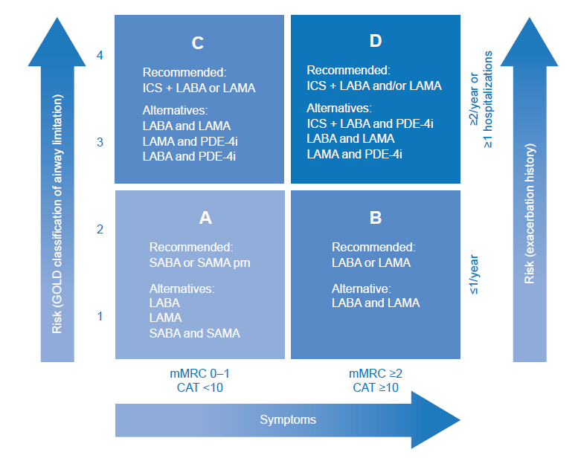
GOLD COPD Assessment and Treatment Approach
http://www.goldcopd.org.
Kaplan AG. Int J COPD. 2015;10:2535-2548.
Notes:
Answer: 4: to rule out lung cancer. USPSTF indications: Age 55-80, 30 pk yr smoking; current smokers or quit within last 15 years
Answer 3 is also appropriate but there are no guidelines for this. Depends on perceived clinical need

Slide 9
Long-Acting Bronchodilators
LAMAs
LABAs
Block acetylcholine-mediated bronchoconstriction (via M₃ receptors)
Aclidinium
Glycopyrronium (glycopyrrolate)
Tiotropium
Umeclidinium
Direct relaxant activity on airway smooth muscle (via β₂ adrenoceptors)
Indacaterol
Formoterol
Olodaterol
Salmeterol
Vilanterol
Spina D. Eur Clin Respir J. 2015;2:26634.

Slide 10
Fixed-Dose Combination LAMA/LABAs
Approved in the US
In Development
Umeclidinium
Vilanterol
Aclidinium
Formoterol
Once daily; dry powder inhaler
Twice daily; dry powder inhaler
Tiotropium
Olodaterol
Once daily; soft mist inhaler
FDCs have the potential to:
Maximize bronchodilation
Provide synergistic effects
Simplify treatment regimen
Glycopyrrolate
Indacaterol
Twice daily*; dry powder inhaler
Glycopyrrolate
Formoterol
Twice daily; pressurized metered dose inhaler
*In Europe, once daily dose/formulation
Singh D. Br J Clin Pharmacol. 2014;79:695-708.

Slide 11
Questions you may have …
Where do these agents fit in the treatment algorithm for patients with COPD?
Are they appropriate in newly diagnosed patients? If so under what circumstances?
How does efficacy compare with monotherapy?
What are the safety issues with fixed-dose combinations? Can they be used safely in patients with cardiovascular comorbidities?
What about inhaled corticosteroids (ICS)?

Slide 12
Meet Sarah
48-years-old
35-year smoking history, still smoking
Works for a professional cleaning service
Increasing dyspnea over the past year (Tracy attributes this to getting older and putting on weight)
Productive cough most mornings

Slide 13
Sarah–Exam and Evaluation
5’5”, 150 lbs
Vitals normal
Labs normal
CXR normal
Worsening dyspnea; productive morning cough
No wheezing or crackles; slightly prolonged expiration
CAT score: 15

Slide 14
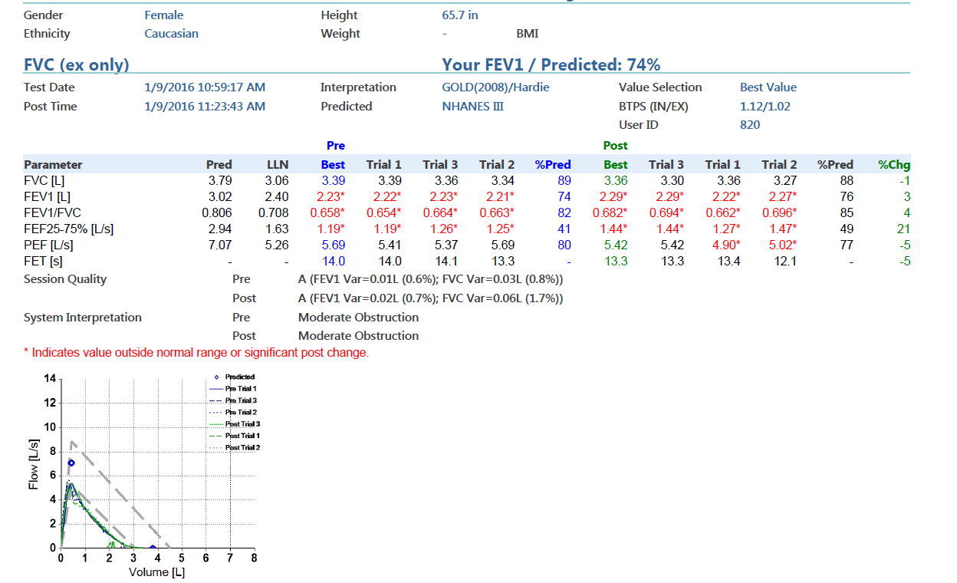
Sarah–Pulmonary Function Test

Slide 15
Sarah–History
No comorbidities
No current medications
Bad case of bronchitis last winter—no treatment; not hospitalized
Never been on medical therapy for respiratory symptoms

Slide 16
Would You Consider Sarah’s Bronchitis an Exacerbation?
Yes
No
Unsure

Slide 17
What Treatment Would You Recommend for Sarah?
Short-acting bronchodilator, PRN
LAMA monotherapy
LABA monotherapy
LABA + ICS
Fixed-dose combination LAMA + LABA

Slide 18
Sarah
http://www.goldcopd.org.
Kaplan AG. Int J COPD. 2015;10:2535-2548.

Slide 19
Treatment Approach—Dual or Monotherapy? What Data Do We Have to Guide Our Decision Making?

Slide 20
Fixed-Dose LAMA + LABA Combinations
Approved in the US
Umeclidinium + vilanterol (once daily, dry powder inhaler)
Tiotropium + olodaterol (once daily, soft mist inhaler)
Glycopyrrolate + indacaterol (twice daily, dry powder inhaler)
Glycopyrrolate + formoterol (twice daily, pressurized metered dose inhaler)
Emerging
Aclidinium + formoterol (twice daily, dry powder inhaler)

Slide 21
Efficacy Endpoints
FEV₁
Health-related quality of life
Symptom scales
COPD exacerbations
Exercise tolerance

Slide 22
Network Meta-analysis: LAMA-LABA Combinations
23 trials; 27,172 patients in the analysis
LAMA-LABA combinations associated with improvement over placebo:
Lung function: trough FEV₁ ⬆201 ml
St. George’s Respiratory Questionnaire: ⬇ 4.1
Transitional dyspnea index: ⬆1.21
Moderate/severe exacerbations: HR= 0.66
Oba Y, et al. Thorax. 2016;71:15-25.

Slide 23
Network Meta-analysis: LAMA/LABA Combinations
23 trials; 27,172 patients in the analysis
LAMA/LABA combinations associated with greater improvement than monotherapies:
Lung function
St. George’s Respiratory Questionnaire
Transitional dyspnea index
Oba Y, et al. Thorax. 2016;71:15-25.

Slide 24
Network Meta-analysis: LAMA/LABA Combinations
LAMA/LABA combinations associated with fewer moderate-to-severe exacerbations vs LABAs, but not vs LAMAs
No significant differences associated with LAMA/LABA combinations vs monotherapies in safety outcomes or severe exacerbations
Oba Y, et al. Thorax. 2016;71:15-25.
23 trials; 27,172 patients in the analysis

Slide 25
Fixed-Dose LAMA + LABA Combinations
Approved in the US
Umeclidinium + vilanterol (once daily, dry powder inhaler)
Tiotropium + olodaterol (once daily, soft mist inhaler)
Glycopyrrolate + indacaterol (twice daily, dry powder inhaler)
Glycopyrrolate + formoterol (twice daily, pressurized metered dose inhaler)
Emerging
Aclidinium + formoterol (twice daily, dry powder inhaler)

Slide 26
FDC Umeclidinium + Vilanterol vs Tiotropium
24-week, phase 3, multicenter, randomized, parallel-group study
905 patients randomized
Moderate-to-severe COPD
Treatment (patients randomized 1:1)
Once daily umeclidinium (62.5 µg) + vilanterol (25 µg) via dry powder inhaler or
Once daily tiotropium (18 µg) via HandiHaler
Primary endpoint
Trough FEV₁ at day 169
Maleki-Yazdi MR, et al. Respir Med. 2014;108:1752-1760.

Slide 27
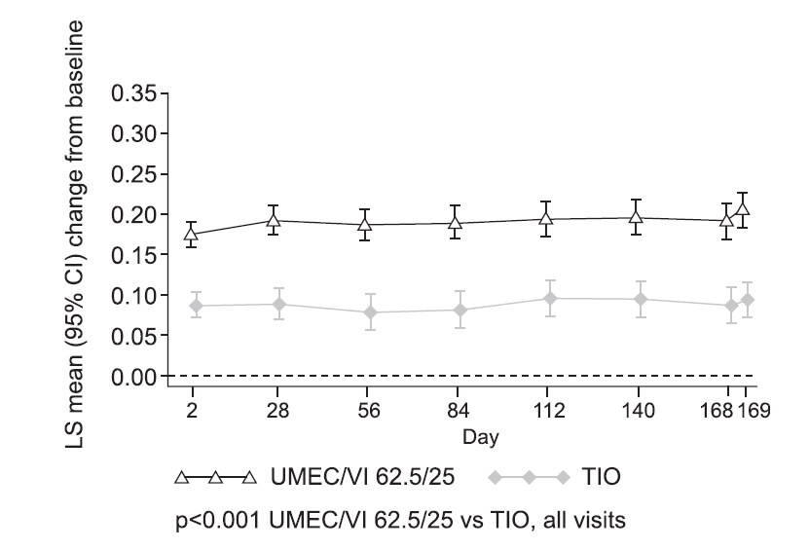
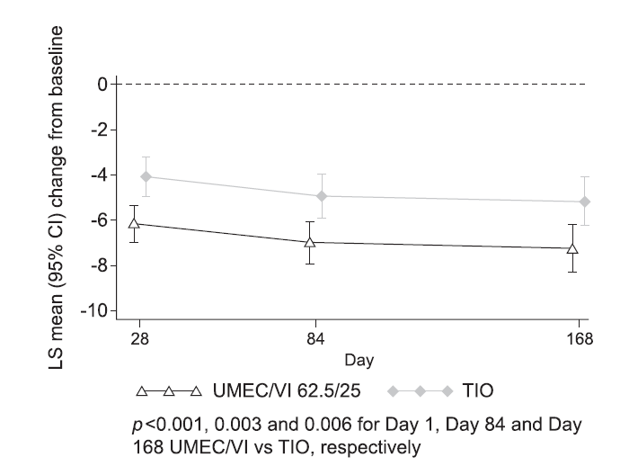
FDC Umeclidinium + Vilanterol vs Tiotropium
Trough FEV₁
SGRQ Total Score
Maleki-Yazdi MR, et al. Respir Med. 2014;108:1752-1760.

Slide 28
FDC Umeclidinium + Vilanterol and Exercise Endurance
Two 12-week multicenter, randomized, double-blind, placebo-controlled, cross over studies
657 patients randomized
Moderate to severe COPD
Treatment
Patients received two of six treatments in sequence
Placebo; UMEC/VI 125/25 µg or 62.5/25 µg*; VI 25 µg; or UMEC 62.5 or 125 µg
Co-primary endpoints
Exercise endurance time (EET) using the endurance shuttle walk test (ESWT)
Trough FEV₁ week 12
Maltais F, et al. Ther Adv Respir Dis. 2014;8:169-181.
*FDA-approved FDC dose

Slide 29
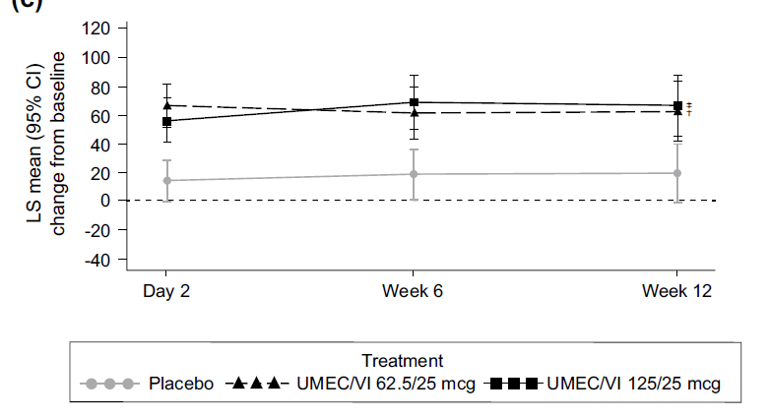
FDC UMEC + VI and Exercise Endurance
Post hoc Integrated Analysis of Studies 418 and 417
Exercise Endurance Time (sec)
Maltais F, et al. Ther Adv Respir Dis. 2014;8:169-181.
†P ≤ 0.01; ‡ P ≤ 0.001 vs placebo

Slide 30
Fixed-Dose LAMA + LABA Combinations
Approved in the US
Umeclidinium + vilanterol (once daily, dry powder inhaler)
Tiotropium + olodaterol (once daily, soft mist inhaler)
Glycopyrrolate + indacaterol (twice daily, dry powder inhaler)
Glycopyrrolate + formoterol (twice daily, pressurized metered dose inhaler)
Emerging
Aclidinium + formoterol (twice daily, dry powder inhaler)

Slide 31
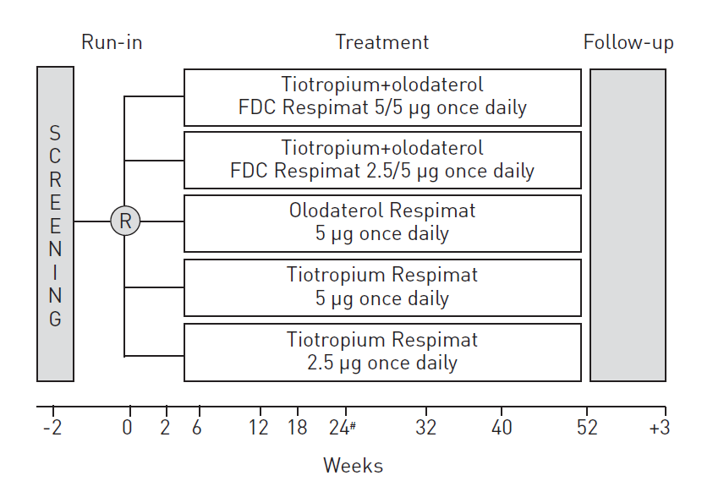
FDC Tiotropium + Olodaterol vs Mono-components (Two – Phase 3 Trials)
COPD Patients
5163 randomized
GOLD stage 2-4
Primary Endpoints
FEV₁ AUC 0 to 3 hr
Trough FEV₁ response
SGRQ total score
Buhl R, et al. Eur Respir J. 2015;45:969-979.

Slide 32
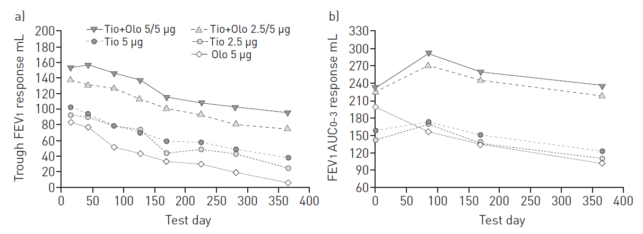
FDC Tiotropium + Olodaterol vs Mono-components (TONADO-1 and -2)
Buhl R, et al. Eur Respir J. 2015;45:969-979.

Slide 33
FDC Tiotropium + Olodaterol vs Mono-components (TONADO-1 and -2)
St. George’s Respiratory Questionnaire at 24 weeks
Treatment comparison | SGRQ Total Score | P-value
Tiotropium + olodaterol 5/5µg vs olodaterol 5 µg | -1.69 ± 0.553 | 0.0022
Tiotropium + olodaterol 5/5µg vs tiotropium 5 µg | -1.23 ± 0.551 | 0.0252
Tiotropium + olodaterol 2.5/5µg vs olodaterol 5 µg | -1.03 ± 0.552 | 0.0620
Tiotropium + olodaterol 2.5/5µg vs tiotropium 2.5 µg | -0.456 ± 0.548 | 0.4051
Tiotropium + olodaterol 2.5/5µg vs tiotropium 5µg | -0.571 ± 0.550 | 0.2988
Buhl R, et al. Eur Respir J. 2015;45:969-979.

Slide 34
Fixed-Dose LAMA + LABA Combinations
Approved in the US
Umeclidinium + vilanterol (once daily, dry powder inhaler)
Tiotropium + olodaterol (once daily, soft mist inhaler)
Glycopyrrolate + indacaterol (twice daily, dry powder inhaler)
Glycopyrrolate + formoterol (twice daily, pressurized metered dose inhaler)
Emerging
Aclidinium + formoterol (twice daily, dry powder inhaler)

Slide 35
FDC Indacaterol + Glycopyrrolate
Approved in Europe, Japan, and Australia once daily
Indacaterol/glycopyrronium 110/50 µg
Phase 3 IGNITE studies
Approved in US, twice daily
Indacaterol/glycopyrrolate 27.5/15.6 µg
Phase 3 EXPEDITION studies (FLIGHT 1, 2, and 3)
http://www.ema.europa.eu/docs/en_GB/document_library/EPAR_-_Product_Information/human/002679/WC500151255.pdf
http://www.accessdata.fda.gov/drugsatfda_docs/label/2015/207930s000lbl.pdf

Slide 36
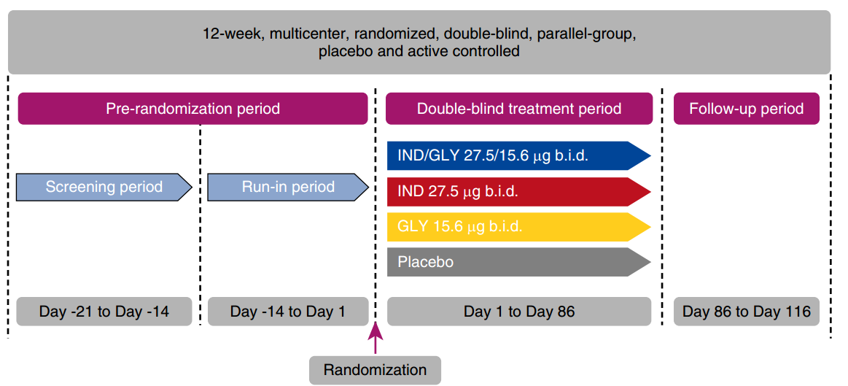
FDC Indacaterol + Glycopyrrolate (QVA149) FLIGHT 1 and FLIGHT 2
COPD Patients
2043 randomized
Moderate-to-severe COPD
Endpoints
FEV₁ AUC 0 to 12 hr
SGRQ total score
TDI total score
Rescue medication use
Mahler DA, et al. AJRCCM. 2015;192:1068-1079.

Slide 37
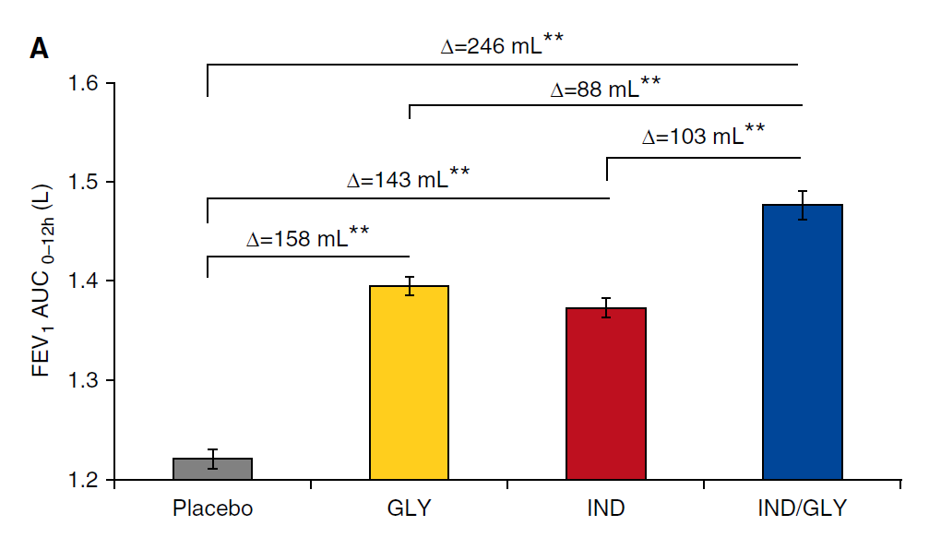
FDC Indacaterol + Glycopyrrolate FLIGHT 1 and FLIGHT 2: FEV₁ at Week 12
Mahler DA, et al. AJRCCM. 2015;192:1068-1079.
**P < 0.001

Slide 38
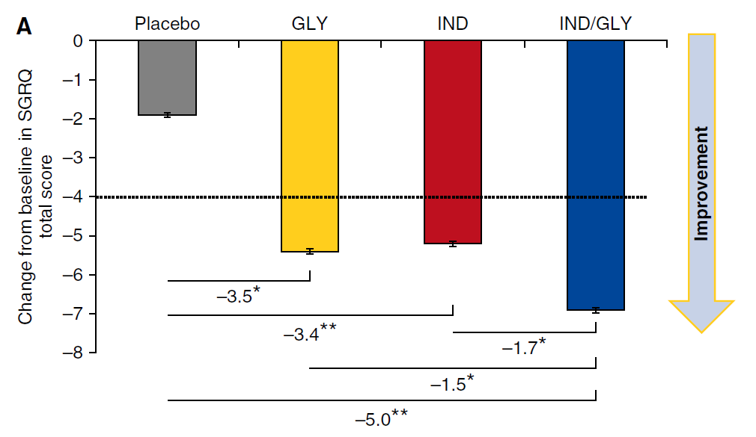
FDC Indacaterol + Glycopyrrolate FLIGHT 1 and FLIGHT 2: SGRQ Total Score
Mahler DA, et al. AJRCCM. 2015;192:1068-1079.
**P < 0.001; *P < 0.05

Slide 39
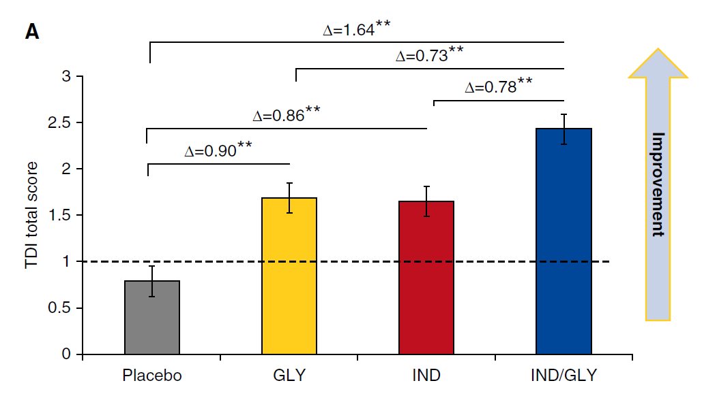
FDC Indacaterol + Glycopyrrolate FLIGHT 1 and FLIGHT 2: TDI Total Score
Mahler DA, et al. AJRCCM. 2015;192:1068-1079.
**P < 0.001

Slide 40
Fixed-Dose LAMA + LABA Combinations
Approved in the US
Umeclidinium + vilanterol (once daily, dry powder inhaler)
Tiotropium + olodaterol (once daily, soft mist inhaler)
Glycopyrrolate + indacaterol (twice daily, dry powder inhaler)
Glycopyrrolate + formoterol (twice daily, pressurized metered dose inhaler)
Emerging
Aclidinium + formoterol (twice daily, dry powder inhaler)

Slide 41
FDC Glycopyrrolate + Formoterol (PT003) PINNACLE-1 and -2 Phase 3 Studies
PT003: co-suspension metered dose inhaler combination of glycopyrrolate (18 µg) and formoterol (9.6 µg), administered twice daily
PINNACLE-1 and -2
Randomized, double-blind, placebo-controlled, parallel-group, multicenter 24-week studies
Patients with moderate to very severe COPD
Treatments: glycopyrrolate/formoterol vs monotherapy components and placebo; PINNACLE-1 also included open-label tiotropium (18 µg, once daily)
Primary endpoints: change from baseline in trough FEV₁ and TDI over 24 weeks
Rabe K, et al. Eur Resp J. 2015;46(S59):LB Abstract.

Slide 42
FDC Glycopyrrolate + Formoterol (PT003) Trough FEV₁
Rabe K, et al. Eur Resp J. 2015;46(S59):LB Abstract.

Slide 43
FDC Glycopyrrolate + Formoterol (PT003) SGRQ Total Score
Rabe K, et al. Eur Resp J. 2015;46(S59):LB Abstract.

Slide 44
FDC Glycopyrrolate + Formoterol (PT003) Transitional Dyspnea Index (TDI)
Rabe K, et al. Eur Resp J. 2015;46(S59):LB Abstract.

Slide 45
Fixed-Dose LAMA + LABA Combinations
Approved in the US
Umeclidinium + vilanterol (once daily, dry powder inhaler)
Tiotropium + olodaterol (once daily, soft mist inhaler)
Glycopyrrolate + indacaterol (twice daily, dry powder inhaler)
Glycopyrrolate + formoterol (twice daily, pressurized metered dose inhaler)
Emerging
Aclidinium + formoterol (twice daily, dry powder inhaler)

Slide 46
FDC Aclidinium +Formoterol
Aclidinium + formoterol, 400/12µg, twice daily, dry powder inhaler
Approved in Europe, not in the US to date
Phase 3 Studies ACLIFORM and AUGMENT
6-month, multicenter, randomized, active- and placebo-controlled studies
Patients with moderate-to-severe COPD
Singh D, et al. BMC Pulm Med. 2014;14:178.
D’Urzo AD, et al. Resp Res. 2014;15:123.
Bateman ED, et al. Respir Res. 2015;16:92.

Slide 47
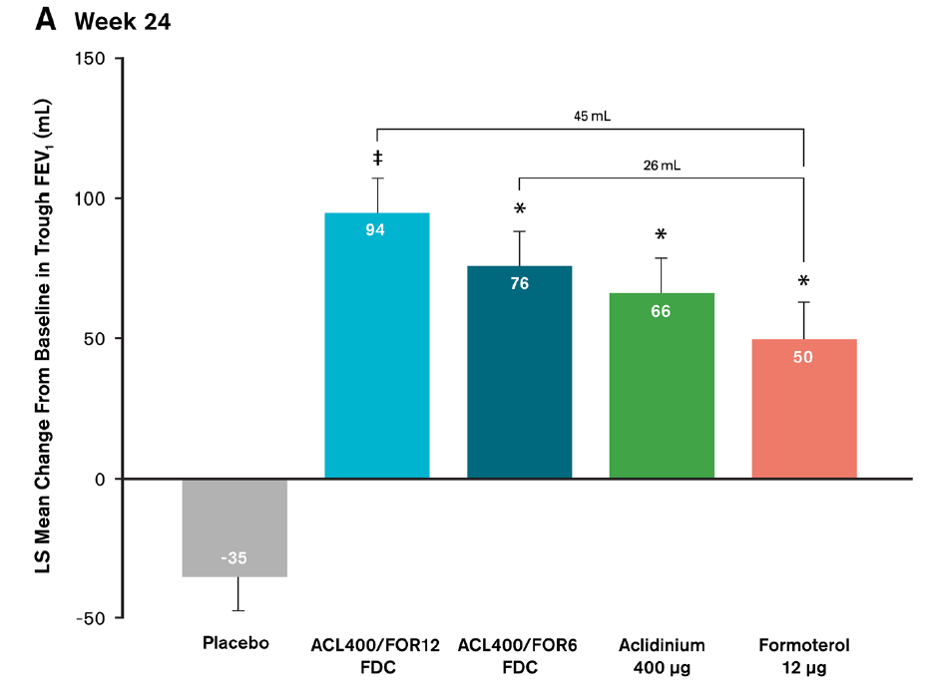
FDC Aclidinium +Formoterol AUGMENT: FEV₁
N = 1692 randomized
*P < 0.05 vs placebo
‡P < 0.05 vs formoterol and placebo
D’Urzo AD, et al. Resp Res. 2014;15:123.

Slide 48
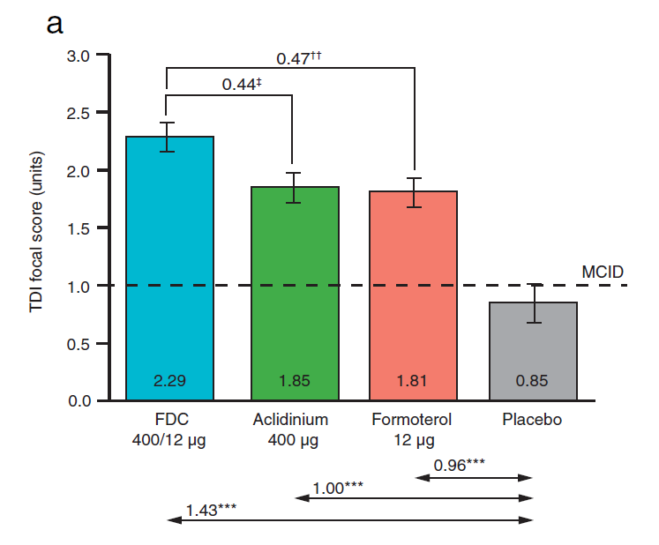
FDC Aclidinium +Formoterol Pooled Analysis of ACLIFORM and AUGMENT
Bateman ED, et al. Respir Res. 2015;16:92.
N = 3394 patients

Slide 49
FDC Aclidinium +Formoterol Pooled Analysis of ACLIFORM and AUGMENT
Aclidinium/formoterol 400/12 µg combination over 24 wks
Improvements in daily symptoms, nighttime, and early morning symptoms vs placebo and monotherapies (all P < 0.05)
Rate of moderate or severe exacerbations was reduced vs placebo (P < 0.05), but not vs monotherapies
Bateman ED, et al. Respir Res. 2015;16:92.

Slide 50
Considerations for Starting a Patient on Single Agent or Fixed-Dose Combination Bronchodilators
Factors in Favor of Single Agents
Factors in Favor of FDCs
Less potential for side effects
Room to increase therapy if greater response desired
Maximal bronchodilation from the initial therapy

Slide 51
Sarah–Treatment Approach
Patient enrolled in a smoking cessation class and successfully stopped smoking
Patient was started on umeclidinium/vilanterol once daily, dry powder inhaler
She felt it would be easier for her to remember once a day therapy rather than twice a day
At her 3 month follow-up, she has had no exacerbations and reports that her cough is gone and dyspnea is slightly improved

Slide 52
Sarah–Key Points
In newly diagnosed patients with mild to moderate COPD, clinicians have many treatment options
Smoking cessation remains a cornerstone of intervention

Slide 53
Meet Tracy
60-years-old
30 year smoker, stopped 15 years ago
Diagnosed with COPD 3 years ago
History of hypertension (15 years) and heart disease
Increasing dyspnea and cough over the last 6 months

Slide 54
Tracy–History
Hypertension (15 years)
COPD exacerbation last year
Hospitalized, treated with IV antibiotics and steroids
Sent home on LAMA (same treatment prior to hospitalization)
Myocardial infarction following the exacerbation
Recently seen by cardiologist
Stable, no angina

Slide 55
Tracy–Exam and Evaluation
5’5”, 138 lbs
Blood pressure slightly elevated (137/92)
CXR normal
No wheezing on examination
CAT score = 22
Current medications
LAMA
Beta blocker; statin

Slide 56
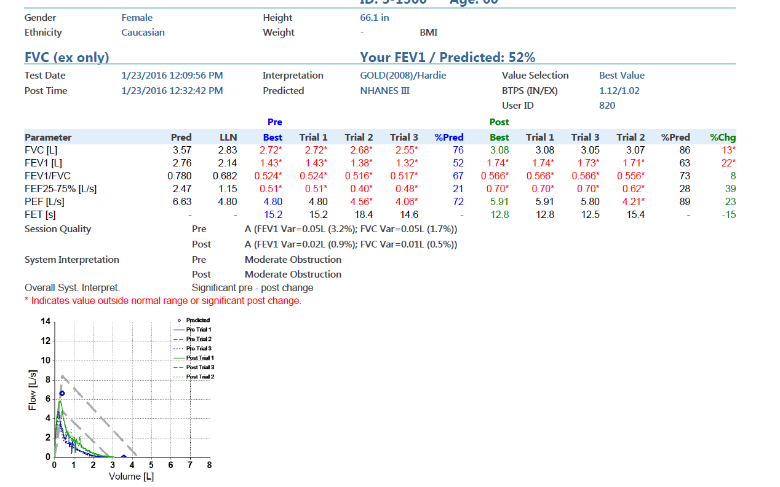
Tracy–Pulmonary Function Test

Slide 57
Does Tracy’s Bronchodilator Response Point to an Asthmatic Component?
Yes
No
Unsure

Slide 58
Is There a Need For a Change in Treatment? What Would You Do?
Continue LAMA monotherapy
Add LABA + ICS to LAMA
Switch to LABA + ICS
Switch to fixed-dose combination LAMA + LABA

Slide 59
Tracy
http://www.goldcopd.org.
Kaplan AG. Int J COPD. 2015;10:2535-2548.

Slide 60
What Do We Know About the Safety Profile of FDC LAMA/LABAs, Including in Patients with Cardiovascular Comorbidities? What Data Do We Have to Guide Our Decision Making?

Slide 61
FDC LAMA/LABAs Caution Regarding Use in Patients with Cardiovascular Disorders
β₂-agonists can produce a clinically significant cardiovascular effect in some patients (increases in pulse rate, systolic or diastolic blood pressure, or symptoms)
β-agonists have been reported to produce electrocardiographic changes (flattening of the T wave, prolongation of the QTc interval, and ST segment depression)
β-blockers and the LABA component of FDC LAMA/LABAs may interfere with the effect of each other when administered concurrently
β-blockers may produce severe bronchospasm in COPD patients
http://www.accessdata.fda.gov/drugsatfda_docs/label/2016/203975s003lbl.pdf
http://www.accessdata.fda.gov/drugsatfda_docs/label/2016/206756s002lbl.pdf
http://www.accessdata.fda.gov/drugsatfda_docs/label/2015/207930s000lbl.pdf

Slide 62
Network Meta-analysis: LAMA/LABA Combinations vs Comparators on Adverse Events
 | Mortality HR | Total SAEs HR | Cardiac SAEs HR | Dropouts due to AEs HR
FDC LAMA-LABA vs placebo | 1.95 (0.73, 7.71) | 1.10 (0.89, 1.38) | 1.65 (0.81, 3.35) | 0.95 (0.71, 1.28)
FDC LAMA-LABA vs LABA | 0.99 (0.61, 1.66) | 0.96 (0.84, 1.10) | 0.82 (0.46, 1.35) | 0.92 (0.72, 1.19)
FDC LAMA-LABA vs LAMA | 0.87 (0.64, 1.16) | 1.04 (0.95, 1.14) | 0.87 (0.59, 1.27) | 1.03 (0.84, 1.26)
Number of studies | 15 | 20 | 16 | 16
Number of patients | 24,041 | 27,172 | 25,913 | 23,529
Oba Y, et al. Thorax. 2016;71:15-25.
HR: hazard ratio; SAE: serious adverse event

Slide 63
FDC Umeclidinium/Vilanterol Cardiovascular Safety
52-week long-term safety study; double-blind, parallel-group, placebo-control
562 COPD patients
Naccarelli G, et al. AJRCCM. 2014;189:A3766.

Slide 64
FDC Umeclidinium/Vilanterol Cardiovascular Safety
 | Placebo (n = 109) | UMEC/VI 125/25 µg (n = 226) | UMEC 125 µg (n = 227)
Any cardiovascular AEs of special interest | 23% | 15% | 22%
Acquired long QT | 0 | 0 | 0
Cardiac arrhythmias | 16% | 12% | 17%
Cardiac failure | <1% | <1% | 2%
Cardiac ischemia | 4% | 2% | 2%
Hypertension | 6% | 4% | 3%
Sudden death | 0 | 0 | 0
Stroke | 0 | 0 | < 1%
Naccarelli G, et al. AJRCCM. 2014;189:A3766.

Slide 65
FDC Tiotropium + Olodaterol (TONADO-1, -2) Safety
Adverse Events | Olodaterol 5 µg | Tiotropium 2.5 µg | Tiotropium 5 µg | Tiotropium + Olodaterol 2.5/5 µg | Tiotropium + Olodaterol 5/5 µg
Treatment related AEs | 76.6 | 73.4 | 73.3 | 74.7 | 74.0
AEs leading to discontinuation | 9.9 | 8.7 | 9.0 | 5.5 | 7.4
Hypertension | 4.6 | 2.7 | 2.9 | 3.4 | 2.9
AEs in patients with cardiac history | 79.7 | 79.0 | 80.6 | 75.8 | 78.1
Buhl R, et al. Eur Respir J. 2015;45:969-979.
Values: %

Slide 66
FDC Tiotropium + Olodaterol (TONADO-1, -2) Cardiac Safety
Adverse Events | Tiotropium + Olodaterol 2.5/5 µg Vs Olodaterol 5 µg | Tiotropium + Olodaterol 2.5/5 µg Vs Tiotropium 2.5 µg | Tiotropium + Olodaterol 5/5 µg Vs Olodaterol 5 µg | Tiotropium + Olodaterol 5/5 µg Vs Tiotropium 5 µg
Any major adverse cardiac event | 0.87 (0.53, 1.44) | 1.00 (0.6, 1.68) | 1.07 (0.66, 1.73) | 1.11 (0.68, 1.80)
Any cardiac event | 0.98 (0.68, 1.40) | 0.97 (0.68, 1.38) | 0.75 (0.51, 1.10) | 0.81 (0.55, 1.20)
Values: rate ratios (95% confidence interval)
Buhl R, et al. Eur Respir J. 2015;45:969-979.

Slide 67
FDC Indacaterol + Glycopyrrolate Flight 3: 52-week Safety Study
 | QVA149 27.5/15.6 µg BID N = 204 | QVA149 27.5/31.2 µg BID N = 204 | Indacaterol 75 µg once daily N = 206
Incidence of AEs | 68.1% | 69.6% | 67.5%
Serious AEs | 12.7% | 12.3% | 11.7%
COPD worsening | 3.9% | 2.5% | 4.9%
Deaths* | 0.5% | 1.5% | 2.4%
Major adverse CV events and/or CV deaths* | 2.0% | 2.5% | 1.5%
CV deaths* | 0.5% | 0.5% | 1.5%
Ferguson GT, et al. AJRCCM. 2015;192:A5762.
*Adjudicated; CV: cardiovascular

Slide 68
Tracy–Treatment Approach
Budesonide/formoterol twice daily was added to her treatment regimen
She has remained exacerbation free at her three month follow-up visit

Slide 69
Safety Considerations in Patients with an Asthmatic Component
Warning associated with approved FDC LAMA/LABA combinations
Increased risk of asthma-related deaths associated with LABAs (class effect)
The safety and efficacy of FDC LAMA/LABA combinations in patients with asthma have not been established
FDC LAMA/LABA combinations are not indicated for the treatment of asthma
http://www.accessdata.fda.gov/drugsatfda_docs/label/2016/203975s003lbl.pdf
http://www.accessdata.fda.gov/drugsatfda_docs/label/2016/206756s002lbl.pdf
http://www.accessdata.fda.gov/drugsatfda_docs/label/2015/207930s000lbl.pdf

Slide 70
What Features Might Lead You to Consider an Asthmatic Component in a Patient Like Tracy?
History of asthma before age 40
Eosinophilia
Wheezing
Elevated IgE
All of the above

Slide 71
Tracy–Key Points
Cardiovascular comorbidities are very common in COPD patients
The presences of bronchodilator responsiveness does not always mean that an asthmatic component is present

Slide 72
Meet Roger
64-years-old
Cigarette smoker
1.5 packs for 35 years
Quit smoking when he started having respiratory problems; occasional cheating, but had largely quit
Relatively active; initially had cough, sputum, shortness of breath with activity such as golf or yard work
Diagnosed with COPD 8 years ago (in 2007)

Slide 73
Roger–History, Physical Exam in 2007
6’2”, 200 lbs
Vitals normal
Mild increase in AP diameter
Reduced breath sounds; occasional rhonchi without crackles, wheezes, or accessory muscle usage
No lower extremity edema
CXR minimal hyperinflation; otherwise normal

Slide 74
Roger–History, 2007
FEV₁ 46% predicted
Mild hyperinflation with TLC 110% predicted, RV 130% predicted
Diffusion capacity 68% predicted
Did not require oxygen; O₂ saturation 93-94%
Comorbidities
Hypertension, hypercholesterolemia, arthritis
Medications: ACE inhibitor, diuretic, statin
Initial COPD treatment: tiotropium bromide with HandiHaler; two oral inhalations of one 18 µg capsule once daily

Slide 75
Is the Medical Therapy Provided to Roger Appropriate to His Disease?
Yes
No
Unsure

Slide 76
Roger
http://www.goldcopd.org.
Kaplan AG. Int J COPD. 2015;10:2535-2548.

Slide 77
Roger–History Continued
Roger did well on tiotropium bromide until …
COPD exacerbation in 2008
Outpatient therapy with antibiotics and steroids
Responded well
Returned to baseline

Slide 78
Roger–History Continued
Severe COPD exacerbation in 2009
Severe symptoms; hypoxemia
Hospitalized for 4 days
Did not require intubation, ventilatory support or BiPAP
Aggressive nebulized therapy; IV antibiotics and steroids
Gradually improved
Treatment adjustment at discharge
Tiotropium bromide HandiHaler; and fluticasone + salmeterol (inhalation, 250 µg /50 µg, twice daily)

Slide 79
Is This an Appropriate Step-Up in Therapy?
Yes
No
Unsure

Slide 80
What Would You Prescribe?
LAMA monotherapy
LABA monotherapy
LABA + ICS (FDC)
LAMA + PDE-4 inhibitor
LAMA + LABA (FDC)

Slide 81
Roger–History Continued
Stable on tiotropium bromide HandiHaler and fluticasone + salmeterol (inhalation, 250 µg /50 µg, twice daily)
Went through pulmonary rehabilitation and did well
Variably compliant with his exercise program (better during summer, less so in winter)
Moderate COPD exacerbation, 2011
Short course of antibiotics and steroids as an outpatient
Stable for 3 years (tiotropium bromide; fluticasone + salmeterol; PRN albuterol inhaler)
No further exacerbations or problems
Retired and now goes to Florida for the winter

Slide 82
Roger–2015 After Returning from Florida
Complains of difficulty with his delivery device for tiotropium bromide
Foil packs are challenging due to increasing arthritis in his hands
He asked if there are other options that might be easier to use

Slide 83
Which of the Following Best Describes Your Approach to Inhalers with Your Patients with COPD?
Reviewed with initial treatment or change in delivery device
Routinely check their technique and ease with their current device
Someone else in my practice asks patients about this
I never really gave it much thought

Slide 84
Considerations with Delivery Systems
Medication/inhaler failures may be due to poor quality technique
Inspiratory flow
Severity of disease
Gender
Height
Dexterity
Visual acuity
Lifestyle
Patient preference
Patients and their needs can change over time; ongoing evaluation of inhalation devices is part of individualized treatment

Slide 85
Roger–A Change in Delivery Device
Respimat inhaler system available with tiotropium bromide (once daily, multidose, don’t need to work with a blister pack)
Continued with fluticasone + salmeterol twice daily
Trial for 4-6 weeks
Roger had a good transition with the new inhaler; the device was much easier to use
He inquires if his other medicine (fluticasone + salmeterol) can be delivered using the same Respimat device
Told that there are no products using this delivery system containing inhaled corticosteroids

Slide 86
Is ICS Withdrawal or Step Down Therapy Possible in COPD?

Slide 87
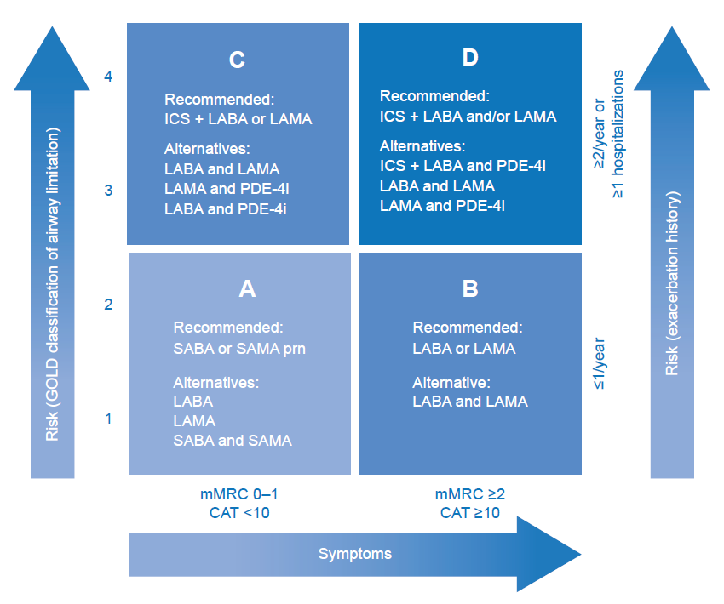
Inhaled Corticosteroids in Patients with COPD
Market research:
ICS used by > 70% patients with COPD
Given as initial therapy to > 50% newly diagnosed patients
Clinical trials:
~35% of patients classified as GOLD A or B were receiving ICS at baseline
Kaplan AG. Int J COPD. 2015;10:2535-2548.

Slide 88
Which Statement Best Describes Your Comfort Level Stepping Down--Removing ICS--From Roger’s Treatment?
Completely comfortable
Willing to try, but somewhat uncomfortable (concerned about exacerbation risk)
No way—too risky based on his history

Slide 89
Inhaled Steroids in COPD
Pros
Cons
Exacerbation reduction when added to LABD in placebo-controlled trials
Improvement in FEV₁ in combination with beta-agonists
Clinical trial evidence
No reduction in COPD progression
No mortality reduction
Side effect profile
Risk of pneumonia
Risk of osteoporosis, adrenal suppression
Oral Thrush
Burge PS, et al. BMJ. 2000;320(7245):1297-1303.
Calverley PM, et al. NEJM. 2007;356:775-789.
Festic E, et al. AJRCCM. 2015;191:141-148.
Kaplan AG. Int J COPD. 2015;10:2535-2548. Suissa S, et al. Eur Resp J. 2015;46:1232-1235.

Slide 90
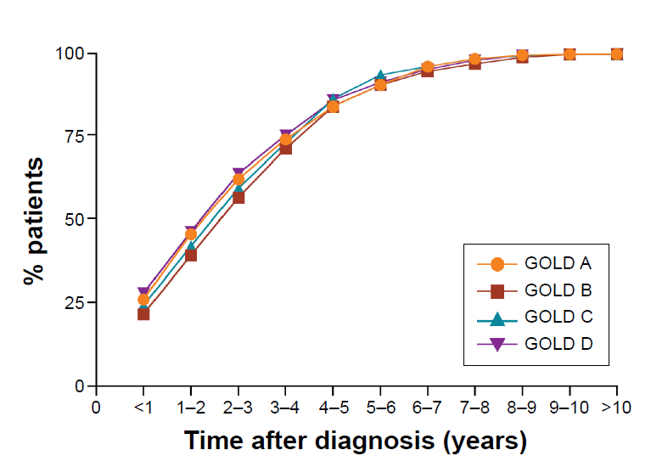
Drift to Triple Therapy in COPD
Cumulative Proportion of Patients Receiving Triple Therapy by GOLD Group (2002-2010)
Brusselle G, et al. Int J COPD. 2015;10:2207‒2217.

Slide 91
OPTIMO: Withdrawal of ICS in COPD Patients at Low Risk of Exacerbation
Multicenter, real-life study
914 COPD patients recruited
On maintenance therapy with bronchodilators and ICS
FEV₁ > 50% predicted
< 2 exacerbations/year
Outcomes (baseline and 6 months)
FEV₁
CAT score (symptoms)
Exacerbations
Rossi A, et al. Respir Res. 2014;15:77.

Slide 92
Corticosteroid Withdrawal in Low Exacerbation Risk COPD Patients (OPTIMO)
P = 0.3468
Patients free of exacerbations after 6 months (%)
N = 816
Rossi A, et al. Respir Res. 2014;15:77.

Slide 93
WISDOM: Withdrawal of ICS in Patients on Maintenance Therapy with Dual Bronchodilation
12-month, double-blind, parallel group study
6 week run-in (tiotropium; salmeterol; fluticasone)
Double-blind phase (1:1 randomization)
Tiotropium; salmeterol; fluticasone
Tiotropium; salmeterol (fluticasone step-down to 0)
2485 patients randomized
Severe or very severe COPD
At least one exacerbation in 12 months before screening
Outcomes
Time to first moderate or severe COPD exacerbation
Change from baseline in lung function
Health status
Dyspnea
Magnussen H, et al. NEJM. 2014;371:1285-1294.

Slide 94
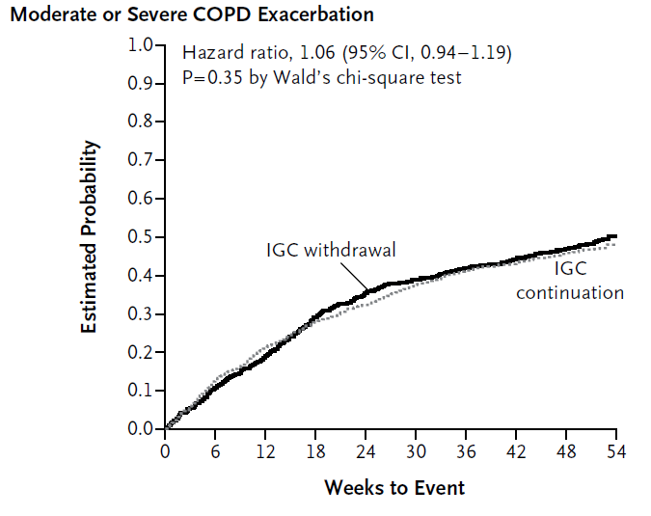
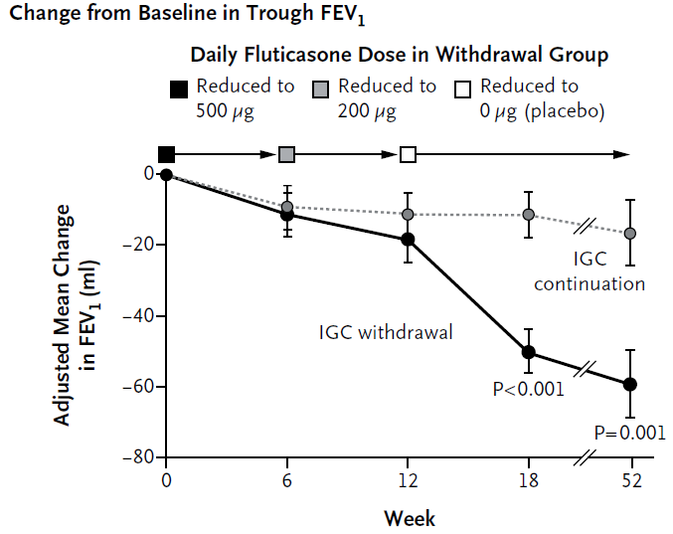
Corticosteroid Withdrawal on Triple Therapy and Risk of COPD Exacerbation (WISDOM)
IGC: inhaled glucocorticoids
Magnussen H, et al. NEJM. 2014;371:1285-1294.

Slide 95
The Role of Inhaled Steroids in COPD Pharmacotherapy
There is no advantage in adding ICS to bronchodilator therapy in patients at low risk of exacerbations
Early observational studies suggested that simply stopping therapy increased the risk of exacerbations. However more recent data suggest that this may not be true if the patient is receiving long-acting inhaled bronchodilators

Slide 96
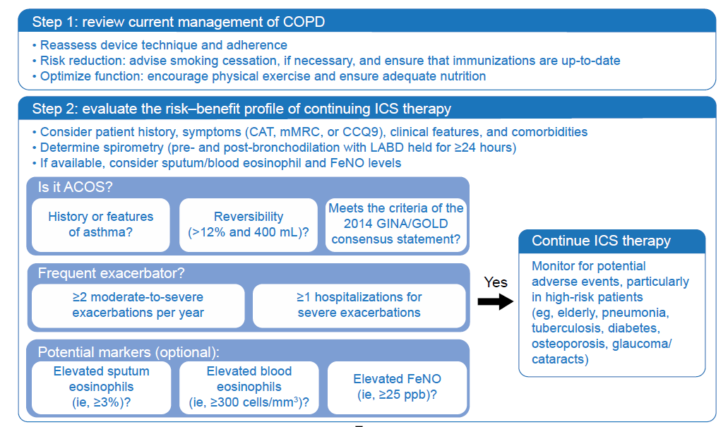
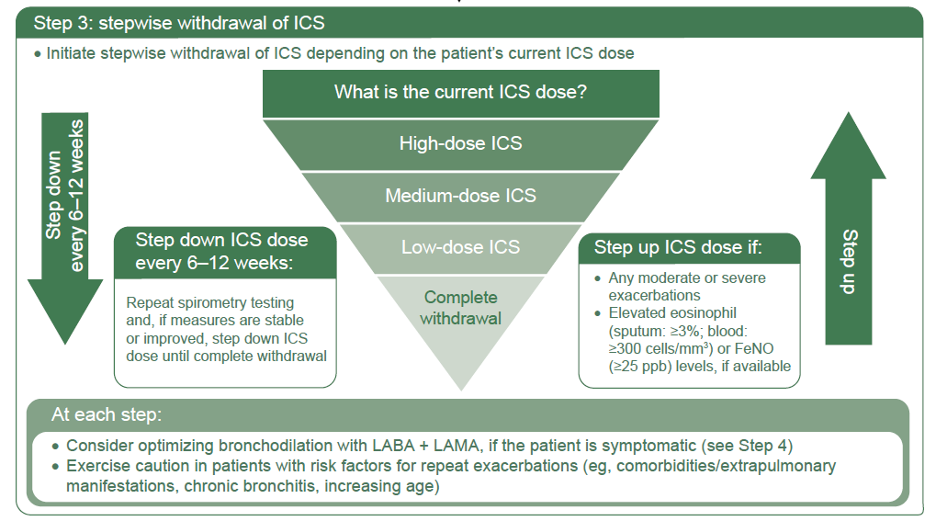
Stepping Down ICS: A Proposed Algorithm
Kaplan AG. Int J COPD. 2015;10:2535-2548.

Slide 97
Roger–Follow-up
After discussing the risks and benefits of stepping down, Roger switched to FDC tiotropium-olodateral (once daily, Respimat soft mist inhaler)
After 3 months follow-up he was stable, with no difference in symptoms
After an additional 6 months, no exacerbations or related problems
Going forward, will need to monitor closely for signs of an exacerbation

Slide 98
If Roger Worsens With an Increase in Symptoms or Severe Exacerbation on LAMA+LABA, What Would You Do?
Continue with FDC LAMA + LABA
Add ICS (off-label) to FDC LAMA + LABA
Return to LAMA and LABA + ICS administered separately and find a delivery system that the patient can use reliably
Enroll in a clinical trial of triple therapy (LAMA + LABA + ICS)

Slide 99
Roger–Key Points
Constant evaluation of COPD patients and changes in patient status over time is essential to good patient care
Choice of inhaled delivery system is very important in the effective use of COPD medications, with different patients having different inhaler needs
Triple therapy may be over used in COPD patients today
Step down therapy, by stopping ICS use in patients on triple therapy, may be considered under the right set of conditions in selected patients
Patients undergoing treatment step down require close monitoring to insure no adverse effects over time, especially COPD exacerbations, are associated with the change in therapy.

Slide 100
Summary
An increasing number of fixed-dose LAMA/LABA combinations are available for the management of patients with moderate to severe COPD
The safety and efficacy of these agents have been demonstrated in placebo-controlled and active-comparator studies
Head-to-head studies are needed to evaluate any differences among the fixed-dose LAMA/LABA combinations
Considerations in the use of fixed-dose LAMA/LABA combinations include dosing frequency, inhalation device, comorbidities and associated treatment(s), and patient preference
For patients with low risk of exacerbations, use of long-acting bronchodilators (including fixed dose LAMA/LABA combinations) may allow step-down from use of inhaled corticosteroids

Slide 101
More on LAMA/LABA Combinations at ATS
D36 COPD: LABA, LAMA, ICS, and Combinations
Thematic Poster Session, 68 presentations
May 18^{th,} 9:00am-3:30pm; author presentations 11:00am-12:45pm

